Slide 1

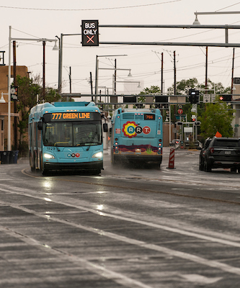
MONTHLY INFORMATIONAL REPORT
FEBRUARY 2023
FEBRUARY RIDERSHIP
DECEMBER
JANUARY
FEBRUARY
PAGE 1

Slide 2
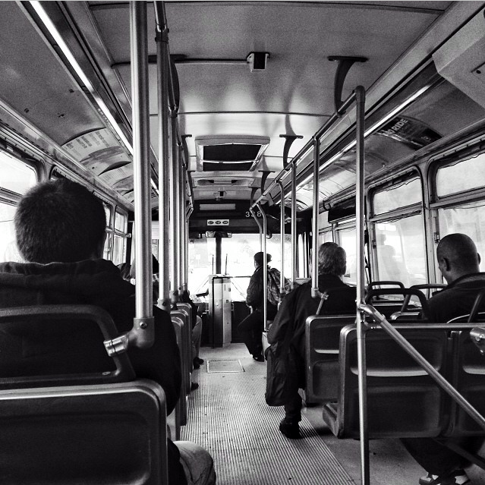
RIDERSHIP
Fixed Route Ridership
Month | FY19 | FY20 | FY21 | FY22 | FY23
JUL | 781,280 | 755,491 | 370,222 | 393,282 | 525,529
AUG | 880,079 | 805,880 | 333,389 | 395,706 | 589,100
SEP | 795,408 | 770,017 | 349,035 | 389,426 | 508,877
OCT | 837,665 | 815,378 | 378,371 | 438,310 | 563,424
NOV | 758,173 | 694,714 | 295,324 | 418,177 | 540,232
DEC | 670,554 | 746,344 | 276,468 | 387,785 | 579,365
JAN | 716,045 | 729,005 | 275,283 | 422,724 | 547,662
FEB | 698,976 | 764,293 | 275,242 | 401,963 | 523,320
MAR | 757,396 | 630,292 | 356,489 | 469,247
APR | 779,357 | 315,901 | 356,158 | 458,194
MAY | 755,731 | 306,544 | 345,151 | 462,601
JUN | 729,045 | 336,563 | 365,471 | 477,309
Total | 9,159,709 | 7,670,422 | 3,976,603 | 5,114,724 | 4,377,509
4.4% decrease from January, 2023
30.2% increase from February, 2022
MONTHLY INFORMATIONAL REPORT | FEBRURY 2023
PAGE 2

Slide 3
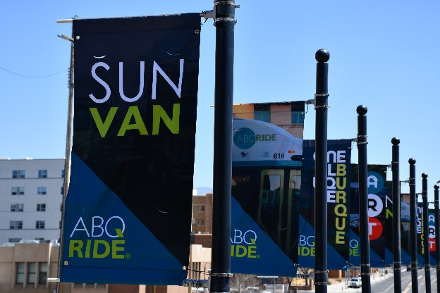
PARATRANSIT/SUN VAN
3.39% increase from January 2023
29.34% increase from February 2022
Paratransit (Sun Van) Ridership
Month | FY19 | FY20 | FY21 | FY22 | FY23
Jul | 20,659 | 20,732 | 6,786 | 10,901 | 13,623
Aug | 23,534 | 22,168 | 7,031 | 12,623 | 16,343
Sep | 21,363 | 21,228 | 7,127 | 13,165 | 15,423
Oct | 24,424 | 23,554 | 7,479 | 14,007 | 15,611
Nov | 21,388 | 19,867 | 5,800 | 12,727 | 13,002
Dec | 19,004 | 19,496 | 6,094 | 12,097 | 14,208
Jan | 22,085 | 21,475 | 6,331 | 12,064 | 14,855
Feb | 20,686 | 20,618 | 6,179 | 11,874 | 15,359
Mar | 21,993 | 12,795 | 8,165 | 14,412
Apr | 22,936 | 3,809 | 9,589 | 14,395
May | 20,937 | 4,296 | 9,519 | 14,267
Jun | 19,741 | 6,348 | 10,215 | 13,756
Total | 258,750 | 196,386 | 90,315 | 156,288 | 120,371
Sun Van Applications
Month | FY19 | FY20 | FY21 | FY22 | FY23
Jul | 78 | 76 | 18 | 37 | 59
Aug | 91 | 91 | 22 | 86 | 50
Sep | 67 | 82 | 26 | 67 | 105
Oct | 90 | 88 | 32 | 58 | 95
Nov | 63 | 72 | 25 | 39 | 104
Dec | 66 | 84 | 19 | 44 | 32
Jan | 70 | 64 | 20 | 37 | 52
Feb | 91 | 75 | 29 | 50 | 40
Mar | 83 | 42 | 34 | 44
Apr | 94 | 7 | 47 | 37
May | 112 | 20 | 37 | 93
Jun | 89 | 30 | 67 | 64
Total | 994 | 731 | 376 | 656 | 577
MONTHLY INFORMATIONAL REPORT | FEBRUARY 2023
PAGE 3

Slide 4
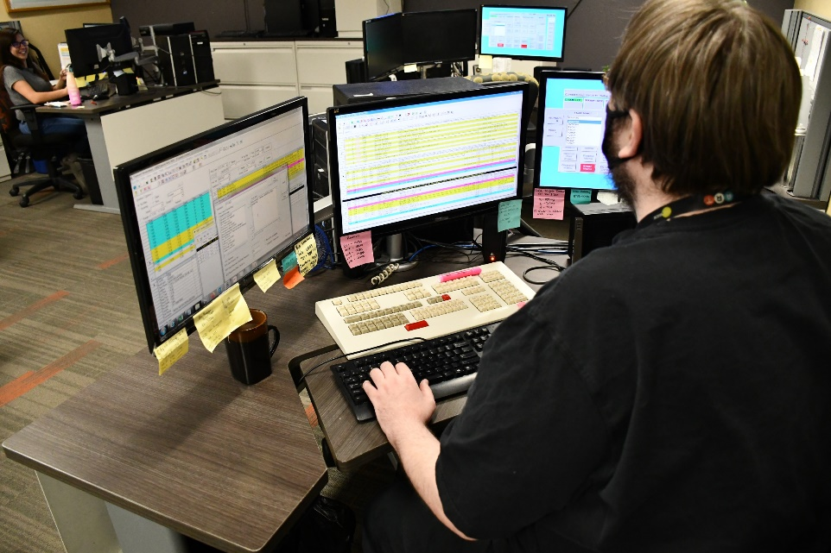
CUSTOMER SERVICE
DECEMBER
JANUARY
FEBRUARY
Month | Plan Your Ride |  |  | Sun Van Reservations |  |  | Total Calls
 | Calls Presented | Calls Handled | % | Calls Presented | Calls Handled | % | Calls Presented | Calls Handled | %
JUL | 2,043 | 1,477 | 72.3 | 13,712 | 12,340 | 89.99 | 15,755 | 13,817 | 87.7
AUG | 2,112 | 1,229 | 58.19 | 16,288 | 13,864 | 85.12 | 18,400 | 15,093 | 82.02
SEP | 2,268 | 911 | 40.17 | 16,795 | 12,609 | 75.08 | 19,063 | 13,520 | 70.92
OCT | 1,856 | 1,029 | 55.44 | 15,653 | 13,160 | 84.07 | 17,509 | 14,189 | 81.03
NOV | 1,449 | 946 | 65.29 | 13,108 | 11,701 | 89.27 | 14,557 | 12,647 | 86.88
DEC | 1,627 | 1,231 | 75.66 | 13,985 | 12,752 | 91.18 | 15,612 | 13,983 | 89.56
JAN | 1,783 | 1,423 | 79.81 | 16,680 | 15,603 | 93.54 | 18,463 | 17,026 | 92.21
FEB | 1,875 | 1,381 | 73.65 | 15,870 | 14,349 | 90.42 | 17,745 | 15,730 | 88.64
MONTHLY INFORMATIONAL REPORT | FEBRUARY 2023
PAGE 4

Slide 5
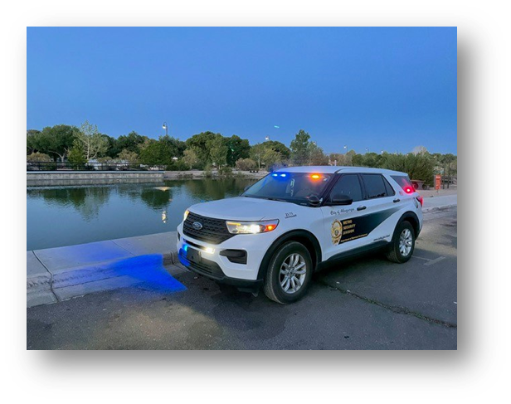
SECURITY
Month | Total Security Calls | Security Check
Jul | 260 | 466
Aug | 245 | 432
Sep | 247 | 444
Oct | 271 | 483
Nov | 294 | 544
Dec | 354 | 597
Jan | 473 | 703
Feb | 398 | 621
*Security Checks include officers conducting proactive/routine checks of Transit facilities (bus stops, transit centers) to ensure these areas remain safe.
MONTHLY INFORMATIONAL REPORT | FEBRUARY 2023
PAGE 5

Slide 6
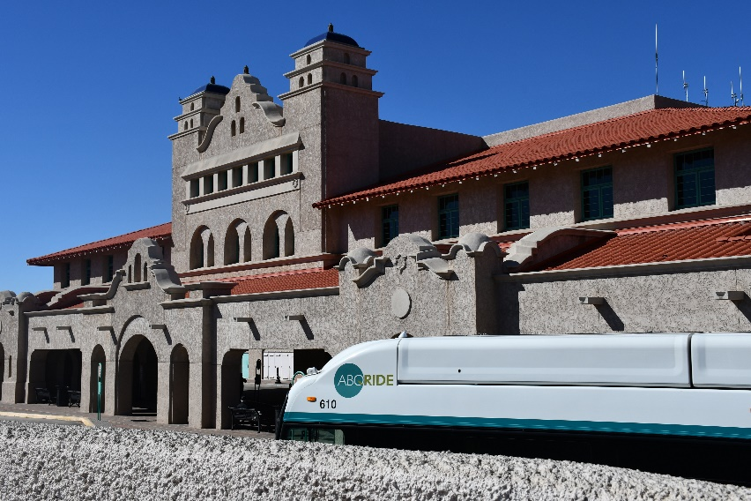
SECURITY CALLS BY LOCATION
February
January
December
MONTHLY INFORMATIONAL REPORT | FEBRUARY 2023
PAGE 6

Slide 7
SECURITY CALLS BY LOCATION
Figure S1
FY23 | ATC | CUTC | MTC | NWTC | UTC | Yale | Daytona | Tramway/Wenonah
JUL | 235 | 76 | 15 | 16 | 76 | 35 | 32 | 49
AUG | 332 | 72 | 1 | 4 | 83 | 17 | 14 | 20
SEP | 274 | 57 | 2 | 8 | 82 | 9 | 10 | 31
OCT | 273 | 78 | 2 | 4 | 81 | 21 | 14 | 35
NOV | 420 | 81 | 1 | 4 | 81 | 6 | 11 | 28
DEC | 441 | 121 | 0 | 7 | 96 | 6 | 16 | 43
JAN | 46 | 35 | 0 | 4 | 14 | 2 | 1 | 8
FEB | 136 | 33 | 0 | 2 | 29 | 2 | 0 | 22
Figure S2
FY23 | Route 1 | Route 2 | Route 5 | Route 8 | Route 10 | Route 11 | Route 16 | Route 31 | Route 50 | Route 53/54 | Route 66 | Route 140/141 | Route 155 | Route 157 | Route 766/777
JUL | 0 | 0 | 7 | 5 | 6 | 4 | 2 | 2 | 0 | 1 | 31 | 4 | 0 | 2 | 52
AUG | 0 | 1 | 1 | 2 | 6 | 3 | 0 | 1 | 1 | 2 | 57 | 3 | 3 | 2 | 46
SEP | 0 | 0 | 4 | 8 | 6 | 5 | 5 | 1 | 0 | 2 | 80 | 4 | 4 | 1 | 77
OCT | 2 | 0 | 8 | 0 | 0 | 4 | 4 | 1 | 0 | 1 | 90 | 5 | 5 | 2 | 96
NOV | 0 | 0 | 3 | 7 | 3 | 5 | 1 | 4 | 0 | 0 | 80 | 5 | 3 | 3 | 100
DEC | 0 | 1 | 7 | 4 | 1 | 1 | 0 | 1 | 2 | 0 | 52 | 10 | 10 | 2 | 117
JAN | 1 | 1 | 2 | 0 | 4 | 3 | 1 | 0 | 0 | 1 | 108 | 6 | 11 | 0 | 86
FEB | 0 | 1 | 0 | 0 | 2 | 5 | 1 | 1 | 1 | 2 | 62 | 7 | 7 | 0 | 66
MONTHLY INFORMATIONAL REPORT | FEBRUARY 2023
PAGE 7

Slide 8
SECURITY CALLS BY TYPE
FY23 | Assault | Fight | Fire | Mental Health | Traffic | Trespass | Vandal | Suspicious Situation
JUL | 0 | 8 | 1 | 1 | 2 | 3 | 3 | 8
AUG | 1 | 7 | 0 | 0 | 0 | 2 | 5 | 31
SEP | 3 | 5 | 1 | 0 | 0 | 7 | 3 | 19
OCT | 0 | 9 | 3 | 1 | 3 | 1 | 2 | 10
NOV | 3 | 4 | 4 | 1 | 5 | 2 | 1 | 5
DEC | 3 | 3 | 3 | 0 | 1 | 1 | 3 | 11
JAN | 1 | 12 | 4 | 0 | 0 | 2 | 1 | 10
FEB | 1 | 9 | 7 | 0 | 2 | 9 | 1 | 4
MAR
APR
MAY
JUN
FY23 | Intoxicated | Other | Narcotics | Disorderly Conduct | Loitering | Wellness/ Medical
JUL | 10 | 57 | 16 | 40 | 41 | 70
AUG | 16 | 29 | 33 | 27 | 49 | 45
SEP | 12 | 13 | 22 | 29 | 68 | 65
OCT | 16 | 7 | 30 | 46 | 93 | 50
NOV | 16 | 12 | 31 | 40 | 119 | 51
DEC | 13 | 16 | 53 | 49 | 116 | 64
JAN | 14 | 16 | 61 | 61 | 179 | 63
FEB | 23 | 21 | 41 | 45 | 134 | 64
MAR
APR
MAY
JUN
MONTHLY INFORMATIONAL REPORT | FEBRUARY 2023
PAGE 8

Slide 9
Monthly Updates & Accomplishments
Closed 49 service requests from 311 related to bus stops
Installed “No Trespassing” signs at all ART stations
Submitted RAISE Grant application for Uptown TOD
Launched phase 2 of public engagement for the ABQ RIDE Forward Network Plan
Engaged with approximately 612 individuals at marketing/tabling events
Thanked ABQ RIDE passengers by passing out free pizza coupons for Papa Murphy’s on Rider Appreciation Day
Trained Dispatchers on new radio system
Addressed safety concerns at route 11 bus stop near UNMH.
Hired 7 new Motorcoach Operators and 3 new Sun Van Chauffeurs
Completed detailed cleaning of 61 buses and 29 Sun Vans
Mechanics completed 592 work orders.
MONTHLY INFORMATIONAL REPORT | FEBRUARY 2023
PAGE 9

