Slide 1
January – June 2018 crime statistics for Albuquerque Police Department

Slide 2
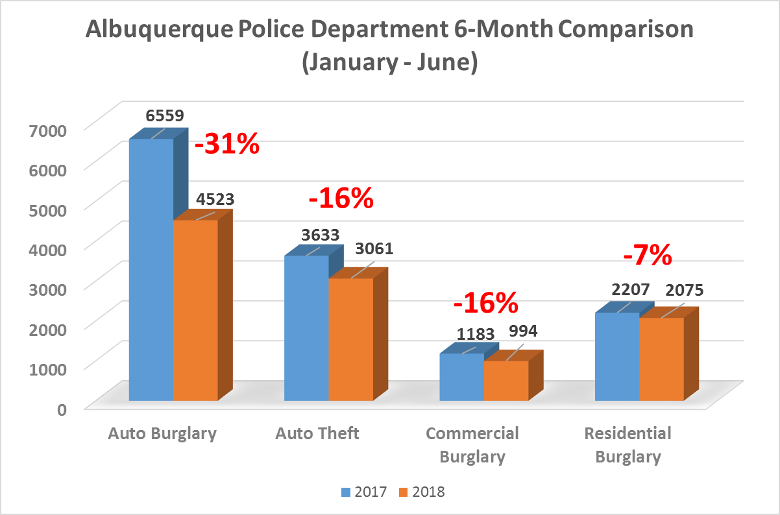
PROPERTY
CRIMES
Data was prepared by Crime Analysis Unit of the Real Time Crime Center, Albuquerque Police Department. Data developed July 12th, 2018.
Disclaimer: Numbers are subject to change. Data represents January – June 2017 as compared to January – June 2018. Data Source: Albuquerque Police Department Police Report Records System. These numbers do not represent Uniformed Crime Reporting numbers.

Slide 3
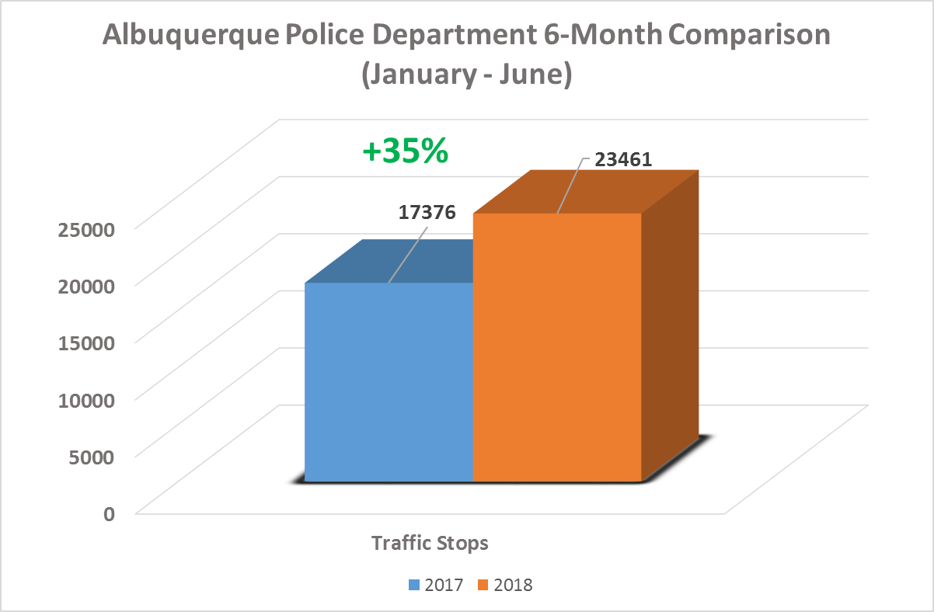
Proactive Policing Measure
TRAFFIC
STOPS
Data was prepared by Crime Analysis Unit of the Real Time Crime Center, Albuquerque Police Department. Data developed July 12th, 2018.
Disclaimer: Numbers are subject to change. Data represents January – June 2017 as compared to January – June 2018. Data Source: Albuquerque Police Department Computer Aided Dispatch System. These numbers do not represent Uniformed Crime Reporting numbers.

Slide 4
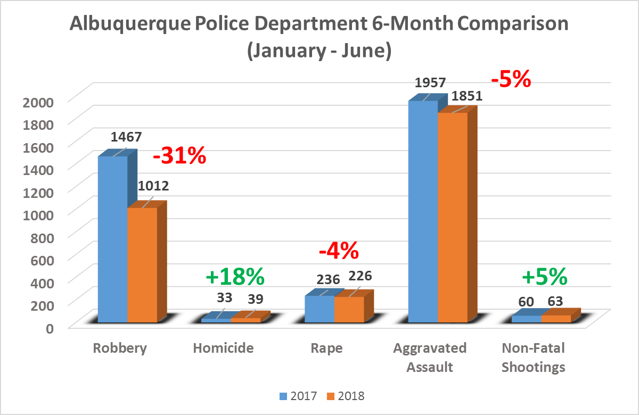
VIOLENT
CRIMES
Data was prepared by Crime Analysis Unit of the Real Time Crime Center, Albuquerque Police Department. Data developed July 12th, 2018.
Disclaimer: Numbers are subject to change. Data represents January – June 2017 as compared to January – June 2018. Data Source: Albuquerque Police Department Police Report Records System and Major Cities Chiefs Association Violent Crime Survey (Data Collected on: July 12, 2018). These numbers do not represent Uniformed Crime Reporting numbers.

Slide 5
Albuquerque Police Department 2018
6-Month (January – June) Auto Theft Related Measures:
Recovered Stolen Vehicles: 2008
Auto Theft Related Arrests: 394
Auto Theft Unit 2018
6-Month (January –June) Auto Theft Related Measures:
Recovered Stolen Vehicles: 207
Auto Theft-Related Arrests: 206 Bait Car Arrests: 24
Value: $2.6 million
AUTO THEFT
Data was prepared by Crime Analysis Unit of the Real Time Crime Center, Albuquerque Police Department. Data developed July 17th, 2018.
Disclaimer: Numbers are subject to change. Data represents January – June 2018. Data Source: Albuquerque Police Department Police Report Records System. These numbers do not represent Uniformed Crime Reporting numbers.

Slide 6
First quarter 2018 crime statistics for Albuquerque Police Department

Slide 7
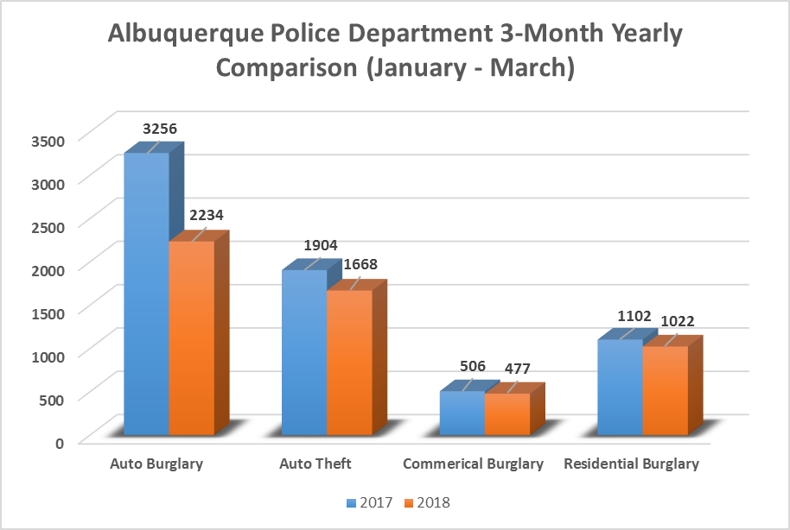
PROPERTY
CRIMES
-31%
-12%
-7%
-6%
Data was prepared by Crime Analysis Unit of the Real Time Crime Center, Albuquerque Police Department. Data developed April 8th, 2018.
Disclaimer: Numbers are subject to change. Data represents January – March 2017 as compared to January – March 2018. Data Source: Albuquerque Police Department Police Report Records System. These numbers do not represent Uniformed Crime Reporting numbers.

Slide 8
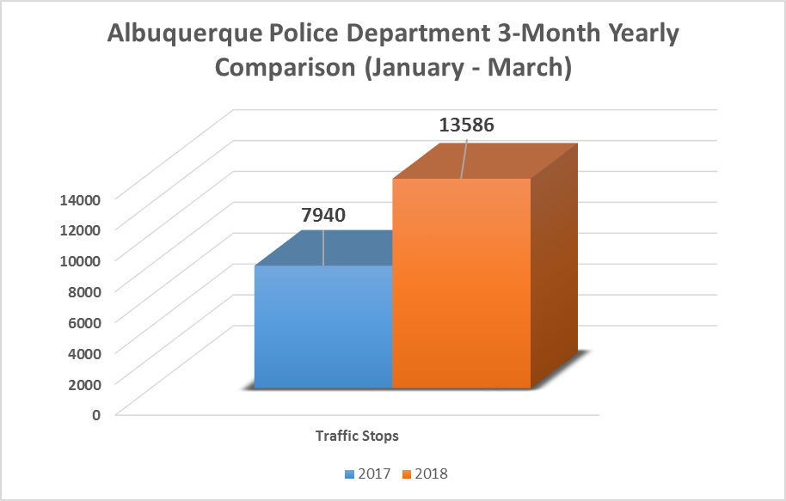
Proactive Policing Measure
TRAFFIC
STOPS
+71%
Data was prepared by Crime Analysis Unit of the Real Time Crime Center, Albuquerque Police Department. Data developed April 8th, 2018.
Disclaimer: Numbers are subject to change. Data represents January – March 2017 as compared to January – March 2018. Data Source: Albuquerque Police Department Computer Aided Dispatch System. These numbers do not represent Uniformed Crime Reporting numbers.

Slide 9
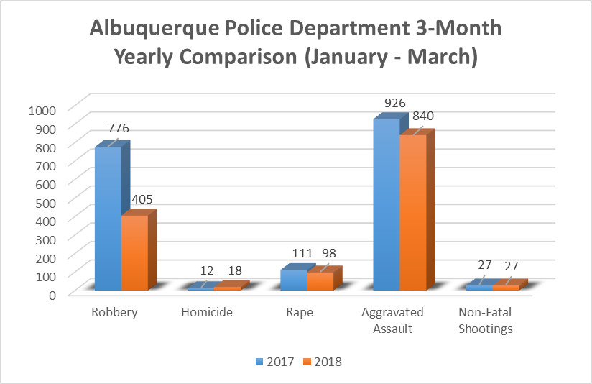
VIOLENT
CRIMES
-9%
-48%
-12%
+50%
0%
Data was prepared by Crime Analysis Unit of the Real Time Crime Center, Albuquerque Police Department. Data developed April 8th, 2018.
Disclaimer: Numbers are subject to change. Data represents January – March 2017 as compared to January – March 2018. Data Source: Albuquerque Police Department Police Report Records System and Major Cities Chiefs Association Violent Crime Survey (Data Collected on: April 12, 2018). These numbers do not represent Uniformed Crime Reporting numbers.

