Slide 1


First quarter 2018 crime statistics for Albuquerque Police Department

Slide 2
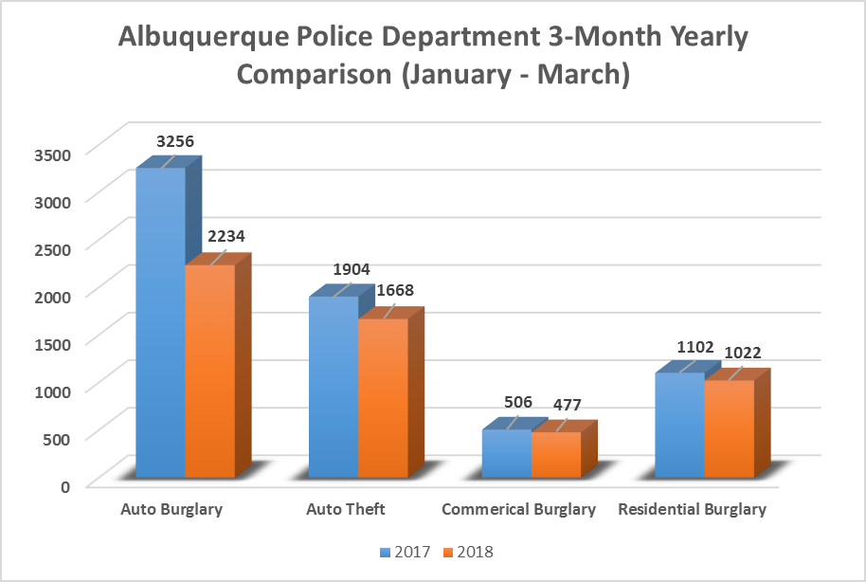
PROPERTY
CRIMES
-31%
-12%
-7%
-6%
Data was prepared by Crime Analysis Unit of the Real Time Crime Center, Albuquerque Police Department. Data developed April 8th, 2018.
Disclaimer: Numbers are subject to change. Data represents January – March 2017 as compared to January – March 2018. Data Source: Albuquerque Police Department Police Report Records System. These numbers do not represent Uniformed Crime Reporting numbers.

Slide 3

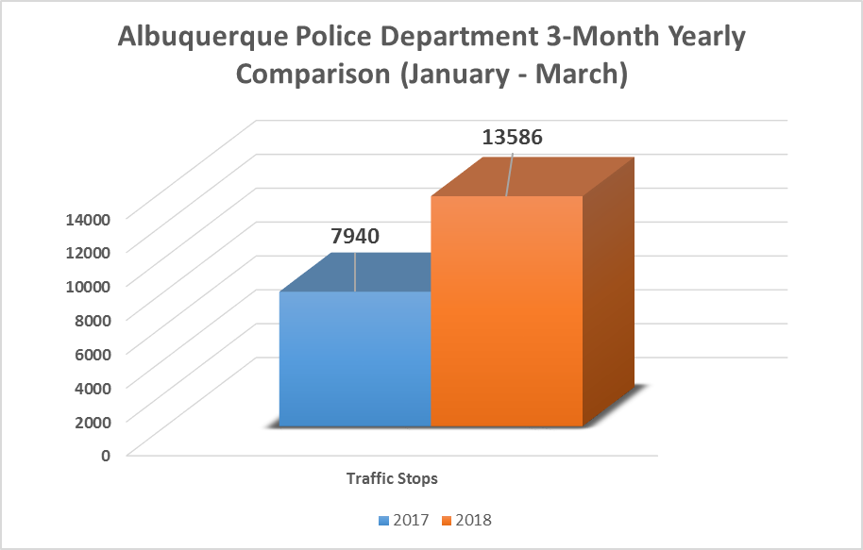
Proactive Policing Measure
TRAFFIC
STOPS
+71%
Data was prepared by Crime Analysis Unit of the Real Time Crime Center, Albuquerque Police Department. Data developed April 8th, 2018.
Disclaimer: Numbers are subject to change. Data represents January – March 2017 as compared to January – March 2018. Data Source: Albuquerque Police Department Computer Aided Dispatch System. These numbers do not represent Uniformed Crime Reporting numbers.

Slide 4
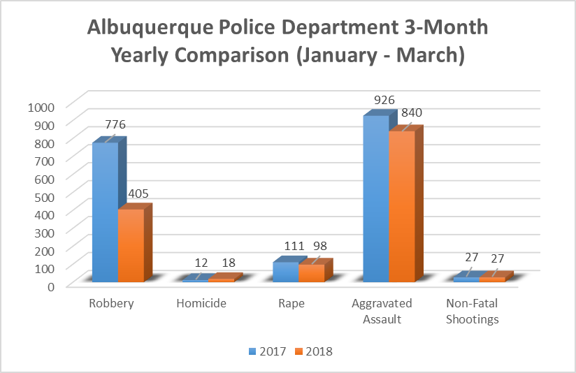
VIOLENT
CRIMES
-9%
-48%
-12%
+50%
0%
Data was prepared by Crime Analysis Unit of the Real Time Crime Center, Albuquerque Police Department. Data developed April 8th, 2018.
Disclaimer: Numbers are subject to change. Data represents January – March 2017 as compared to January – March 2018. Data Source: Albuquerque Police Department Police Report Records System and Major Cities Chiefs Association Violent Crime Survey (Data Collected on: April 12, 2018). These numbers do not represent Uniformed Crime Reporting numbers.

