Slide 1
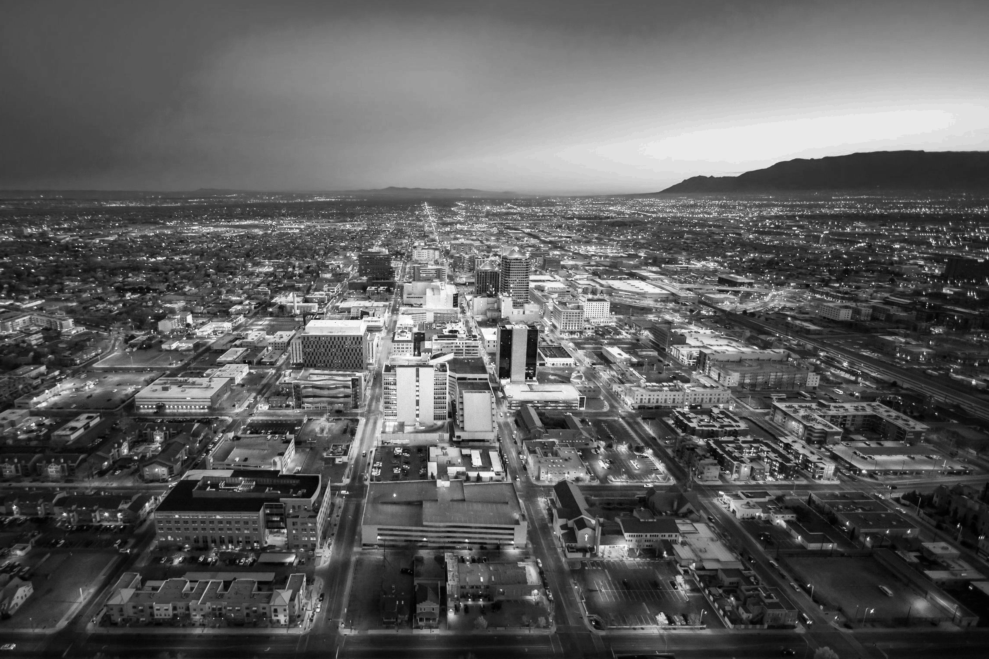


Albuquerque Community Safety
The Right Response at the Right Time
Mariela Ruiz-Angel, MSW, MBA
Director | ACS
mra@cabq.gov
505-768-3036

Slide 2
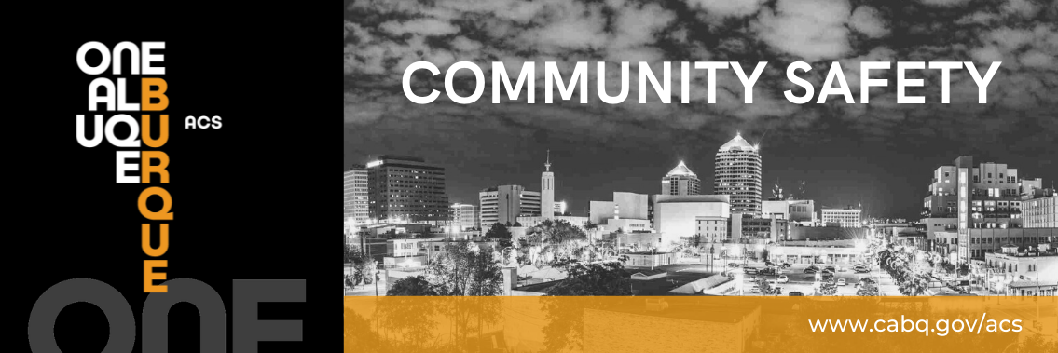

The Albuquerque Community Safety department (ACS) is the third branch of the City’s public safety system.
ACS sends trained professionals to non-violent and non-medical 911 calls for service involving issues such as mental/behavioral health, homelessness, and addiction as well as non-behavioral issues such as abandoned vehicles and needle pick ups.

Slide 3
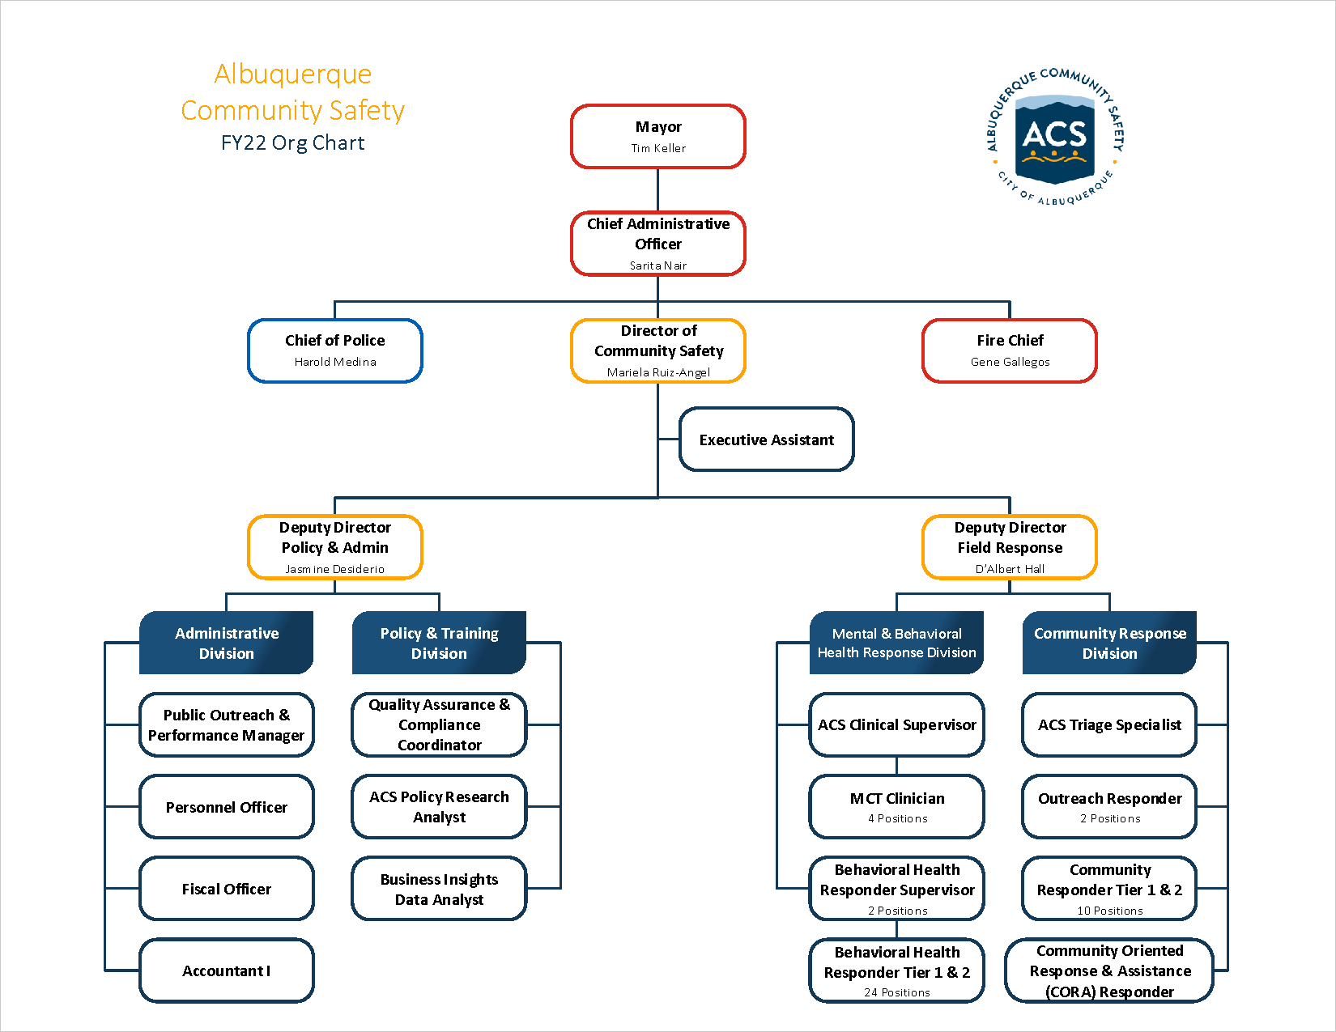


Slide 4

ACS Field Responders
286
Online Intake Form
Community responders
Street Outreach and Resource Coordinator
Respond to minor injuries or incapacitation, abandoned vehicles, non-injury accidents, or other calls for service in the community.
Provide street outreach in coordination with City departments and organizations to individuals experiencing homelessness in encampments; conduct in-person assessments; assist with screening, organizing and prioritizing reports regarding homeless encampments.
Behavioral Health Responders
Respond in person in pairs or by phone to requests for assistance with individuals experiencing issues with mental and behavioral health, inebriation, homelessness, addiction, chronic mental illness as well as other issues that do not require Police, Fire or EMT response.
Mobile Crisis Team (MCT)
Licensed Clinicians
Provide professional behavioral health services in a co-response model with Albuquerque Police officers, Sheriff’s deputies, and other first responders.

Slide 5
Training Plan

Slide 6
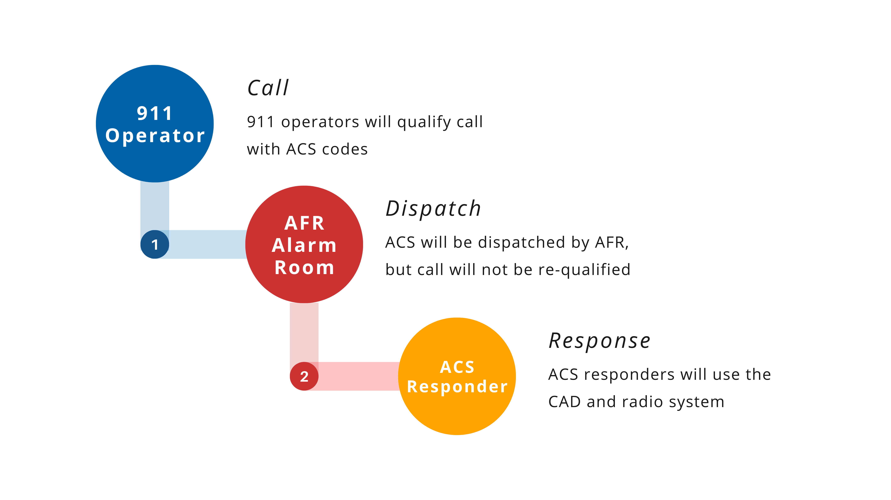
Dispatch Process

Slide 7
Starting with lower acuity calls
About 3,000 to 3,500 calls a month
Calls will be received via 911 dispatch, 311 ticket, self-dispatch, direct calls, and starting in 2022 via 988.
228

Slide 8
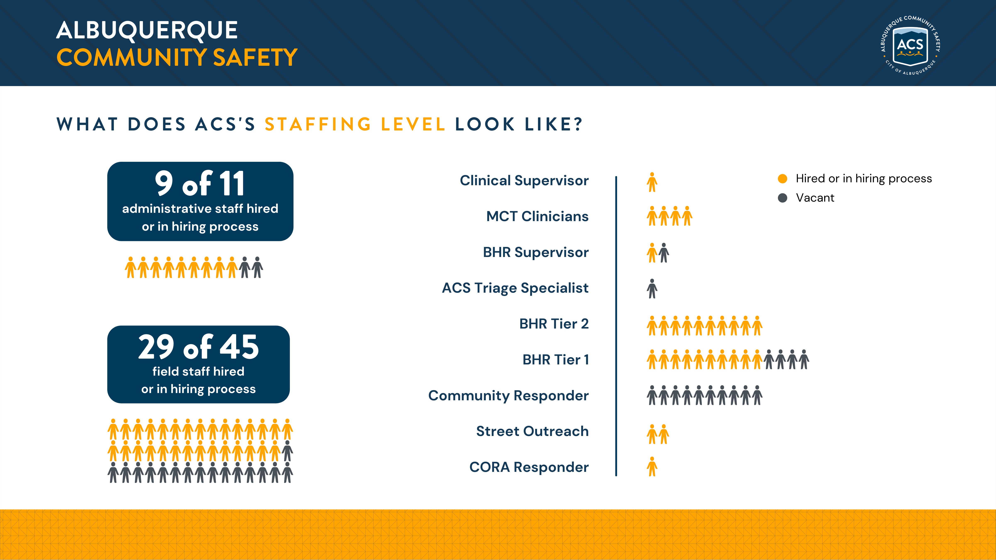

Slide 9
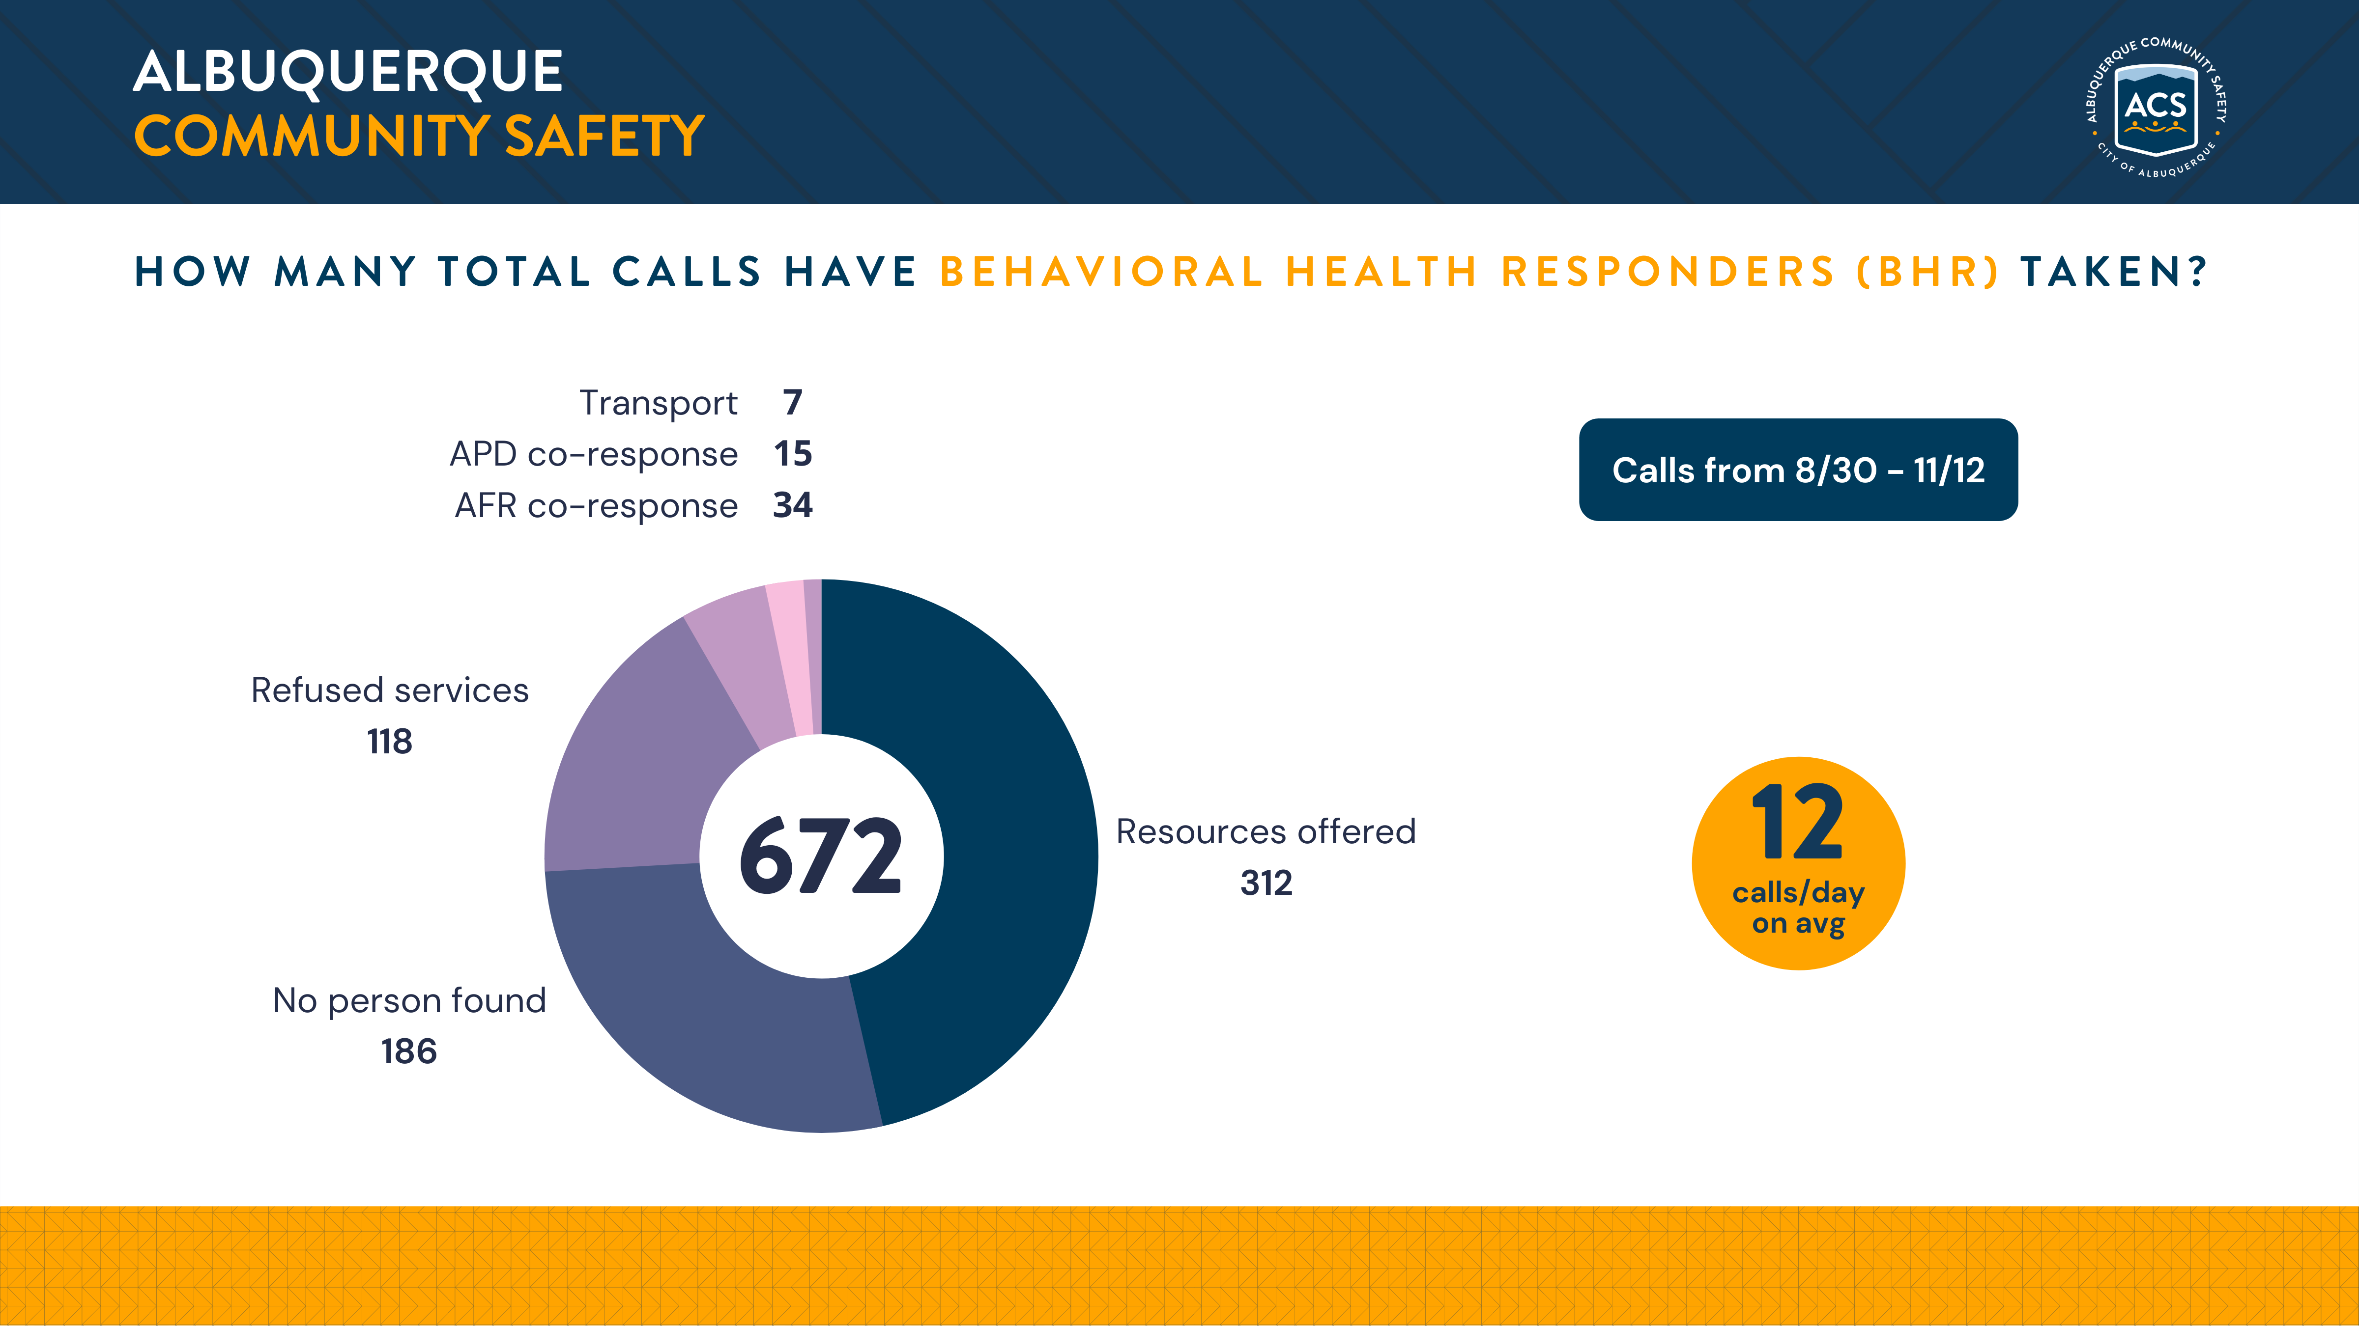

Slide 10
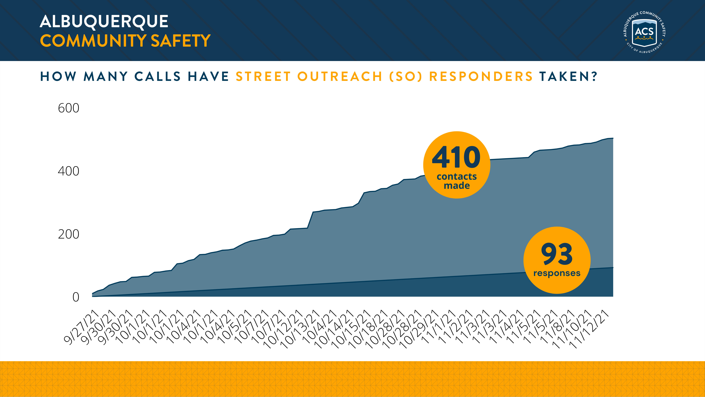

Slide 11
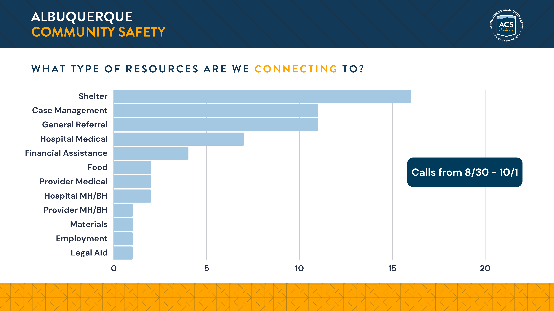

Slide 12
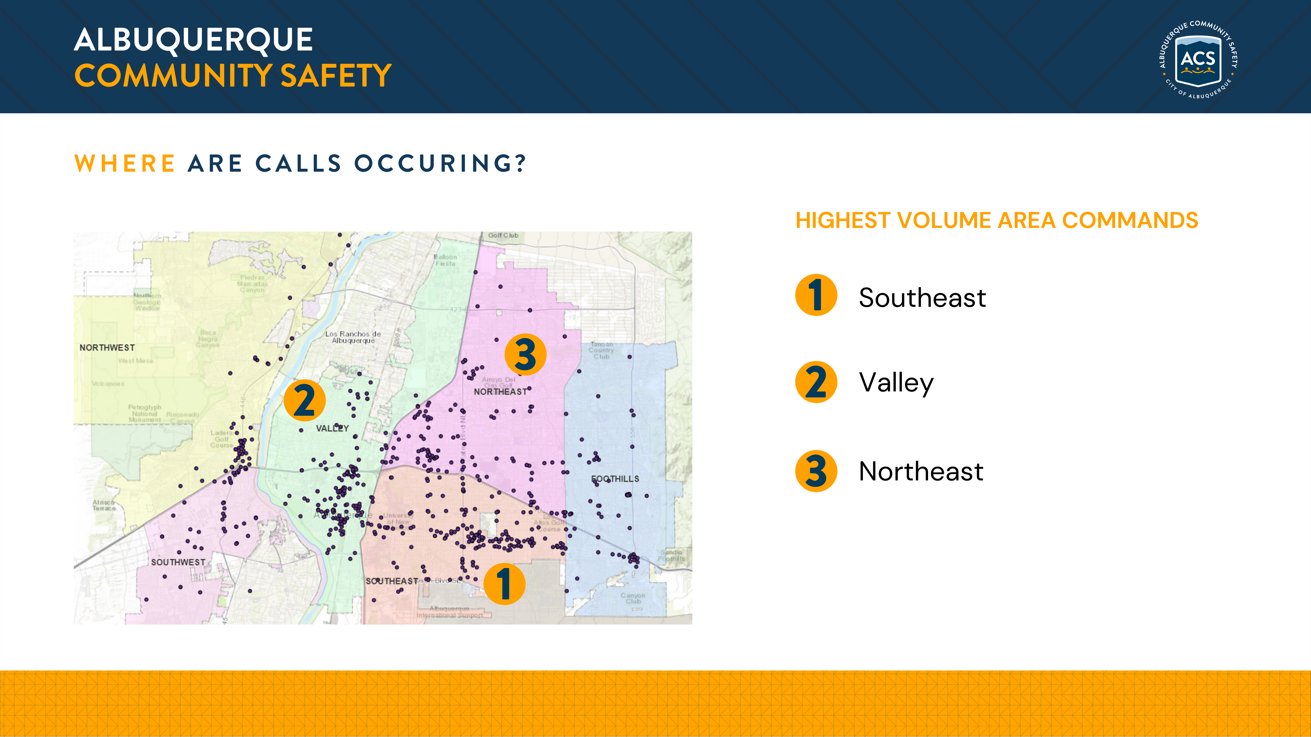

Slide 13
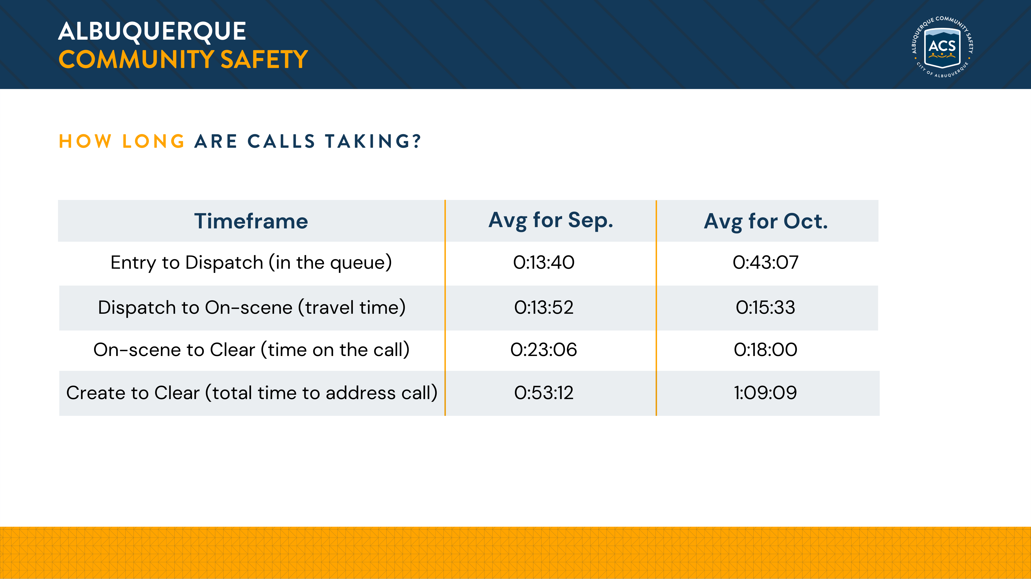

Slide 14
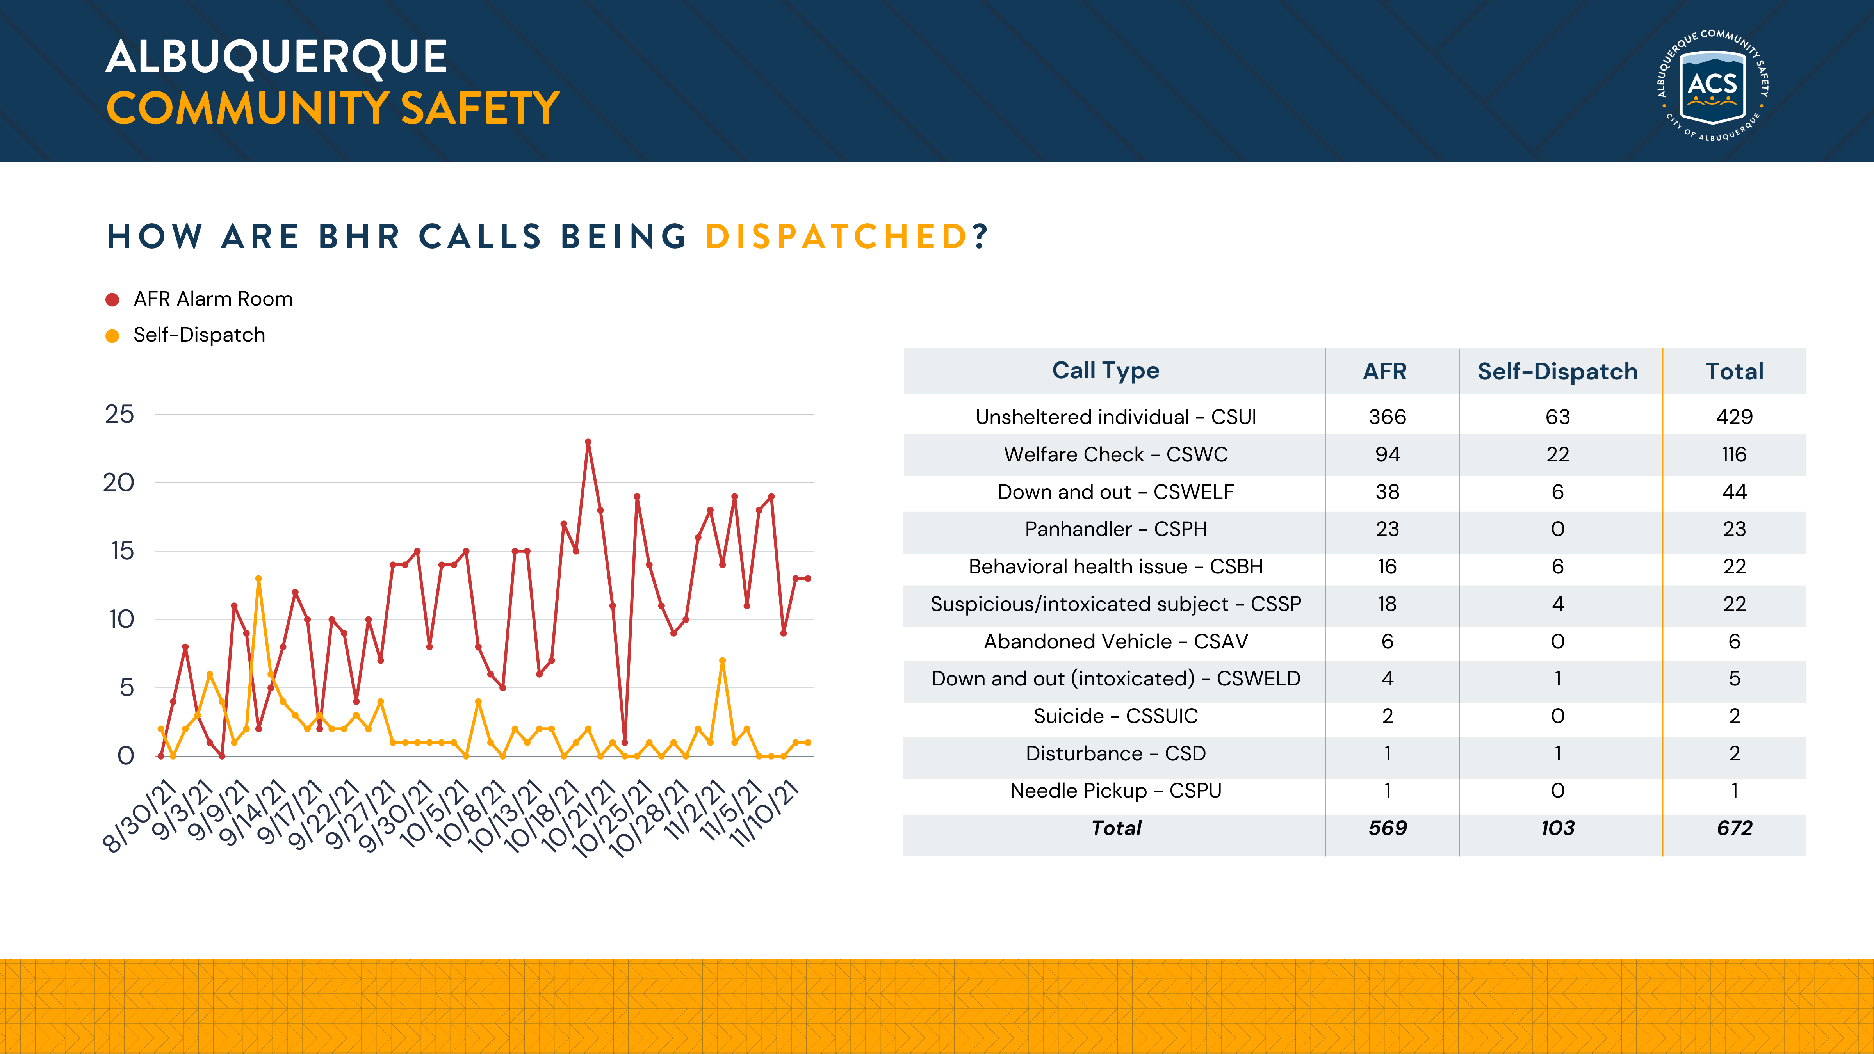

Slide 15
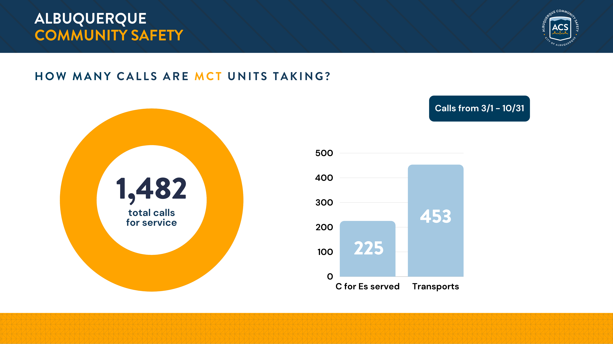

Slide 16
Thank you.

