Slide 1

State Capital Outlay
Capital Improvements Program

Slide 2
Contacts and Introduction
Shawn Maden
  CIP Strategic Program Mgr – smaden@cabq.gov - 505-768-3616
Mark Motsko
  CIP Official – mmotsko@cabq.gov – 505-768-3832
Jeanne Young
  CIP Program Coordinator – jyoung@cabq.gov – 505-768-3873

Slide 3
What is this presentation for?
Explain the Capital Outlay/State Grant process
Background information
City’s Fiscal Agent process
State’s Online entry
Questions between slide groups and at the end

Slide 4
What is Capital Outlay?
“Capital Funds” is used unofficially as a catch-all term by public
  Source and recipient determine applicable laws
Large sums of funds intended for larger, long term purchases, such as renovations, construction, vehicles, walk-in freezers, HVAC, etc.
  Not operating funds or consumables
This coming session is Severance Tax Bonds, next is General Obligation Bonds
State minimum of $10,000

Slide 5
The 30,000’ overview
Work with Department to create project
Apply for City to be Fiscal Agent
Enter Project online
State Bill is passed
State ensures project meets State Law and Anti-Donation clause before funds certified for release
  Org & City work with State to get funding certified
State gives City funds
City provides project requested by Org
Org provides public services

Slide 6
Key Takeaways
No project will receive any funding until the State Department of Finance & Administration (DFA) or State Board of Finance (SBoF) certifies that the project meets State law.
  Due to the NM Constitution's Anti-Donation clause, meeting State law ALWAYS includes a Use Agreement/Contract with a City Department.
Open communication with your sponsoring City Department at all stages will smooth many of the roadblocks, problems, and slowdowns common with Non-Profit Capital requests.
Per State Law, your Organization cannot receive Capital funds. The City receives these funds and spends them on your behalf.
  This means the City must use its own purchasing processes.
CIP Is the liaison between City and State regarding Capital funds. If CIP doesn’t know about your project, it will take a very long time to obtain project funding.
  We have 100-200 of these to process and track!

Slide 7
Things to remember
The City WANTS to help you acquire these funds quickly and get your project going.
CIP is the liaison between the City and the State regarding Capital. If CIP doesn’t know anything about your project, it will slow your project immensely.
The rules we list are a non-exhaustive set of things that DFA/SBoF will ask you to ensure are met before they will certify funding.
Your Organization does not purchase anything. The City is provided funding by the State, and the City makes the purchases.

Slide 8
For Example
Organization “KindFolks” uses the City as their Fiscal Agent to request $450,000 in Capital Funds from the State “to purchase land, acquire right of way, and to purchase, obtain, renovate, improve, and otherwise provide for a teen homeless shelter in ABQ in Bernalillo County”
The bill passes, allocating KindFolks $285,000. DFA/SBoF contacts the City for information to ensure State Law is met.
KindFolks produces this information to the City, including a use agreement with the City’s Dept. of Family and Community Services (FCS). This Agreement specifies that KindFolks will utilize a City owned facility to operate a teen homeless shelter, and will provide services to the City in lieu of rent, as provided in their Contract. DFA/SBoF agrees and certifies the project.
This money is released to the City. FCS then coordinates with KindFolks, purchases a property and home, and pays City contracted companies for the necessary renovations using those funds. KindFolks then begins utilizing the facility to provide the services specified in their Use Agreement.

Slide 9
Notes
Because the Department with which you have a use agreement makes all purchases, they must follow their own purchasing rules.
The information on how the funding may be used is to inform you about what you may and may not ask the City to purchase when deciding on your project and writing your Scope.
The City does not receive the leftover funds.

Slide 10
More Notes
You have 6 months from the sale of the bond to create “a substantial binding obligation to a third party to expend 5%” of the funding.
85% of the funds must be spent within 3 years of the sale of the bond, or all remaining funds revert back to the State.
If DFA/SBoF has not released/certified your request by the end of the fiscal year 3 years later, the authorization for that project is automatically voided.
All of these stipulations regarding timing are in the first 10 or so pages of the bill. Read Them!

Slide 11
2021-2022 Timeline - Applications
Year-round: Begin coordinating with your associated City Department regarding your Organization’s upcoming projects and capital requests.
Oct 7th – Capital Outlay Project Requests open for submission.
Dec 30th 2021 5 p.m. – City’s Deadline for Fiscal Agent Applications to smaden@cabq.gov
Jan 13th 2022 3 p.m. – Deadline for Online Capital Outlay Request entry.

Slide 12
2021-2022 Timeline – Legislation
Feb 17th – Session Ends
Mar 9th – Deadline for Governor action – may Line Item Veto
Questionnaires and follow-up by DFA/SBoF
Bond Sales – Typically June and December
Sponsors and Legislators have a different set of Deadlines than we do.

Slide 13
Main Rules
The Non-Profit Organization (NPO) must have an active Use Agreement/Contract with the City of Albuquerque before the project will be placed in the bond sale.
Any and all items procured with these funds belong to the City of Albuquerque, even after the expiration of the Use Agreement/Contract.
Building renovation/improvement funds may only be used on/for a building owned by the City of Albuquerque.
All outlay funds/items/projects must be used in furtherance of the service contracted by the City of Albuquerque.
  Building habitability projects (bathrooms, HVAC, etc.) are permitted.
Capital funds may only be used for the items/project/locations defined in the Legislation as passed.

Slide 14
Procurement and Anti-Donation
The two main hurdles to jump for purposes of the Use Agreement/Contract (on the City-side), are anti-donation and procurement.
Procurement refers to the Rules the City has to follow in order to buy or procure services and goods.
Anti-donation refers to the prohibition in the NM Constitution that prevents the government (including the City) from giving money or anything of value to any private entity – even a non-profit entity.

Slide 15
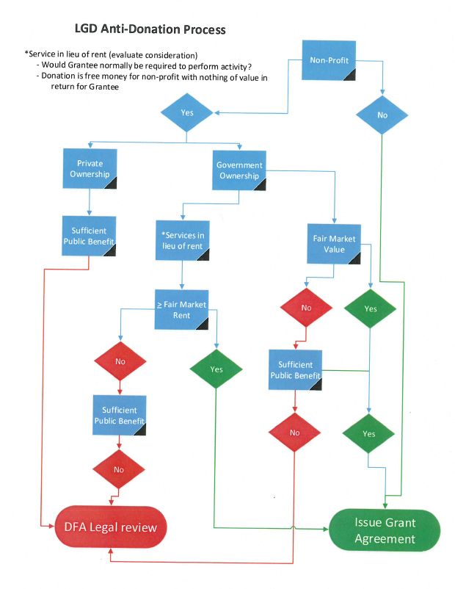
State Anti-Donation
Flowchart
This is a flowchart from the State outlining their process for determining Anti-Donation compliance.
Notice the lack of a link leading from DFA Legal review to Issue Grant Agreement? That’s not an omission: Legal review can be a long and complicated process.

Slide 16
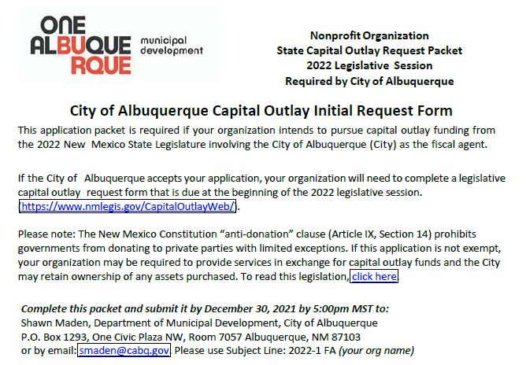
City Fiscal Agent Application
Can be found at https://www.cabq.gov/municipaldevelopment/programs/state-capital-outlay-for-non-profits​
Return by email to smaden@cabq.gov
Please use Subject Line: 2022-1 FA (your Org name)
City’s Deadline to return to Shawn is 12/30/2021 5pm
Applications are sent to sponsoring Department Director and Mayors’ Office for approval

Slide 17
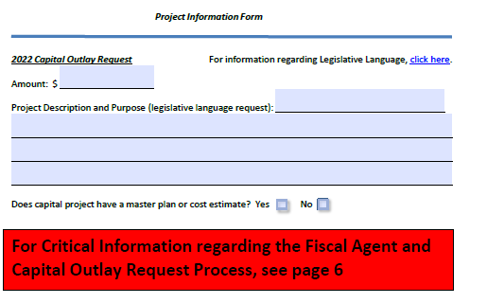
Application – Project Information Form
Page 3
Legislative Language used, this is the “Scope” of the project.
“to acquire land, right of way, construct, equip, furnish, install, and otherwise provide for a teen homeless shelter in Albuquerque in Bernalillo County”
“Or otherwise improve”/”Or otherwise provide for”
“for”

Slide 18
Scope vs Scope
The Scope of your project, as defined by the spending bill “legislative language” is NOT the “Scope of Services” in your Use Agreement with the City.
The Scope of your project defines what the Capital Outlay may legally be used for. This is what is placed in your City FA Application and the Online Capital Outlay Portal.
  i.e. to purchase, modify, and equip hot food delivery trucks in ABQ in Bernalillo County
The Scope of Services in your Use Agreement is the description of the services that you will provide for the City in return for use of the equipment/facilities purchased by said Capital funds.
  i.e. KindFolks shall shelter, feed, and support homeless teens, up to 5 at a time, at the rate of $30/person/day for the Family and Community Services Department of the City of Albuquerque. Feeding shall be 3 hot meals, support shall be access to social services, behavioral health, and tutoring…

Slide 19
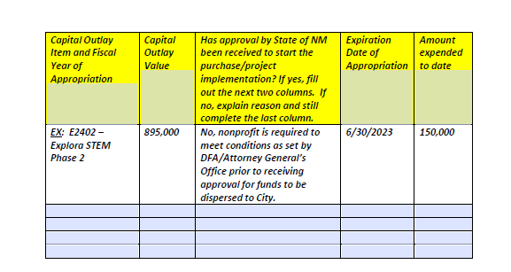
Application – Previous Capital Outlay Identification Form, Page 4
ALL previous Capital Outlay funding requests that have been signed into law by the Governor AND are still in process of being expended or approved.
Do not include projects/funding that have been completed.

Slide 20
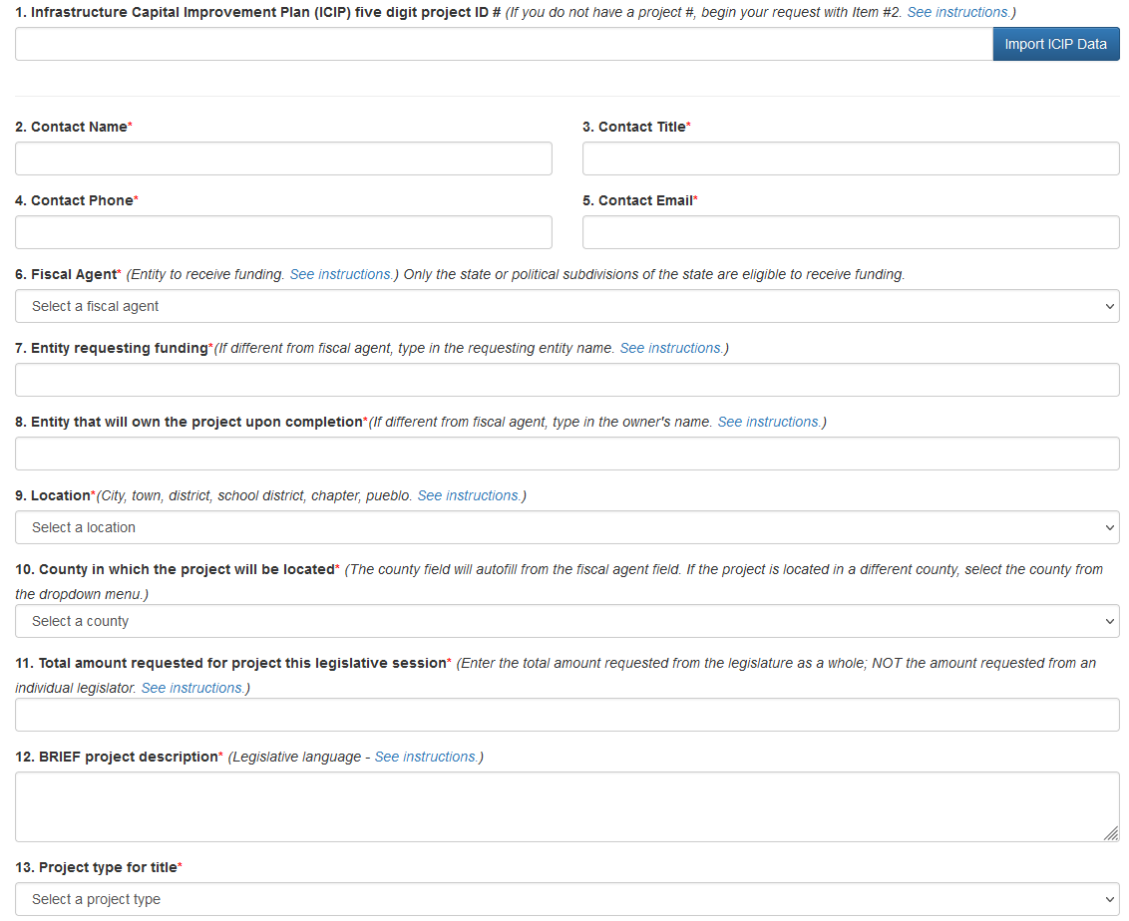
Online Application
This is mostly self-explanatory, but here are a few things to know:
  Line 1 – Leave Blank
  Line 6 – Albuquerque
  Line 7 – Your Organization
  Line 8 – Albuquerque
  Line 9 – Albuquerque
    Unless outside City limits, then Bernalillo County
  Line 12 – This is the Scope of your project
    to acquire, plan, design, build…in ABQ in Bernalillo County
  Line 13 – Construct/Purchase/Renovate are most common

Slide 21
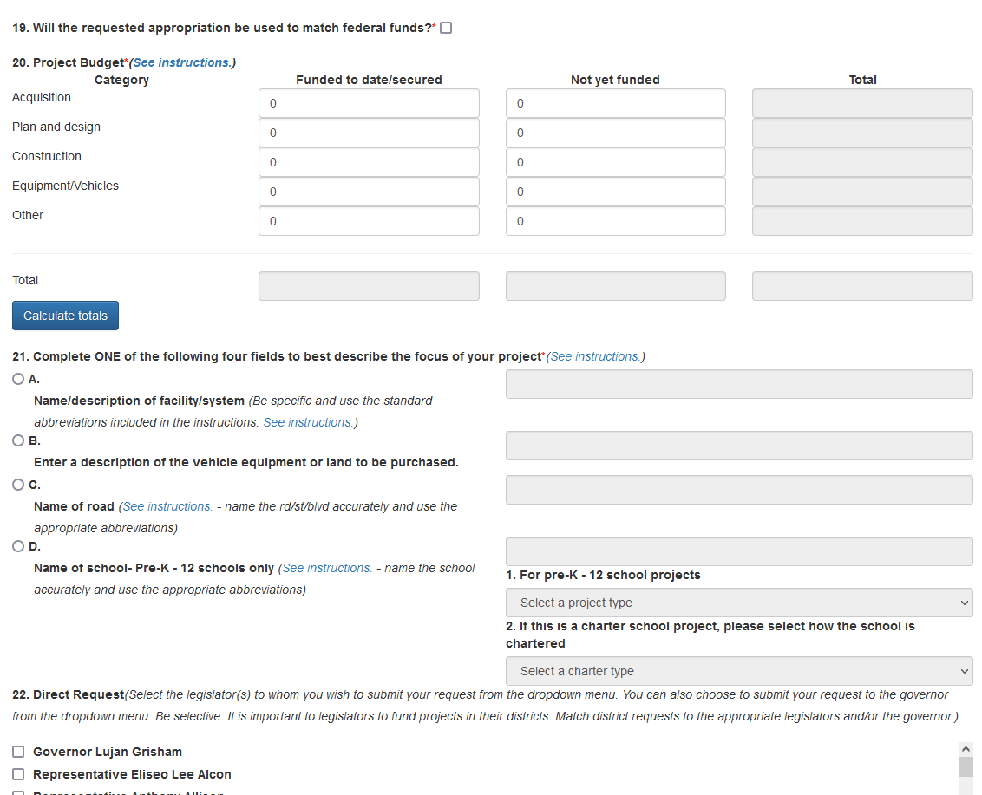
Online Application part 2
  Line 20 – Acquisition means land or building purchase
  Line 21 – choose only 1; A is most common. Specific IT, equipment, vehicle purchase is B.
    Use their instructions!
  Line 22 – Be Selective!

Slide 22
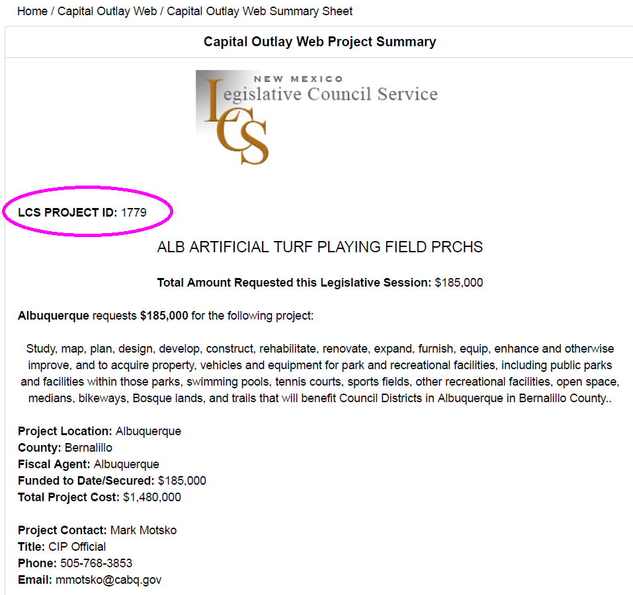
Email the City
When asked to print the summary shown, please download as PDF and send it to smaden@cabq.gov using the same subject line 2022-1 FA (your Org name)
At a minimum, please email me the LCS Project ID number. This makes it much easier for us to track, as there are typically over 2000 entries in the bill.

Slide 23
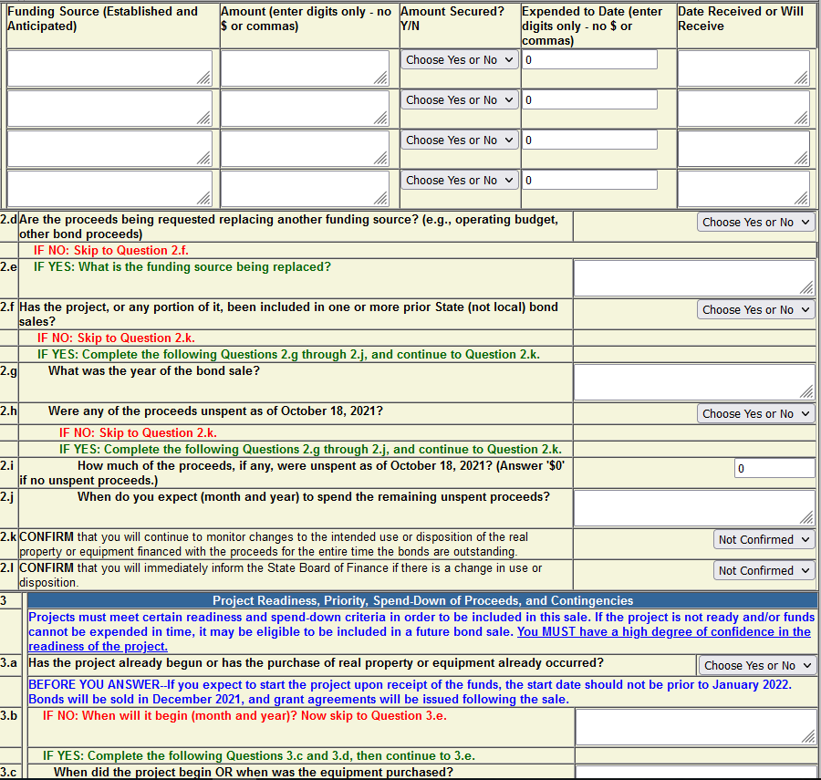
DFA/SBoF
Questionnaires
They will follow up with additional questions in CPMS
Questionnaires must be filled out online at https://www.state.nm.us/capitalprojects/index.jsp
Prior to project inclusion for Bond Sale, DFA/SBoF will look into each project to assess compliance. Projects not meeting requirements will not be included in Bond Sales until all proof is provided.
  This includes Use Agreements/Contracts with City.

Slide 24
The Wait, a.k.a. “Where’s the money?”
Even if the bill passes permitting your Organization to receive Capital funding, those funds WILL NOT be released until DFA/SBoF ensures the project meets State Law.
You will need to be proactive, but patient, regarding the process of obtaining funding, especially with the upcoming session.

Slide 25
The Wait, pt. 2
Funds are approved for sale in an upcoming bond by DFA/SBoF after their requirements are met.
  Waiting for funds to be approved by the Governor to begin communication with City Departments will greatly slow the process.
The State sells bonds twice a year, typically June and December.
  If you’re not ready by the first sale, you’ll be waiting until the next, at least. Remember that the date of sale begins the 6mo/5% and 3y/85% reversion timeline.

Slide 26
Notice of Obligation
This is the process between the City and the State after Funds are approved for sale by DFA/SBoF
After a Bond is sold, the NoO Process is followed to disburse funds.
Step 1: Grantee (City) ensures that work performed is reimbursable under the terms of the grant
Step 2: Grantee procures 3rd party vendor using State or local procurement code
  Submit 3rd Party vendor information “as soon as possible after execution by the 3rd Party but prior to execution by the Grantee.”
Step 3: Grantee completes and submits:
  a. proof of procurement (quotes, copy of bids, RPF, etc.)
  b. completed NoO

Slide 27
Notice of Obligation, Pt. 2
Step 4: Agency (DFA/SBoF) will verify:
  a. proposed purchase is consistent with authorized language of grant
  b. scope of work is reimbursable under NMAC 2.61.6.8 (Scope)
  c. budget
  d. 3rd party was procured properly
Step 5: Once Agency determines 3rd party agreement and NoO meet criteria, Agency signs NoO and processes the paperwork for encumbrance.
Step 6: Agency issues a Purchase Order to encumber funds for the amount indicated by NoO.
Step 7: Once the funds are encumbered, Agency will return a copy of the approved NoO to Grantee.
Step 8: Grantee can receive invoice and make payments.

Slide 28
Questions?
Thank you for attending!

