Slide 1

2025 GO Bond Instructions
2025 General Obligation Bond Program
2025-2034 Decade Plan
Complete class
Capital Implementation Program
Department of Municipal Development
Jennifer Turner, Interim Director
Donnie Quintana, CIP Official

Slide 2
Introductions
Shawn Maden
CIP Strategic Program Manager SMaden@cabq.gov 505-768-3616
Marlene Chavez
Senior Administrative Assistant MarleneChavez@cabq.gov 505-768-4469
Donnie Quintana
CIP Official DonnieQuintana@cabq.gov 505-546-7795
Jeanne Young
CIP Program Coordinator JYoung@cabq.gov 505-768-3873

Slide 3
GO Resources
Page
https://www.cabq.gov/municipaldevelopment/programs/2025-g-o-bond-information

Slide 4
City of Albuquerque
Capital Program
More than GO Bonds
  State Capital Outlay
  Enterprise Funds - Aviation, Solid Waste, Parking
  Consolidated Plan/CDBG Funds
  Metropolitan Redevelopment Funds
  Various ¼ Cent Programs
  Impact Fees/CCIP
  More than two billion dollars in Capital Improvements
GO is almost half of the total amount of the Capital Program

Slide 5
Component Capital
Improvement Program (CCIP)
CCIP for Impact Fees – Growth related projects
  Must be on approved list
  Ronald Vonderhaar – Impact Fees Administrator
Must be spent on tangible improvements within 7 years
  Unspent funds return to payee
  Phase completion of a project is acceptable
Examine 2023 Capital program now to ensure that “at risk” CCIP Funds are spent
  Also expiring state capital outlay, F-Grants primarily

Slide 6
General Obligation Bonds
General Obligation Bonds (G.O. Bonds) are bonds backed by the full faith and credit of the City of Albuquerque. They may be redeemed by any regular source of City funding, but as a policy matter are generally redeemed by property taxes paid to the City

Slide 7
Planning Process
The City has a two year Capital planning process because it believes that this durations allows adequate time for the following required components, while remaining flexible and responsive to the needs of the City
  Planning
  Staff Review
  Decision-making by elected officials
  Public participation
  Bond election
  Sale of Bonds
This process is generally well regarded and contributes to high bond ratings, leading to lower interest rates
Notes:
process?

Slide 8
Criteria Resolution
Section 1 – Centers & Corridors
The Capital Improvements Program and many of the processes it undertakes are mandated by the CIP Ordinance 27-1994 § 2-12
  The first priority of the City’s Capital Improvement Program shall be to rehabilitate, replace, and maintain in good condition the capital assets of the City
The GO Bond Program is established by the Criteria Resolution
Section 1
  Consistent with the CIP ordinance, it is always the policy of the City of Albuquerque that the capital program supports the Albuquerque/Bernalillo County Comprehensive Plan and adopted growth policies. For the two-year 2023 general obligation bond program, it shall be the policy of the City of Albuquerque to emphasize infrastructure and facility improvements that support the rehabilitation, deficiency correction and/or development of designated activity centers or corridors and to support projects that contribute to economic development within these areas.

Slide 9
Criteria Resolution
Section 2 – Rehabilitation
Section 2
  It shall be the policy of the City of Albuquerque that a goal of approximately 90 percent of the 2025 General Obligation Bond Program and Decade Plan shall be for rehabilitation and deficiency correction of existing facilities and systems. Of the 90%, a goal of 55% should be dedicated to rehabilitation.
Rehabilitation: Projects that extend the service life of an existing facility or system, or that restore original performance or capacity by rehabilitating or replacing system components.
Deficiency: Projects that correct inadequate service, provide system backup capability, or minimize downtime or loss of service ability.

Slide 10
Criteria Resolution
Section 3 – Equity
Section 3
  It shall be the priority of the City of Albuquerque in the 2023 General Obligation Bond Program to fund programs and projects in socially vulnerable areas as identified by the Office of Equity and Inclusion and/or geographically inequitable areas as indicated in Council Bill F/S R-20-85 (Enactment No. R-2021-007) regarding equity criterion.

Slide 11
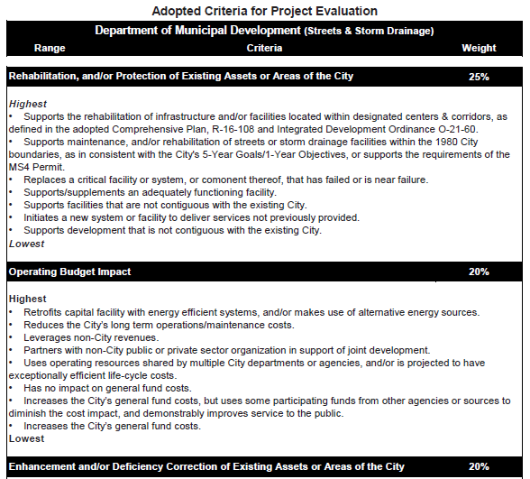
Criteria Resolution
Sections 4 & 5 - Grading Criteria
Each Department Group has their own
  All very similar, just slight tweaks to make relevant
Criteria evaluate how aligned projects are with desired City conditions and outcomes
Scored by Staff Review Committee

Slide 12
Criteria Resolution
Section 8 – Departmental Funding Allocations
 | Approx % | Allocated | +20%
Streets | 22% | $39,500,000 | $47,500,000
Storm | 7% | $12,000,000 | $14,500,000
Parks & Recreation | 10% | $17,500,000 | $21,000,000
Public Safety | 12% | $21,000,000 | $24,800,000
ABQ Ride/Transit | 1% | $1,750,000 | $2,100,000
Housing, Health, & Homelessness | 6% | $10,000,000 | $12,000,000
Community Facilities | 27% | $46,625,000 | $56,100,000
Total | 85% | $148,375,000 | $178,000,000

Slide 13
Criteria Resolution
Section 8 – Mandates
 | Approx % | Allocated
Council-Neighborhood Set-Aside Program | 7.5% | $13,500,000
3% for Energy Conservation | 3% | $5,250,000
3% for Open Space Land Acquisition | 3% | $5,250,000
1.5% for Art in Municipal Places | 1.5% | $2,625,000
Total | 15% | $26,625,000
Please note that, in accordance with O-23-81, the Council-Neighborhood Set-Aside Program is scheduled to increase to $15.75M for the 2027 GO Bond Cycle, then to $18M for the 2029 and subsequent GO Bond Cycles.

Slide 14
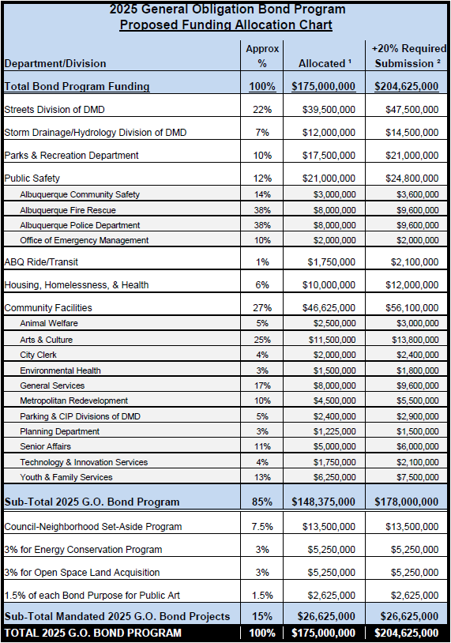
Allocation
Chart
FCS – split into HHH, YFS
OEM under Public Safety
Open Space Land Acquisition 3% now permanent
AIMP – 1.5%
Council Set-Aside - $13.5M increasing to $15.75M & $18M

Slide 15
Facility Condition Assessments
& Asset Management
General Services Department
  Approximately 10% of City buildings have an FCA, does not apply to roads, parks, storm drainage, etc.
  Depts may have legacy asset management plans if GSD has none
FCAs
Louis Martinez
Facilities Official LXMartinez@cabq.gov 505-549-0476
Ronny Chavez
Senior Project Coordinator RRChavez@cabq.gov 505-857-8015
Energy Assessment
Saif Ismail
Energy Sustainability Division Mgr SIsmail@cabq.gov 505-768-5391

Slide 16
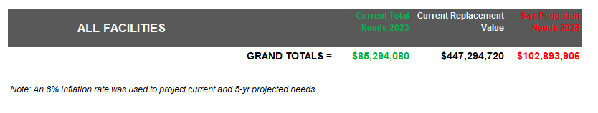
Deferred
Maintenance
Average ~8% base cost increase per year, not including general inflation
Roof patches become replacements, associated interior damage
Windows leak, causing rot, energy waste
Stucco breaks bypass waterproofing design
Potholes or safety risks cause injuries

Slide 17
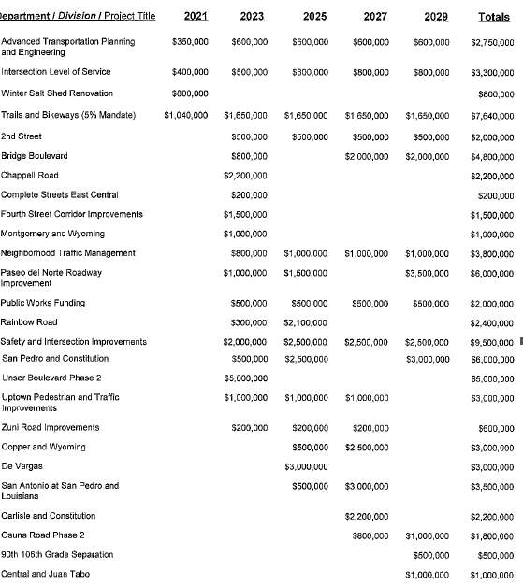
Decade
Plan

Slide 18
https://login.procore.com/
Project Request
Form

Slide 19
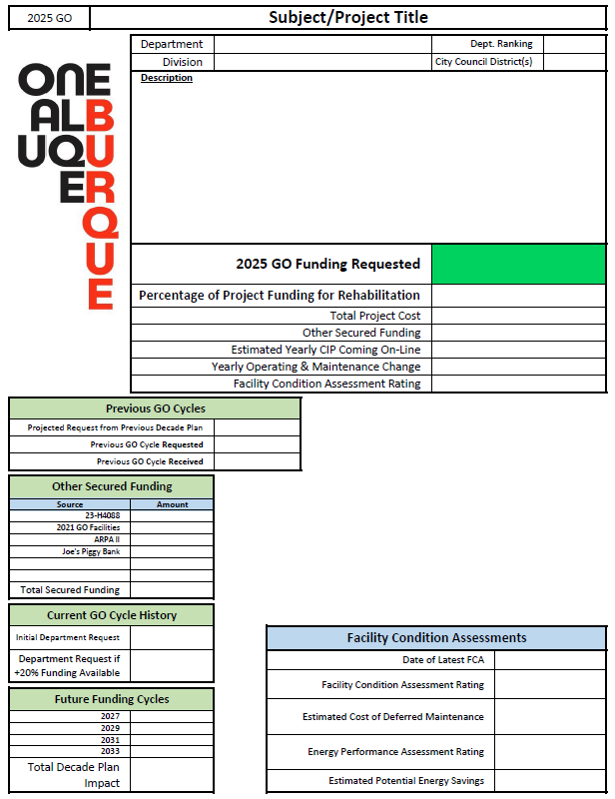
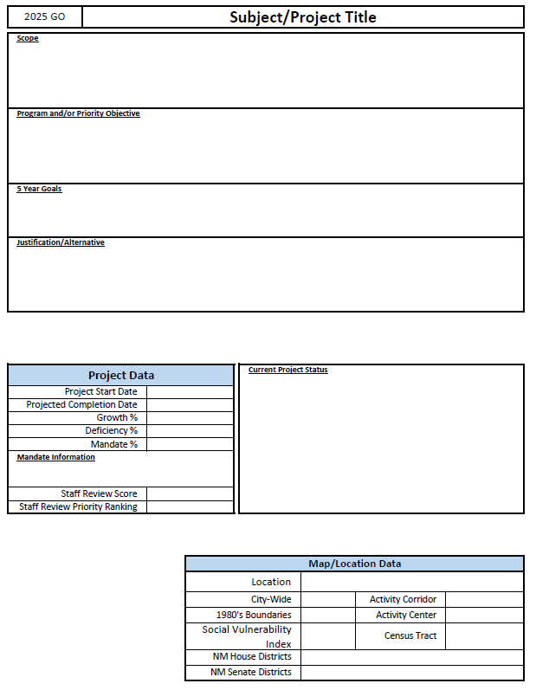
Project Request
Form

Slide 20
2025 General Obligation
Project Request
General Information Section
Subject - project title
Description – not scope
Department Ranking – Please rank # of X (total # of requests)
Rehab % - Remember that this is the goal of the CIP Ordinance

Slide 21
Funding Data
Section
Amount Requested for the 2025 GO Cycle – This is the actual amount you’re requesting right now, to receive in March 2026, based off the “Allocated” column
Department Request if 20% additional funding is available - Requested amount assuming Dept is allocated 20% “Required Submission” amount
  May be same as allocated request if that amount would cover entire project or Dept does not wish to increase funding to the project
  Possibly to only have a value for +20% (and not 2025 request) if Dept would not request project if allocation not increased, make sure Ranking reflects this also
  Do not use this +20% amount for any other calculations

Slide 22
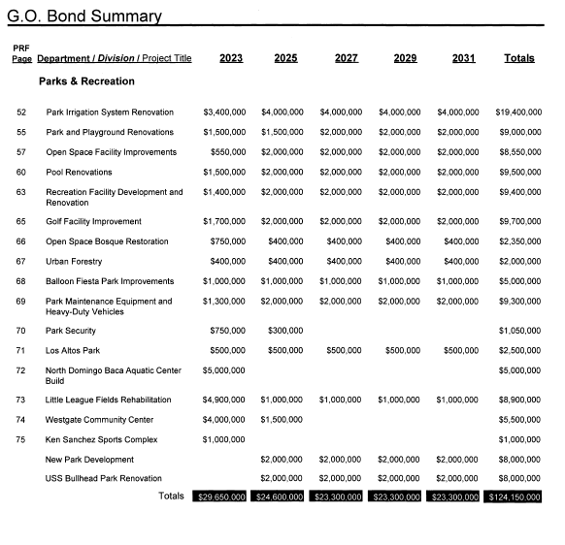
Funding Data
Section
Previous Cycle Decade Plan Request – The amount you projected in 2023 that you were going to request in 2025
Previous GO Cycle Requested – How much you initially requested in 2023
Previous GO Cycle Received – How much you actually received from the 2023 GO Program

Slide 23
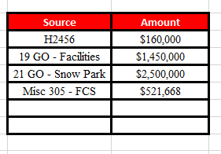
Funding Data
Section
Other Funding Sources – will need to insert chart
  2020-2023 State Grants
    Please list grant #’s when can
  GO Bonds
    Please list year/Project
  Any other funds
  If need more than 5 Rows, email me the info
  Can use Activity, but prefer plain description
  Give amount planned to use, not allocated
  If you have no other funding, write None, don’t leave blank

Slide 24
2025 General Obligation
Project Request
Funding Impacts Section
Planned 20__ GO Cycle Request – Use Decade Plan chart online to see totals to project and plan against
  Constrained to the “Decade Plan Submission” amount
Change in yearly CIP coming on-line – estimate the upcoming yearly capital needs this project will increase (or decrease!) by looking at maintenance and replacement value vs expected life
  Not operating or maintenance that will be covered by 110, that will be O&M
Change in yearly Operating & Maintenance – will be total from O&M form
  Make sure you’re doing O&M forms if you claim energy savings or decreased maintenance
  All growth will also need O&M

Slide 25
2025 General Obligation
Project Request
Facility Condition Assessment Section
Only around 10% of facilities currently have an unexpired FCA
Other independent condition assessments are acceptable
Asset management is part of FCA
Facility Condition Assessment Rating – Red/Yellow/Green
Estimated Cost of Deferred Maintenance – this is part of the FCA, but can also enter if no FCA
Energy Performance Assessment Rating – Red/Yellow/Green
Estimated Potential Energy Savings – Obtain from GSD Energy & Sustainability
  Also useful for O&M

Slide 26
2025 General Obligation
PRF pt. 2
General Information Section
Subject – make sure it mirrors the Subject from the first correspondence
Due Date – Project Completion Date
Attachments – feel free, but not required
Scope
  Design, acquire, plan, construct, etc.
  “or otherwise improve/provide for”
  Travel and Training may not be requested
  For legal definitions of Scope verbiage, see Page 47
Current Project Status – A brief update on the status, such as 75% design for Phase 2 complete, Phase 1 under construction, est. completion 3/2025, awaiting funding for Phase 3
ICIP # - Use list on Page 42

Slide 27
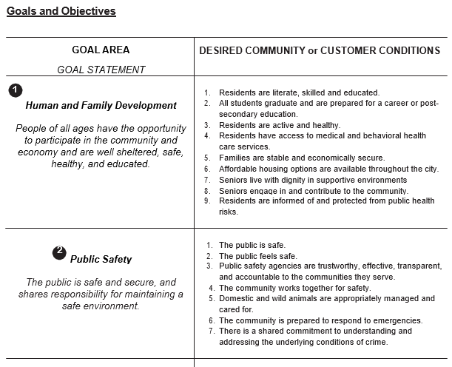
2025 General Obligation
PRF pt. 2
Criteria Section
5-Year Goal & Program/Priority Objective
  Write out fully
Justification/Alternatives
  Language should be derived from Criteria Resolution, 5-Year Goals, and Priority/Program Objective.
  Alternatives are required by CIP ordinance

Slide 28
2025 General Obligation
PRF pt. 2
Project Data Section
Project Start Date – If funded as requested (including future cycles), when will project begin
See Section 6 of CR for definitions
Projects may be more than one type
  If multiple types, list approx. % of each type
Mandate Name and Information - very short

Slide 29
2025 General Obligation
PRF pt. 2
Map/Location Data
Specific address, street range, or intersection
  Candelaria between University and San Mateo
  NW Corner of Montgomery and Wyoming
  Central and Zuni Intersection
Generic projects, or those with no specific location are Citywide – please use Sub-Form!
Activity Centers and Corridors are located throughout the City
Social Vulnerability Index and Census Tract
  Multiple Census Tracts – pick highest SVI, or M for >2
Council, NM House, and NM Senate Districts

Slide 30
GO Resources
Page
https://www.cabq.gov/municipaldevelopment/programs/2025-g-o-bond-information

Slide 31
Vehicle
Requests
Request vehicles & associated equipment separately, but expect to not see them in your list
This applies only to “light-duty” fleet, so 1 ton or less capacity
This does not apply to APD or AFR
Heavy-duty vehicle requests are unchanged

Slide 32
Decade Plan
Needs
If submitting just for Decade Plan, only the basics are needed
  Department
  Subject
  Description
  Department Ranking
  Rehab %
  “Planned” requests for 2027 – 2033
  Total Project Cost
  Ideally when project would have begun (year)
  Ramifications for delaying implementation
  Checkboxes for (Pick 1)
    Deferred Maintenance - Current need but deferred due to lack of funds
    Planned Growth
    Service Deficiency Correction

Slide 33
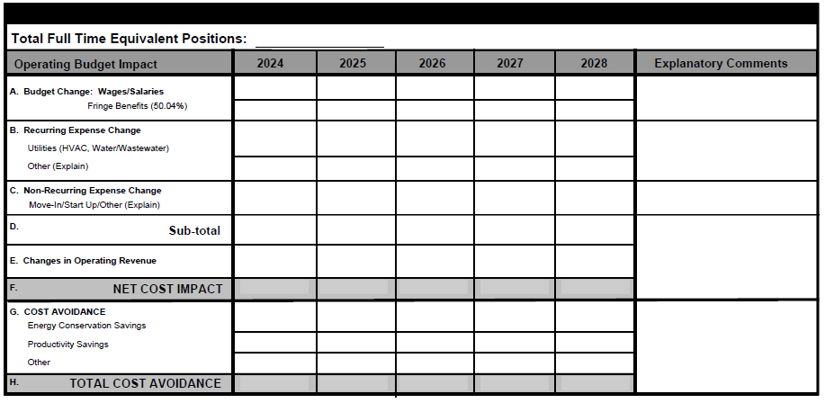
Operations &
Maintenance - 1

Slide 34
O&M - 2
Total Full Time equivalent Positions
FTE – Full time positions or part time position converted to full time equivalent
You can have part of a position, e.g. 0.25
Wages
Budget positions at the first non-probationary step of the current pay scale
Hold costs constant over time, the Budget office will make inflationary assumptions
Fringe benefits will automatically calculate

Slide 35
O&M - 3
Recurring Expense Change
Expected to occur year after year
May rise or decrease
Distinguish Utilities from other recurring expenses
Non-Recurring expense
One-time expenses
Start Up Costs – minor equipment purchases, move in costs, storage during construction

Slide 36
O&M - 4
Operating Revenue
Fees for service, Entry Fees
May increase over time
Increases in revenue will defray increases in operating expenses

Slide 37
O&M - 5
Cost Avoidance
Cost avoidance is associated with utility and production savings
Because the cost of utilities and labor are increasing faster than projected savings, the savings are expressed as Cost Avoidance
  Examples –
    New HVAC uses less energy, but rising costs consume savings. Calculate the savings as Cost Avoidance
    Installation of new irrigation system results in cost avoidance because it saves water and its associated costs, as well as increased productivity due to decreased maintenance needs

Slide 38
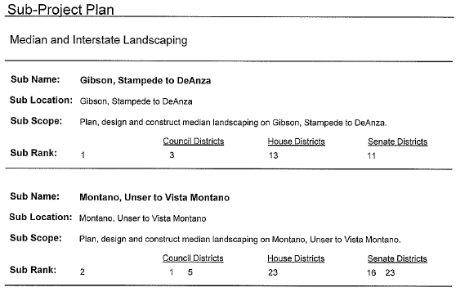
Sub-Project
Form

Slide 39
https://login.procore.com/
Project Request
Form

Slide 40
Important
Dates
April 25, 3pm – PRFs Due
May 28-30, 1-5pm – Staff Review Committee
  Presentations to evaluate against scoring criteria, no funding decided
July 29, 30, & Aug 1, 1-5pm – Capital Implementation Program Committee
  Directors present to Chief Officers to determine funding
November 14, 9-Noon – Environmental Planning Commission
  CIP presents, be prepared for questions
1st Council meeting in January – Council Review
  FGO, COW, Full Council – CIP presents, be prepared for questions, COW requires written

Slide 41
PRF Deadline
3pm Thursday April 25th, 2024
Thank you for your time!
Capital Implementation Program
Department of Municipal Development
Jennifer Turner, Interim Director
Donnie Quintana, CIP Official

