Slide 1


Talent Management
The ROAD to Employee Engagement

Slide 2
 | Topic | Presenter(s)
1 | Introduction | Human Resources
2 | Encouraging Employees to Take the Wheel | Enterprise Resource Planning Department
3 | Talent Management
 | Profile Management
 | Performance Management
4 | S.M.A.R.T. Performance Goals | Public Service University
5 | Career Goals
6 | Starting the Journey
 | Checklist for Managers
 | Training Support
 | Contact List
 | Quiz Instructions

Slide 3
Introduction
Administrative Instruction 7-32-1
  Employee Work Plan (EWP)
Administrative Instruction 7-32-2
  Performance Evaluation Guide (PEG)
Effective February 2006
  Mandatory, but compliance was difficult
  Process cumbersome

Slide 4

Talent Management replaces EWP’s and PEG’s
No more paper performance evaluations. Completed online in PeopleSoft.
Identifies employee contributions to achieving goals
Supports two-way communication: Manager and Employee
Increases Employee Involvement: Input on career goals and self-review
Staggered Performance Evaluation Due Dates
Driven by Employee Anniversary Dates (not Fiscal Year start/end)
What’s New?
Five Point Rating Scale
2 Levels of Manager Approval
Manager Dashboard
Checkpoints
Compliance tracking by HR
Expectation: 100% Participation

Slide 5

Encouraging Employees to Take the Wheel

Slide 6





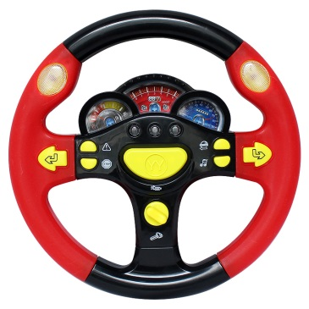




Memory Lane
Beep, Beep!

Slide 7



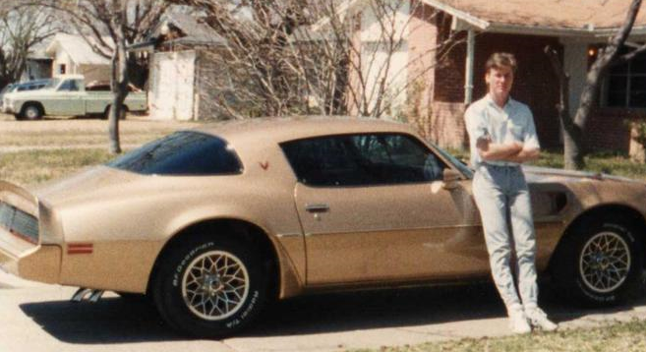

How you felt on the inside
How you looked on the outside
When you weren’t driving
When you were driving

Slide 8

Getting from Point A to Point B
Point A: Can’t Drive
Point B: Licensed Driver
Driver’s Ed Class
Driving Test
Permit
Studying
Practice Driving

Slide 9

Is driving your car as fun as it used to be?
Probably not, but it’s still just as important to keep control of the vehicle as it was the very first day.
You create goals and provide guidance.
Employees need to understand the Performance Goals and actively participate in setting Career Goals.
We are committed to moving both the City
and our employees forward!

Slide 10

Talent Management
Career Driver’s Handbook
Driving to Success

Slide 11


What is Talent Management?
There are two parts to Talent Management
Profile Management + Performance Management
Part One: Profile Management
  Person Profiles track military service, training, education, as well as, licensing and certifications of any type (personal or professional).
  Help supervisors track certification expirations and employee KSA’s (Knowledge, Skills and Abilities).

Slide 12





Driving Your Career
Person Profiles are created by YOU.
Person Profiles are about YOU.
Person Profiles SHOWCASE YOU!
There is more to YOU than a Job Description!
Licenses
Volunteer
VETERAN
Multi-Lingual
College
Degree

Slide 13
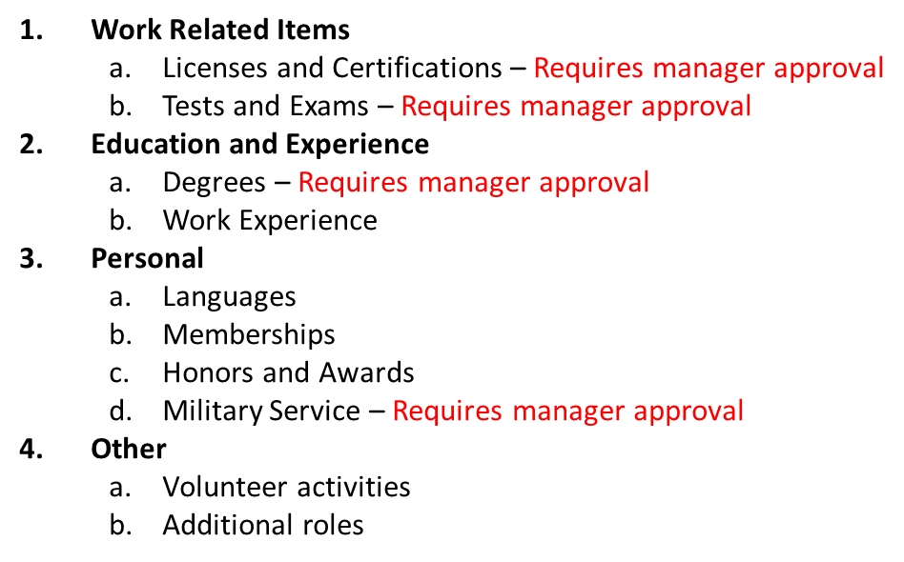
Create Your Person Profile
My Current Profile
Several items require manager approval.
Upload supporting documentation to prove the validity
with your submission for these items.

Slide 14
Person Profile Responsibility
Required: Add a Career Goal (to Performance Document) for each employee to create a Person Profile.
  Require employees to enter all work related licenses and certifications along with the expiration dates.
  The system will alert you and the employee when their expiration date is approaching so their license/certification does not expire.
  This eliminates manual tracking efforts and employee downtime.

Slide 15
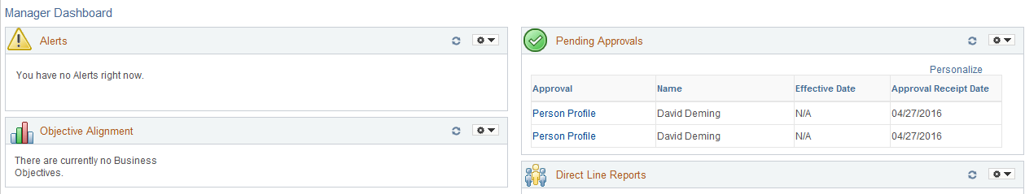
Manager Dashboard
When employees add attributes to their Person Profiles that require manager approval you will be notified.
Pending approvals will display on your Manager Dashboard.
If appropriate documentation has not been provided:
Deny the request and provide notes to the employee on what additional information is needed to receive an approval.
Then they can resubmit for approval.

Slide 16
Part Two: Performance Management
Performance Management is an ongoing, year round ACTIVE system.
PeopleSoft is the tool that facilitates the communication process with these important aspects:
  Communicating the business direction
  Planning performance
  Managing performance
  Evaluating performance
  Career Development
  Shared Accountability
  Two-way Communication

Slide 17
Performance Management Timeline
Starts on Employee Anniversary Date
Checkpoint 1
Checkpoint 2
Ends Day before next Anniversary Date

Slide 18
Performance Management Roles
MANAGER ACTIVITIES
Evaluating Manager
Creates Document Adds City Goal(s) – Not Rated Reviews Core Values with Employee at beginning of year Rates & Comments at end of year Sets & Reviews Performance Goals with Employee at beginning of year Rates & Comments at end of year Sets Career Goals with Employee Documents & Comments Conducts Checkpoints End of Year Review & Shares with Employee Feedback from Employee Finalizes Performance Document
Approving Manager
Compliance Gatekeeper Review and approves/closes evaluation
EMPLOYEE ACTIVITIES
Reviews City Goals (Not Rated) Reviews Core Values (Rated) Reviews & Discusses Performance Goals with Manager (Rated) Sets Career Goals with Manager Participates in Checkpoints with Manager throughout year End of Year: Conduct Self-Review, Ratings & Adds Comments Receives Manager Review Provides Feedback/Comments Acknowledges Final Review/Rating

Slide 19
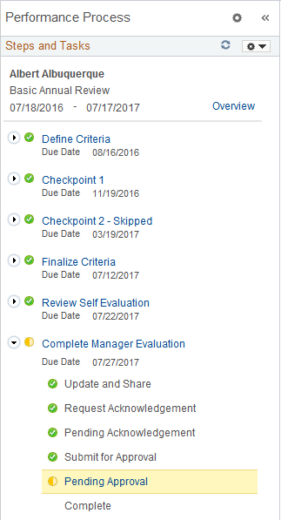
Beginning Process
Manager creates Performance Document
Manager adds City Goal to the document
Manager reviews
Core City Values
Manager adds Performance Goals to the document
Manager adds Career Goals to the document
Reviews the Performance Document with the Employee

Slide 20
During the Year
Manager & Employee:
Add Performance Notes (Ongoing)
Checkpoint 1: Manager Comments & Shares
Employee reviews comments and adds comments
Checkpoint 1: Complete
Checkpoint 2: Manager Comments & Shares
Employee reviews comments and adds comments
Checkpoint 2: Complete

Slide 21
End of Year
Employee: Self-Review
Manager: Conducts Review
Manager & Employee: Discuss Review & Ratings
Employee Acknowledges
Evaluation
Employee’s Manager
Finalizes Evaluation
Approving Manager: Reviews & Approves or pushes back until complete
Annual Evaluation Closed

Slide 22
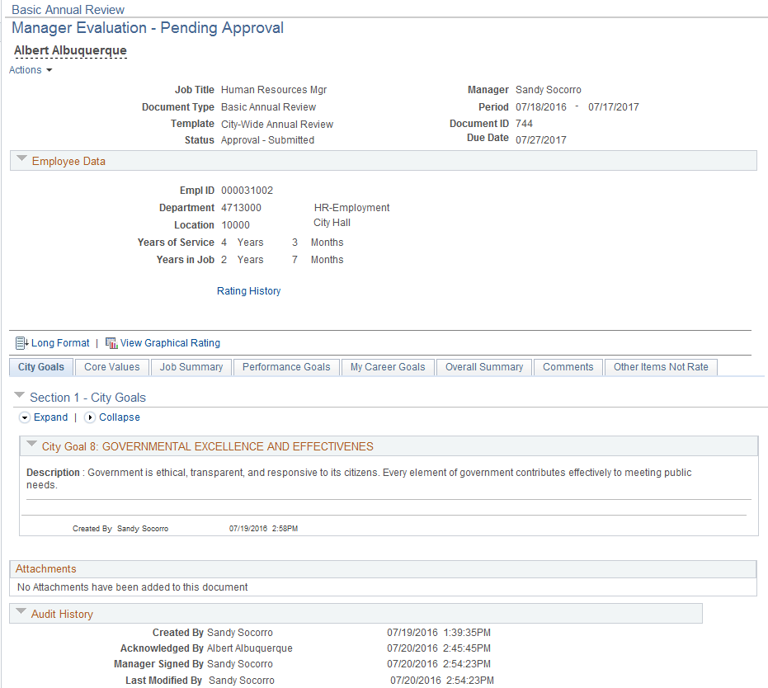
Performance Document
Tabs:
City Goals
Core Values
Job Summary
Performance Goals
My Career Goals
Overall Summary
Comments
Attachments can be added to the document by the Evaluating Manager Only.
Audit History on the bottom of every document.

Slide 23
New Rating Scale
5 Point Rating Scale
  Unsatisfactory Performance
  Needs Development
  Meets Expectations
  Exceeds Expectations
  Exceptional Performance
There are two Rated Sections:
  Core City Values
  Performance Goals

Slide 24
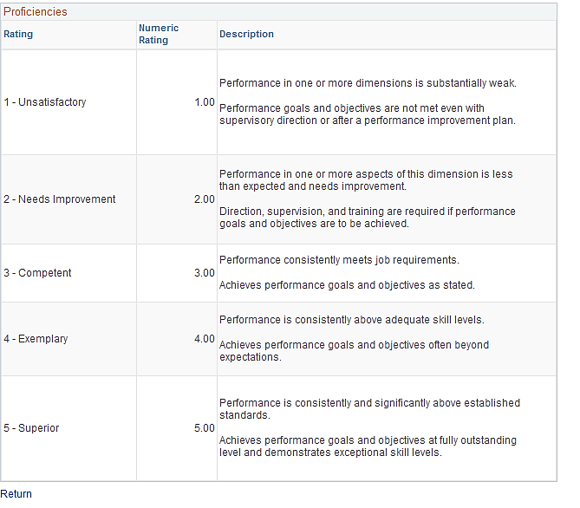
View of the 5 Point Rating Scale

Slide 25
Additional Performance Tools
Ability to Add Performance Notes all year
  Advantages:
    Performance Notes are Private
    Jogs your memory about highlights/successes
    Quick access to copy and paste to your Performance Document
    Helps you support your manager ratings
    Assists in evaluation discussion with employee
Workflow E-mails
  System generated e-mail reminders/updates
  Directs manager and employee to the next steps in process
  Provides a URL link to take you to the Performance Document

Slide 26
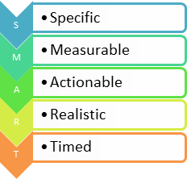
SMART Performance Goals
S
M
A
R
T

Slide 27
What is a SMART Performance Goal?
  A carefully crafted, comprehensive statement about what the employee intends to accomplish throughout the year
  An individual action plan
Advantages of SMART Performance Goals
  Provides guidance and direction for work
  Links employee accomplishments to organizational objectives/goals
  Clarifies expectations for the employee and supervisor
  Improves performance

Slide 28
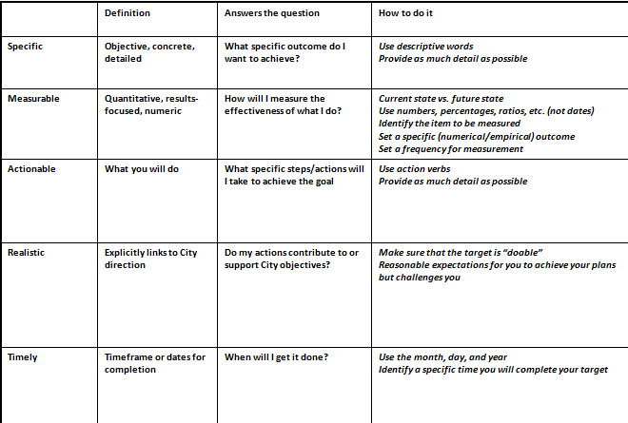
Elements of SMART Performance Goal
Example:
Reduce time from answering call to first responder call-out by 10% by 6/30/2017 in order to support Public Safety.

Slide 29
Manager: Providing Direction
Sets the Performance Goals and adds them to the Performance Document
Communicates the goals and responsibilities to employee
  Remember: You will rate employees on these.
Makes sure that the employee understands the goals
  Answers employee questions to clarify.
The manager is responsible to create the goals, but employee is responsible for their performance.
Comments on progress at Checkpoints
Rates and Comments at end of performance year

Slide 30
Employee: Taking the Wheel
Reviews the Performance Goals set by the manager
Understands goals and their associated responsibilities
Asks questions until the goal is clear
Responsible for performance related to meeting the Performance Goals
Comments on progress at Checkpoints
Conducts Self-Review at end of performance year
Managers may work with employees to create the goals, but managers have the final responsibility to set the Performance Goals.

Slide 31
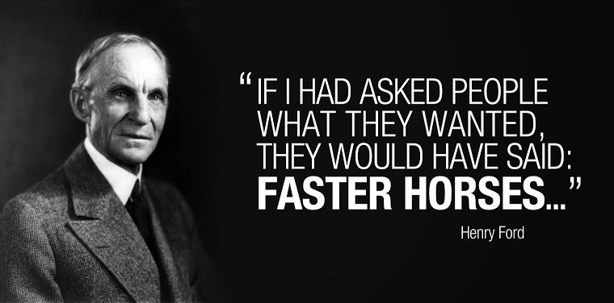
Career Goals

Slide 32

Where do you want to be in 1 year? 5 years? 10?
  Career Goals help you get there!
Advantages of Career Goals
    Assists in achieving the Performance Goals
    Enhances your Knowledge, Skills and Abilities
    Uniquely YOURS! Tailored to help you meet your personal career goals.
    Helps you keep your current career on track
    Helps prepare you for your career future

Slide 33

Questions to help create a Career Goal
Development Target
What do I need to improve?
How to Achieve
What Development Method(s) will I use?
Measurement
How will I measure my improvement?
Completion Date
When will I complete my Development Target?
Results
What was the impact on my performance?
Managers will work with employees to create meaningful Career Goals, but managers have the final responsibility to enter them into the system.

Slide 34

Career Development Opportunities
  Advisory Committees
  Apprenticeships
  Certifications
  Challenging/Stretch Work Assignments
  Classroom Training
  Conferences
  Cross Training
  Degree Programs
  Internships
  Job Rotation
  Job Shadowing
  Job Swap
  Mentoring
  Online Learning
  On the Job Training (OJT)
  Professional Association Activities
  Reading (Book Club)
  Research Projects
  Self Study
  Skill Development
  Special Projects
  Task Groups
  Volunteer Activities

Slide 35
Career Goals
Every employee should have a minimum of two Career Goals
Every employee should have a career goal to complete their Person Profile
Career Goals are NOT RATED, but they are Documented (Met or Not Met)
They are not part of the performance rating

Slide 36
Starting the Journey

Slide 37
Checklist for Managers
Person Profiles
Ask all Direct Reports to create a Person Profile in PeopleSoft – Adding work related licenses & certifications with expiration dates
Performance Management
Check Manager Dashboard for Employee Work Anniversary Dates in July, August and September
Create Performance Documents for these employees
  Add City Goal to document (choose from dropdown list)
  Create SMART Performance Goals (Specific, Measurable, Actionable, Realistic, Timed)
  Create Career Goals - Minimum of two. One should be for the employee to create a Person Profile.
Review Performance Document with Employee to make sure expectations are clear

Slide 38
Training Support for Talent Management
Public Service University -
Classroom sessions: SMART Targets, etc.
On-Demand Online Courses – Activity Based
  Courses in See It! and Try It! mode
  System Process Documents (Detailed Job Aids)
  Job Aids (Quick Steps)
Open Workshops

Slide 39
Contacts
Department SME’s (identified by Director)
Department HR Coordinators
Public Service University, 768-3200
DTI Help Desk, 768-2930
  Password resets & system issues

Slide 40



Talent Management
Quiz
There are two parts to complete before you will receive course credit:
Part One: Complete training session
  Attended the training session
Part Two:
  Complete Quiz (final step)
  You will receive an e-mail with the link to the Quiz. Complete the Quiz to receive credit.

Slide 41
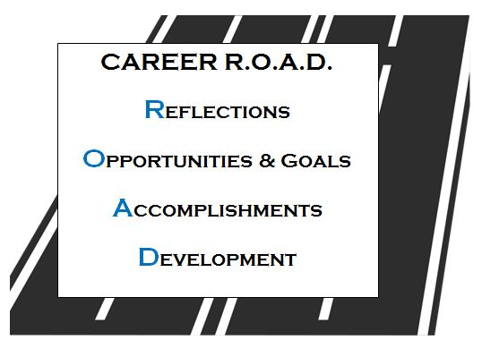
Talent Management

