Slide 1
Jocelyn Black, CRC®
Strategy Financial Group
Strategy Financial Group provides investment and insurance services.
1/22 – 197841C
Notes:
"Hello. I'm [Agent Name] from [DBA or Agency Name, if applicable], [Insurance License number, if applicable], and I am an insurance agent and [investment adviser representative, if applicable [registered representative, if applicable]] hosting this event. [I/We] offer retirement strategies, which may include the use of annuities. [I am/We are] available to discuss how annuities and/or investment products may be used to fill retirement income gaps after this presentation. [I/We] do not represent a government agency and information on this topic is available at no cost from the Social Security Administration at www.SSA.gov.

Slide 2
DISCLAIMER
The presenter, speaker and sponsor of this seminar as well as the information presented at the seminar is not related to, endorsed by, nor connected with and not approved by any government agency or organization. For information regarding your Social Security benefits, you are encouraged to speak to your local Social Security Administration office or visit the Social Security Administration website at www.ssa.gov. This material is provided courtesy of Strategy Financial Group and contains general information to help you understand basic financial planning strategies. Nothing I say should be construed as a recommendation to buy or sell any financial vehicle, nor should it be used to make decisions today about your investments.
My goal with this presentation is to expose you to ideas and financial vehicles that may help you work toward your financial goals. Please understand that I cannot make any promises or guarantees that you will accomplish such goals. All investments are subject to risk including the potential loss of principal.
This presentation is designed to provide general information on the subjects covered. It is not, however, intended to provide specific legal or tax advice and cannot be used to avoid tax penalties or to promote, market or recommend any tax plan or arrangement. Please note that Strategy Financial Group and its representatives do not give legal or tax advice. You are encouraged to consult your tax advisor or attorney.
Despite efforts to be accurate and current, this presentation may contain out-of-date information; we are under no obligation to advise you of any subsequent changes related to the topics discussed in this presentation.
At the end of the seminar, you will be provided an opportunity to schedule a one-on-one phone call or virtual meeting to discuss your situation and questions. There is no obligation to you for this visit. Additional meeting time may be arranged at your discretion and may include the recommendation of investment and/or insurance strategies following a comprehensive planning process that is complementary and also at no obligation to you.
Investment advisory services are required to be provided in accordance with the fiduciary standard- this means that the advice must be in the best interest of the client with any conflicts of interest fully disclosed to the client. Investment advice is offered through Strategy Financial Services, LLC, a registered investment advisor. Any references to protection benefits or lifetime income generally refer to fixed insurance products, not securities or investment products. Insurance and annuity product guarantees are backed by the financial strength and claims-paying ability of the issuing insurance company. Insurance products are sold based on the suitability standard at both the state and insurance carrier level- this means that product recommendations must meet the stated financial needs and objectives of the client. Annuities are not suitable or appropriate for all individuals, are subject to fees and surrender charges, and pay customary commissions to Strategy Financial Insurance and/or your licensed insurance agent. Clients are never obligated to purchase the insurance products we recommend, or to purchase them through our affiliates. Insurance and annuity products are offered separately through Strategy Financial Insurance, LLC.
Notes:
Throughout the program, we may generally discuss different financial vehicles; however, nothing I say should be construed as a recommendation to buy or sell any financial vehicle, nor should it be used to make decisions today about your investments.
My goal in this program is to expose you to ideas and financial vehicles, including annuities, that may help you save money in taxes, create lifetime income, protect your assets from market losses and potentially minimize taxes for your beneficiaries. Guarantees in annuities are backed by the claims-paying abilities and financial strength of the issuing carrier. You should consult with a professional specializing in the areas of tax, legal, accounting or investments regarding the applicability of this information to your situation.
Now sit back, relax, take lots of notes. At no point will you be asked to make any decisions regarding your financial circumstances; this is a conversation.

Slide 3
ABOUT YOUR PRESENTER
Philadelphia native and Southwest transplant since 2013
Juggling mom of two middle schoolers and two rescued fur babies
Former owner of an independent financial planning practice based in Albuquerque
Merged practice with Strategy Financial Group, independent firm based in Phoenix with office in ABQ
Licensed insurance agent and registered investment advisor representative
Fiduciary standard
Certified Retirement Counselor®
Over 18 years of experience
Passionate about financial education

Slide 4
TODAY’S TOPICS
General information on how Social Security retirement benefits work
How you can get the most out of your Social Security retirement benefits
The importance of coordinating all facets of your retirement income strategy
Notes:
What are we talking about today … First, I want to share some general information with you about how Social Security retirement benefits work. We're not going to be talking about the disability portion of Social Security; we're going to be talking about how the age you begin to take Social Security distributions and the decision to continue working after beginning distributions can affect your benefit payment amount.
Second, I want to share with you how you can get the most out of your Social Security retirement benefits. We all have been putting money into this thing for how many years now? We want to get as much as we can out of it.
And then, third, we want to make certain you fully understand that your Social Security benefits are just one part of your overall retirement income strategy. For you to make appropriate financial decisions for your retirement, you need to consider how all of your sources of retirement income will work together.

Slide 5
THE THREE-LEGGED STOOL
Social
Security
Retirement
Savings
Employer-Sponsored Plans
Notes:
Historically, we’ve always referred to the traditional sources of retirement income as a three-legged stool, composed of:
1. Government entitlement programs (Social Security and Medicare)
2. Personal savings and investments
3. Employer-sponsored plans
In the past, retirees could typically count on three sources of retirement income that divided roughly into thirds. The three sources of income have traditionally been: government-funded Social Security, employer-sponsored components, and individual savings. With this traditional scenario, both the government and employer-sponsored components were considered predictable, reliable income sources that may also be adjusted for inflation. Only one-third, individual savings, was the responsibility of the individual.
These days, the general perception is that pensions are few and far between – and many of those that exist are in danger of not being able to pay out benefits, given recent years of low interest rates and longer life spans. It is now more common to see employer-sponsored defined contribution plans such as 401(k)s or 403(b)s.
While Social Security is able to pay benefits to today’s retirees, it is widely acknowledged that changes must be implemented to sustain the program in the future.
Then there is our own personal savings and investments, which can include personally directed qualified plans, such as IRAs, along with other financial vehicles, such as CDs, savings accounts, mutual funds, etc. This is the leg of the stool over which we have the most control – and that may constitute a larger portion of our retirement income in the future.
You may find yourself in a situation where you do not have a defined-benefit plan, such as a pension. If so, you’ll likely be relying on Social Security benefits and any retirement savings from a defined contribution plan and/or your personal savings to generate income during retirement.

Slide 6
GENERAL INFORMATION
Will Social Security be there for us in the future?
Notes:
All right, let's start with general information. And we're going to go ahead and talk about the 900-pound gorilla in the room, and that is a question we get all the time: Will Social Security be there for us in the future?
The cartoon reads:
"This guy Madoff is going down. He was paying off his old investors with money he got from the new ones.” And there's Uncle Sam, a little sweating under the collar there, saying, "You can get busted for that?"
It’s funny because although Social Security was originally intended to be a fully funded system financed by payroll taxes, in 1939, the fully funded system was replaced by the pay-as-you-go system. The money paid into the system funds several trust funds. The trust funds then distribute funds to individuals claiming Social Security benefits in the form of Social Security checks to use for retirement or disability income. The Social Security taxes that are paid by an employed individual are used to contribute to the funds that are used to pay retired workers. Thus, the current generation provides for the retiring generation.
NOTE TO PRESENTER: For additional information on the funding of Social Security see:
http://www.ssa.gov/oact/progdata/fundFAQ.html

Slide 7
FROM THE SOCIAL SECURITY ADMINISTRATION …
August 2021 …
“… The combined asset reserves of the Old-Age and Survivors Insurance and Disability Insurance (OASI and DI) Trust Funds are projected to become depleted in 2034, one year earlier than projected last year, with 78% of benefits payable at that time …”
SOURCE: https://www.ssa.gov/news/press/releases/2021/#8-2021-2. Accessed Jan. 5, 2022.
Notes:
As of August 2021, the Trustees project that the combined OASDI Trust Funds will become depleted in 2034. This is one year earlier than 2020’s projection. After this depletion, combined funds would be sufficient to pay just 78% of program costs.
We have provided you with a complete link to the source so you can read it in its entirety, but what they’re projecting here is not that Social Security is going away. Instead, what they’re projecting is that, at this point, less than 15 years from now, Social Security collections will only be sufficient to pay for 78% of the program’s cost.
However, that doesn’t necessarily mean that benefits must be reduced. Our federal government may take a different approach and pull money from other tax revenues, for example. But, based on their projections, Social Security tax revenues won’t be enough by themselves to fund full benefits in 2034 unless something is done.

Slide 8
I’M TAKING NOW!
“I’m worried Social Security will be gone in the future, so I’m taking my benefit NOW while I still can.”
What is wrong with that?
Notes:
Now, the next question that comes up — we hear this all the time — is people say, "All right, well, I'm going to take it now then.” You may be concerned that Social Security won’t be there in the future and you may be considering taking your benefit NOW.
What's wrong with that? Well, as we've said, we just found out that Social Security is not going away. But if benefits are reduced in the future, potentially optimizing your benefit payments can help to make sure you get the most that you can after that potential reduction.

Slide 9
WHAT MIGHT CHANGE?
Push Full Retirement Age (FRA) back for younger people
Increase taxes on those who are working
Play with the Consumer Price Index (CPI) numbers¹
Adjust earnings restrictions
Some combination of the above
¹ https://www.ncpssm.org/documents/social-security-policy-papers/chained-cpi-will-hurt-seniors/. Accessed Jan. 6, 2022.
Notes:
In talking about pushing back FRA — which stands for full retirement age — there’s been some discussion about pushing full retirement age back for younger people. If you recall, there was a time when full retirement age was 65. For some younger baby boomers, the full retirement age has been pushed back to 67. So the full retirement age has already been pushed back. Discussions are ongoing about possibly extending it to 70 for younger people, pushing back when they can receive benefits.
What else might change? Well, the taxes on those who are working may increase.
And if those who are working are taxed more, then there's more money in the system. So it makes it more sustainable.
What else? So you know how every year when you get Social Security, it's supposed to increase with inflation? Well, inflation numbers can be used in several ways, and changes in the calculation rate for inflation can impact programs like Social Security. Inflation adjustments for Social Security benefits can be higher or lower.
Earnings restrictions may be adjusted too. But earnings restrictions basically stipulate that if you're taking Social Security early, if you're earning a certain amount of money, then a portion of your Social Security benefit may be reduced if you're earning too much. We’ll address more about that later, but the earnings restrictions may be adjusted.
Some combination of the above also could transpire.
But here's what I want you to do — what's not on the screen here might be the No. 1 reason why I don't think that Congress will ever reduce your Social Security benefits once you're collecting.
The question I have for you is — who is a politician’s No. 1 voting block? It's always people aged 55 and above.
So people who are taking Social Security vote, right? They vote. So here you are, put yourself in the shoes of a congressperson, a Senator, some elected official. And you have the choice of either making changes that would affect the younger people who don't vote as much and who are not yet receiving Social Security and who don't really believe they're going to get it anyway in the future, or you have the choice of reducing benefits to your No. 1 voting constituency.
What are you going to do? You know when you reduce benefits to your No. 1 voting constituency what they are going to do to you? They're going to vote you out of office. You can count on one thing, and that is that a politician is going to do whatever it takes to get re-elected. I find it very difficult to believe that they're going to affect Social Security benefits for those of you who are already receiving them or soon to receive them.
SOURCES RE. VOTER DEMOGRAPHICS:
https://money.usnews.com/money/retirement/aging/articles/why-older-citizens-are-more-likely-to-vote. Accessed 1.6.22
https://newrepublic.com/article/160380/2020-election-exit-polls-elderly-turnout-senior-vote. Accessed 1.6.22

Slide 10
HOW TO OPTIMIZE YOUR BENEFITS?
Notes:
To potentially optimize your Social Security benefits, you need to understand the rules. You need to know what the rules are. So I want to spend a couple minutes on the next slide. It talks about full retirement age and collecting benefits early.

Slide 11
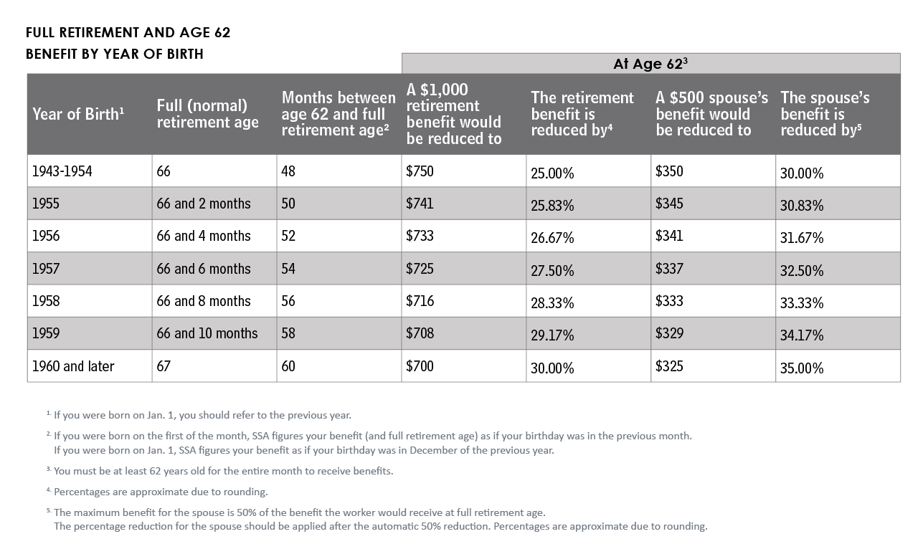
Full Retirement Age and Collecting Benefits Early
SOURCE: http://ssa.gov/retire2/agereduction.htm. Accessed Jan. 6, 2022.
Notes:
The first thing you need to understand is this first column called the year of birth. It tells you, based on the year that you were born, what your full retirement age is. So we can look for a certain year of birth, let’s say 1958, and look in the next column to the right and see that full (normal) retirement age for someone born in 1958 is age 66 and 8 months.
Then, when we get to those born in 1960 or later – likely many of you in this room fall into that category – full retirement age lands at an even 67, age 67.
Imagine the following scenario: When you are 67 — let's imagine that your benefit would be an even $1,000 a month. So $1,000 a month. It may be more, it may be less, but just for illustration it's about $1,000 a month.
What would your benefit be if you took it early at age 62? Well that's what this column does. It says if you take — it's 62, and here's the number right here — instead of $1,000 a month you would get $700. So in other words your benefit would be reduced by 30 percent. And every year that you wait to take benefits between the age of 62 and 67 — every month that you wait to begin your benefits, your benefits would go up pro rata, “meaning in proportion.” You can actually calculate exactly what they would be. The important thing to understand here is that your benefits are reduced, and if you take them at 62, they're reduced and permanently reduced.
Now the next column over talks about a spousal benefit. So one of the things you should be aware of — for some people a spouse, and you've probably heard this — a spouse may qualify to claim benefits based upon the record of the person they're married to. They may be able to get up to half of their spouse's benefits. Now historically the husband has been the one working; maybe the wife was at home raising kids. So the husband has a larger Social Security benefit; the wife has a smaller Social Security benefit. But who knows, it might be reverse. The point is that, historically speaking, since the wife stayed at home, she may not have much of a benefit. She can get up to half of her husband's benefit. But that only applies if she files at full retirement age. If she files early, say at 62, instead of getting $500, which is half of $1,000, she would only get $325. Same principle applies: The longer she waits, the bigger the benefit gets. So that's full retirement age and benefit reduction for retiring early.

Slide 12
DELAYED RETIREMENT CREDITS (TAKING LATER)
INCREASE FOR DELAYED RETIREMENT
SOURCE: http://ssa.gov/retire2/delayret.htm. Accessed Jan. 6, 2022.
Notes:
Well what if, on the other hand, you retire and start collecting benefits later? Now it's interesting, many are not familiar with something called delayed retirement credits. That's a fancy phrase that's Social Security Administration speak for, "Hey, if you wait until after full retirement age, you get more money." The benefit increase no longer applies after you reach age 70, even if you continue to delay taking benefits. So for those of you at the bottom here, most of you in the room were born after 1943, in fact I would almost say all of you, then each year that you delay taking benefits, you get 8 percent more.
So let's say we said $1,000 at age 67. What if you wait until age 68? Well now you get $1,080. What if you wait until age 69? You get $1,160. If you wait until age 70 you might get as much as $1,320 a month, so 32 percent more just by waiting for a few years. That can be pretty powerful. Taking benefits before full retirement age reduces your benefit amount and delaying benefits until after full retirement age can increase your benefit amount. If you delay your full retirement, your benefit amount is greater, but you may be receiving it for a shorter amount of time because you waited to start taking the benefit.

Slide 13
LONGEVITY
This is KEY!
According to the Society of Actuaries …
If a man and woman are married, the chance that at least one of them will live to any given age is increased. There’s a 50% chance that one of them will live to age 92.
SOURCE: https://www.newretirement.com/retirement/live-to-be-100-how-much-need-retirement/ Accessed Jan. 6, 2022.
Notes:
Which brings up — so how do you know? Should you take early? Should you take late? What should you do? Well that's where longevity comes into play. And this is a key point. According to the Society of Actuaries’ data, 1/3 of men and 1/2 of women who are in their mid-50s today will live to age 90. For a married couple who are 65 today, there is a 50% chance that one of them will live to age 92. Now what does that mean?
So let's say you're married. Flip a coin. If it lands heads then one of you, maybe both of you, but at least one of you will celebrate your 92nd birthday. If it lands tails, neither one of you make it that long. But half of you in the room, if you're married, half of you will have somebody making it to 92. Somebody's going to celebrate a 92nd birthday.
Now husbands, bad news for you, right? Probably not you. But what's important here is people often underestimate how long they're going to live.

Slide 14
WE ARE JUST GETTING STARTED…
You can:
File early
File late
File at Full Retirement Age (FRA)
File on a spouse’s record
File on a divorced spouse’s record (must be married for 10 years)
And all kinds of combinations
While there are many filing scenarios, only a few options likely make sense for your individual situation
Notes:
Now we're just getting started, though, with all this because we've already talked about how you can file early, you can file late, you can file at your full retirement age, you can file on a spouse's record; we’ve already talked about all that. You can even file on a divorce or deceased spouse's record. In order to claim on a divorced person’s record, the spouse has to have been married 10 years and still be unmarried. For a deceased spouse benefit, the claimant only has to have been married 9 months. So there are so many ways you can take Social Security. And pretty soon we're going to talk about how you can optimize your benefits. While there are many filing scenarios, only a few options likely make sense for your individual situation.

Slide 15
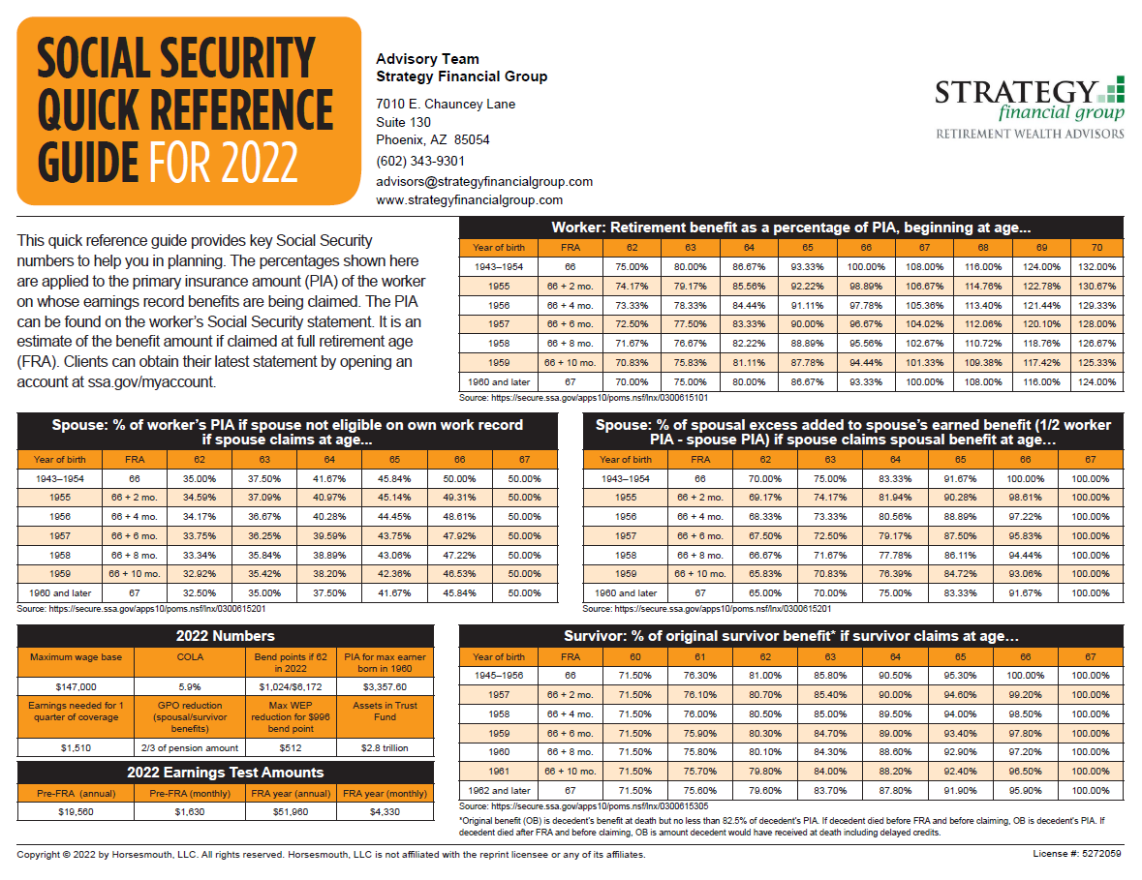
Notes:
As a worker, the most you can claim is 132% of your PIA which stands for Primary Insurance Amount. That’s only if you were born prior to 1955 and wait until age 70 to claim. PIA is an estimate of the benefit amount if claimed at full retirement age or FRA. The most you can claim as a spousal or ex-spousal benefit is 50% of your spouse’s PIA, again—as long as you were married at least 10 years, have been divorced at least two years, and are not remarried.
100% of PIA is available for survivors, even ex-spouse survivors, but only if you wait to claim at your FRA. The earliest a survivor can claim is at age 60, but you will only receive 71.50% of the PIA.
Pop quiz: does Social Security increase every year? You guessed right if you said no. Cost of living adjustments have not occurred every year in the past. In fact, in 2010 and 2011 there was no COLA. However, this year, there was long overdue increase of 5.9% and next year’s increase is projected to be 8.7%, which would be the biggest increase in more than 40 years!
LOTS of information to digest, so I encourage all of you to download this PDF once you receive the slides and review it more carefully as well as explore the web links listed on the other side.

Slide 16
HOW EARNINGS AFFECT YOUR BENEFITS (2022)
When taking benefits EARLY…
$1 of benefits is deducted from your Social Security benefit for every $2 of earnings over $19,560
In the year of FRA, $1 of benefits is deducted from your Social Security benefit for every $3 of earnings over $51,960 (only applies to months before FRA)
Once you reach FRA, you will receive your full benefit payment regardless of how much you earn
SOURCE: https://www.ssa.gov/benefits/retirement/planner/whileworking.html
Accessed Jan. 6, 2022.
Notes:
This is as of 2021, of course. When you take benefits early and continue to work, your benefits will be reduced if your earnings exceed certain limits for the months before you reach your full retirement age. So let's imagine that your full retirement age is 66. But you start -— you take at 62, but you still work part-time. Anything you earn over $19,560 for this year will result in a reduction of your Social Security benefit.
So let's give an example. Let's make it simple. Let's imagine that instead of earning $19,560, you earn exactly $10,000 more than that. You earn $29,560. What does that mean? Well, that's $10,000 above your limit; $1 of benefits is deducted from your Social Security benefit for every $2 of earnings. What does that mean? You're $10,000 above the number? Because you have earned money above the earnings limit, your Social Security benefit will be reduced by $5,000, which can be significant.
Well the year in which you turn 66, your full retirement age, $1 of benefits is deducted from your Social Security benefit for every $3 of earnings over $51,960, so they really loosen it up a bit, and it only applied to the months before your birthday, or that full retirement age date. So let's say that you turned 66 in May; you can earn $50,000 between January and April and not be penalized at all.
So, that helps out quite a bit. Now remember, of course, once you reach your full retirement age, you can work all you want and make all the money in the world you want and there is no impact on your Social Security earnings.

Slide 17
WHAT IS “MAGI”?
(Modified Adjusted Gross Income)
SOURCE: IRS Publication 915, Page 4, http://www.irs.gov/pub/irs-pdf/p915.pdf. Accessed Jan. 25, 2022.
Notes:
The next thing you need to know is something called MAGI. Now this comes straight from IRS Publication 915, Page 4. Here's how to figure out how much your Social Security benefits might be taxable. What you do is write in your gross Social Security benefits. What did you get? Not the net, your gross. And then B: take half that number.
So if between you and your spouse if you're married, or just you, if you've got $20,000 in Social Security benefits in column B you write that amount then B it's $10,000, half of that. C says put in all of your taxable pensions, wages, interest, all your taxable income. And in D add in your municipal bond interest if you have it. Under some circumstances, a taxpayer who receives tax-exempt interest will have a greater portion of his or her Social Security benefits taxed than if he or she received no tax-exempt interest. So although municipal bond interest is tax-free, it can affect how much of your Social Security is taxable.
We add up half of your Social Security in line B plus basically everything else and that gives you your MAGI, Modified Adjusted Gross Income. You may have heard of “Provisional Income.” Provisional income is equal to Modified Adjusted Gross Income + ½ you Social Security benfits

Slide 18
WHY IS “MAGI” IMPORTANT?
If married:
$32,000 MAGI (50%)
$44,000 MAGI (85%)
If single:
$25,000 MAGI (50%)
$34,000 MAGI (85%)
SOURCE:https://www.investopedia.com/ask/answers/013015/how-can-i-avoid-paying-taxes-my-social-security-income.asp. Accessed Jan. 6, 2022.
Notes:
Once you have that number you go to the next page. Why is that important? Well, if you're married and if your MAGI is over $32,000, then up to half of your Social Security benefits are taxable; if it's over $44,000, then up to 85 percent of your benefits are taxable. If you’re single and if your MAGI is over $25,000, then up to half of your Social Security benefits are taxable; if it’s over $34,000, then up to 85 percent of your benefits are taxable.

Slide 19
OPTIMIZING YOUR BENEFITS
Case Study
John is 62 and Jane is 61.
John’s SSI benefit at FRA is $2,520 (at age 66 and 10 months)
Jane’s SSI benefit at FRA is $1,185 (at age 67)
Both assumed they would begin benefits at Full Retirement Age
This hypothetical example is for illustrative purposes only, should not be deemed a representation of past or future results and is no guarantee of return or future performance.
Notes:
Now it’s time to move on to how to make decisions on when to claim your benefits. For the purposes of today’s discussion, we will be talking about a married couple. Married couples have a couple of more options than a single person. However, if you are single, the concepts we discuss here will also apply to you.
John and Jane are a hypothetical couple, but they may be just like you. They may have come to an event like this and one day began wondering “Wow, maybe we should have an analysis run and see if there is a better way.” Remember, John and Jane are fictional — your actual experiences will vary, and your decisions should be made in light of your own financial situations.
So here's our situation: John is 62 and Jane is 61. They're trying to plan ahead a little bit. John's benefit, if he waits until his full retirement age, is $2,520 and Jane’s is $1,185. That's if they wait until full retirement age, which again for their age is what? 66 and 10 months for John (who was born in 1959) and 67 for Jane (who was born in 1960). They were planning on retiring and using their retirement accounts to provide income for the first few years, and then turn on their Social Security at full retirement age.

Slide 20
OPTIMIZING YOUR BENEFITS
Case Study – Additional Information
John has $250,000 in his 457(b) and they have $100,000 in a joint account
All of their money was invested in a traditional “balanced” approach (60% stocks, 40% bonds)
John and Jane would like $5,000 / month after taxes to support their retirement lifestyle
This hypothetical example is for illustrative purposes only, should not be deemed a representation of past or future results and is no guarantee of return or future performance.
Notes:
For us to help them make the smartest decision on their Social Security benefits, we need to have some additional information about their circumstances. Obviously, everyone’s situation is different, and that is why we will be offering you the opportunity to come visit with us so we can run the same kind of analysis for you and your individual circumstances.
In this case, John was getting ready to retire and had $250,000 in his 457(b). He and Jane also had $100,000 in a joint account that they had recently inherited when her parents passed away. All of their money was invested in a traditionally balanced portfolio, because that is what they heard made the most sense.
Their goal in retirement was pretty straightforward. They wanted a retirement income of $5,000 per month after taxes, or $60,000 per year, growing with inflation.
(PRESENTER NOTE: inflation calculated at 2%)

Slide 21
POTENTIALLY OPTIMIZING YOUR BENEFITS
Case Study – Additional Information
One more important piece of information…
John figured that he would live to age 85
Jane assumed age 90
This hypothetical example is for illustrative purposes only, should not be deemed a representation of past or future results and is no guarantee of return or future performance.
Notes:
We need one more piece of information here, and it is SUPER IMPORTANT. How long should we expect John and Jane to live?
In this example, we will use typical life expectancy for a couple. We will use a life expectancy on John of 85 and 90 on Jane. What do you think? Does that sound reasonable?
Clearly, life expectancy is a key consideration in any analysis. Different life expectancies can change your Social Security decisions dramatically!

Slide 22
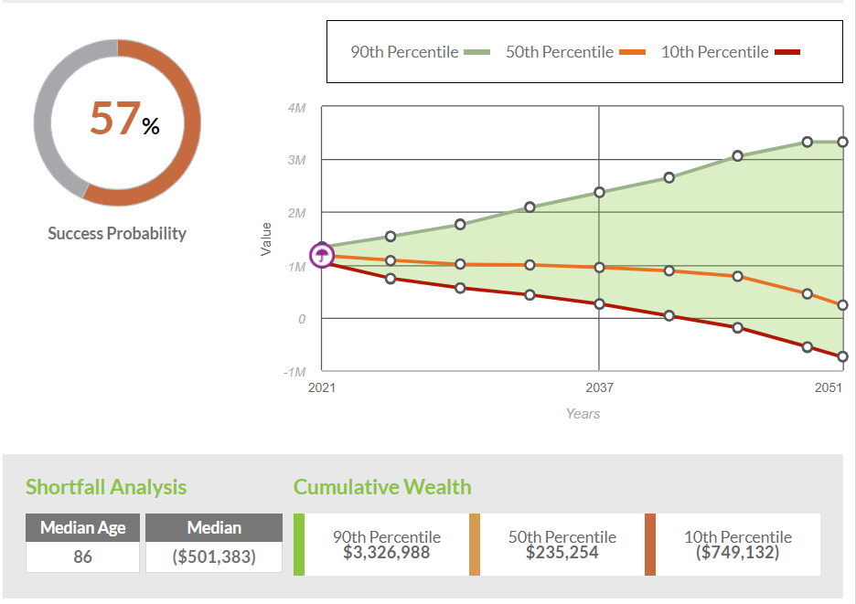
Notes:
When we put all of John and Jane’s information in our retirement software, which runs probability analysis, we learned that based upon their current planning (turning on Social Security at full retirement age and investing in a balanced portfolio), they would have a 57% chance that their money would last for their expected lifetimes.
How would you feel about that percentage if this were you? Would you be comfortable going into retirement knowing that you have about a 57% chance of your money lasting and about a 43% chance of it running out?
Probably not too confident, right? Let’s see if we can help John and Jane out a bit.
(PRESENTER NOTE: These hypotheticals — slides 22-27 — were generated with the software inStream.)

Slide 23
STEP 1 – OPTIMIZE SSI BENEFITS
Jane begins benefits based on her earnings record in the estimated amount of $1,185 at age 67
John begins benefits based on his earnings record in the estimated amount of $3,293 at age 70
When John begins drawing his benefits, Jane can add spousal benefits, increasing her total estimated amount to $1,260
Notes:
The first thing we need to do is to optimize their Social Security benefits. Using advanced Social Security planning software, and given John and Jane’s situation, it turns out that they should take the following approach.
Jane should begin to take her Social Security benefits based on her record when she reaches her full retirement age, age 67. This is exactly what she was planning on doing anyway. But this is where things change up a bit.
In this example, John should wait to take his benefits until he hits age 70. This way he can get the largest benefit possible.
Once John starts taking his benefit, Jane would automatically receive the larger spousal benefit based on John’s record (50% of John’s full retirement age benefit of $2,520).
Let’s see if this helps them out at all.

Slide 24
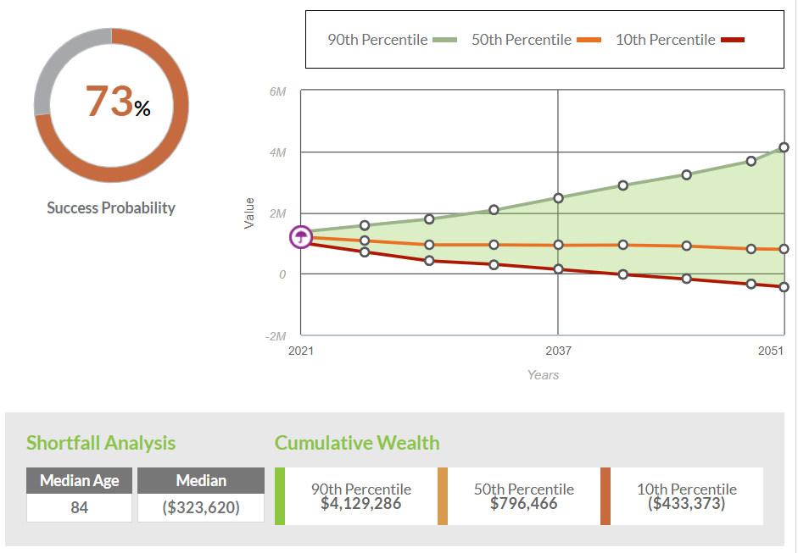
Notes:
Wow! That’s a pretty big jump for simply changing how they choose to take their Social Security benefits! That one decision moved them up from a 57% chance of their money lasting up to a 73% chance. We are moving in the right direction here!
Still, how comfortable would you be to go into your retirement knowing you have a 27% chance of running out of money? It’s better, but it still isn’t quite what we would want to see. What else could we do to help John and Jane better plan for their retirement?

Slide 25
STEP 2 – OPTIMIZE PORTFOLIO
Reposition portfolio assets with the goal of maintaining returns while, more importantly, reducing volatility (risk)
This hypothetical example is for illustrative purposes only, should not be deemed a representation of past or future results and is no guarantee of return or future performance.
Notes:
The next step is to optimize their retirement portfolio, similar to how we optimized their Social Security planning.
Investing during retirement is very different from investing while you are working. John and Jane had a fine portfolio for when they were working, but we can do better for their retirement.
Specifically, John and Jane need to reallocate their portfolio to reduce their volatility. This means that they need to create a portfolio that delivers more consistent returns over time. They don’t necessarily need a higher rate of return, just one that comes with less variance.
Obviously, designing a lower volatility portfolio will be different for everyone. This needs to be handled on a case-by-case basis.
For John and Jane, let’s assume that we are able to develop an investment plan that maintains their expected average return but cuts their variance in half. How would that help them?

Slide 26
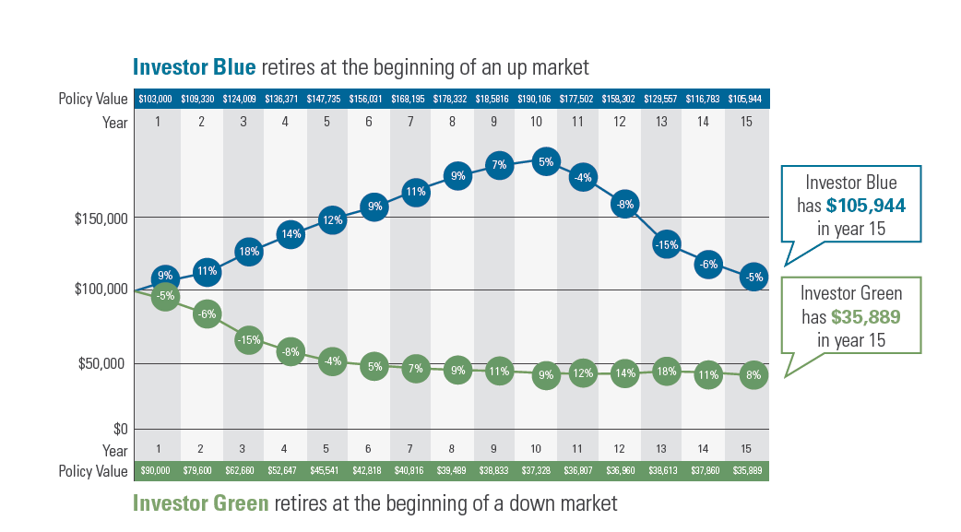
SEQUENCE OF RETURNS RISK
*The hypothetical illustration does not represent the results of an actual investment. It does not reflect any investment fees, expenses or taxes associated with investments. An average annual return of 4% is reflected for both investors. Annual withdrawals of $5,000 are taken at the end of each year.

Slide 27
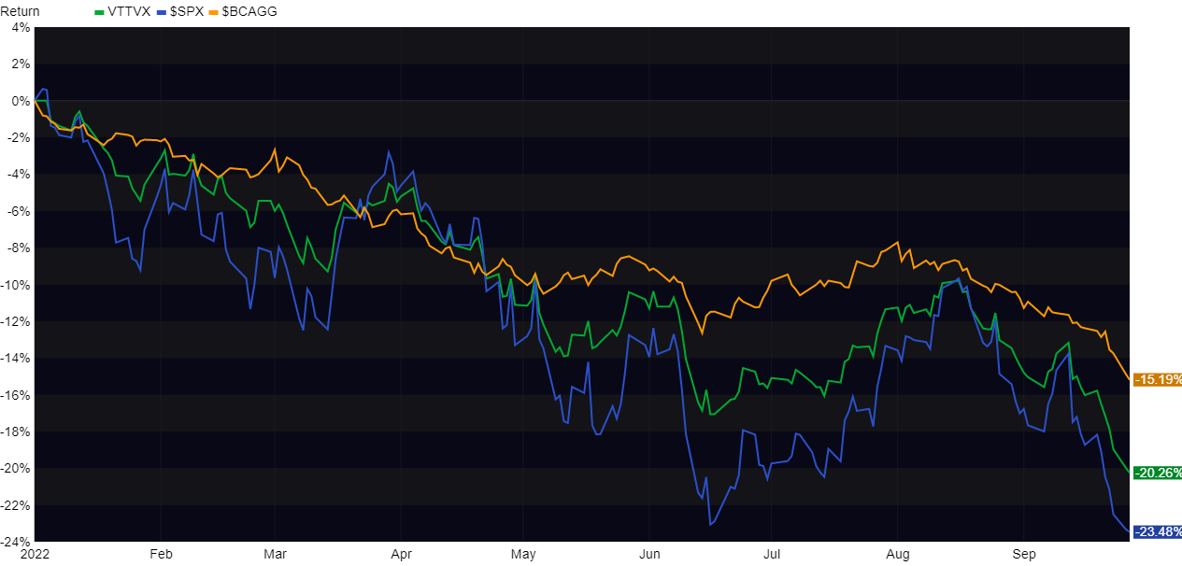
YTD PERFORMANCE

Slide 28
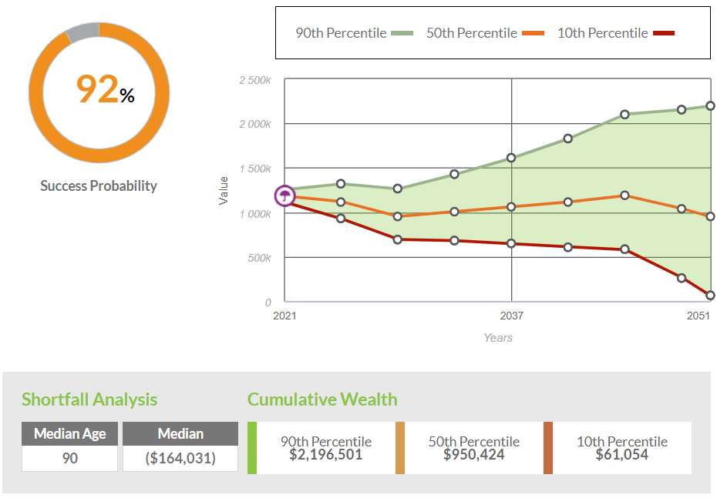
Notes:
Now we are talking! By combining the improvements of their Social Security planning and their investment planning, we are able to dramatically increase the probability that their money will last for their lifetimes. We have moved from 57% probability to 73% to now 92% probability that their money will last through retirement.
This looks much better and gives John and Jane significantly more confidence going into their retirement.

Slide 29
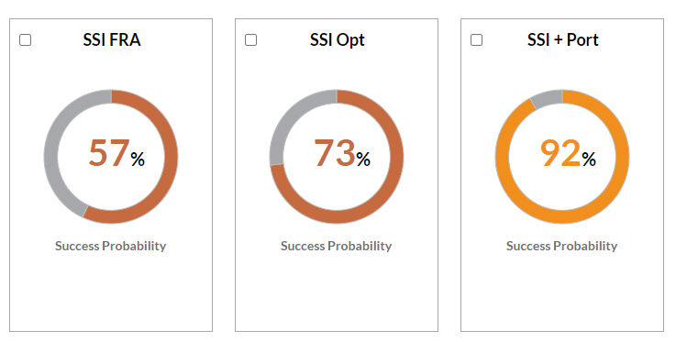
Notes:
What do you think? Did John and Jane benefit from coming to visit us to evaluate their planning options? What about you? What is your current probability of success with your planning? Would making some changes with your Social Security claiming strategy help improve your outcomes? Would updating your investment strategies and/or changing your asset allocation help?

Slide 30
RECAP
How you choose to take your Social Security benefits may be more complex than you first thought.
Many factors come into play, including your marital status, health/longevity, retirement savings, etc.
It’s important that you consider ALL factors BEFORE making decisions on when to claim your Social Security benefits. Our firm can help put the Social Security claiming decision in context with the entirety of your retirement income strategy.
Notes:
I want to recap this a little bit. We talked about some general information on how your Social Security retirement benefits work. Remember, you take it early and your benefits may be reduced; you take it later and your benefits may increase, depending on your full retirement age. And your longevity plays a key role in what makes the most sense. We talked about how to potentially get the most out of your Social Security retirement benefits. We have a tool available to help you time your Social Security payments and potentially enhance your overall retirement income.
When you look at your overall retirement income strategy, which is unique to every individual, sometimes seeking to maximize Social Security benefit payments is not a strategy that meets your goals.
Folks, this is why planning for retirement income is so important, isn't it? Because you have to understand how all of these factors interrelate so that you can get an outcome that helps you meet your goals. And each one of you in this room is different from the person sitting beside you. That's why it's so important.

Slide 31
THE THREE-LEGGED STOOL
Retirement
Savings
(Deferred Comp, IRAs, Real Estate, Brokerage Accounts)
Social
Security
Pensions
(Employer-provided and/or annuities)
Notes:
You are probably interested in helping to increase your Social Security benefits, but we all need to remember that it is just one leg of a three-legged stool for our retirement income. All three legs need to work together to have a solid retirement income strategy. And if your pension isn’t enough to cover all of your expenses, there are there are strategies to carve out some of your retirement savings to ensure that you can fill the gap for as long as you need.

Slide 33
YOUR NEXT STEP
Click here to schedule a 1-1 consultation via phone or virtual meeting to receive your complementary Social Security optimization analysis*
*Please specify “CABQ” in the notes field
Please complete this fact finder and return to jblack@strategyfinancialgroup.com at least one day prior to your appointment
*Initial consultations and Social Security analyses are offered at no cost or obligation to purchase any products or services or work with Strategy Financial Group. Strategy Financial Group does offer products and services for a fee and/or commission.
Notes:
[Read slide]

Slide 34
FOR JOINING! QUESTIONS?
Notes:
Thanks for coming! Thanks for your time; hope you find it helpful. Go talk to the folks in the back.

