Slide 1
Senior Affairs Point of Sale System Memberships Training Course
Section 6
Alternate DSA Membership Eligibility/Linking in Point of Sale System- Special Codes
Revised December 28, 2016

Slide 2
DSA Memberships Course-Section 6 Alternate Membership Eligibility/Linking in Point of Sale System- Special Codes
Scenario: Under AAA and DSA guidelines, there are certain instances where a person qualifies for the same benefits as eligible seniors. Review alternate eligibility criteria below:
Scenario | Alternate Membership Eligibility/System Meal Special Code | Membership Card Color/Benefits
Spouse under 60 years of age | Eligible for lunch on a donation basis-needs to fill out a SAMS form and be entered into the SAMS system. (32AGSpouse) | Same card banner age eligibility color as qualified senior. Eligible for Title III congregate meal. A spouse under 60 is also eligible to participate in Activities/Trips, etc. with qualified senior present.
Disabled child living with qualified senior 60+ | Eligible for lunch on a donation basis - needs to fill out SAMS form and enter into the SAMS system. (32AGDISWE) | Same card banner age eligibility color as qualified senior. Eligible for Title III congregate meal. A disabled child living with a qualified senior under 60 is also eligible to participate in Activities/Trips, etc. with qualified senior present.
For this process, you will begin by following the same steps as creating a New Membership. (Refer to Section 4 New Membership process for screenshots)

Slide 3
DSA Memberships Course-Section 6 Alternate Membership Eligibility/Linking in Point of Sale System- Special Codes
Membership> Member New >Select Appropriate Age Option> Set Guest
Enter the following information for the eligible member (Please Refer to section 3-New Membership process for screenshots):
Birth Date- Age Calculated Automatically
Zip Code
Phone Number
Address
Email
Enter SAMS Access Information Number- 1 + Birthdate (mm/dd/yy) Enter SAMS Access Information Number(Addit No) – 1+Birthdate (dd/mm/yy) e.g. Birthday 01/07/1937, Last four of SSN: 1234: AdditNo = 10107371234
Save – Return to main screen.
“Pass Ready” Must be visible

Slide 4
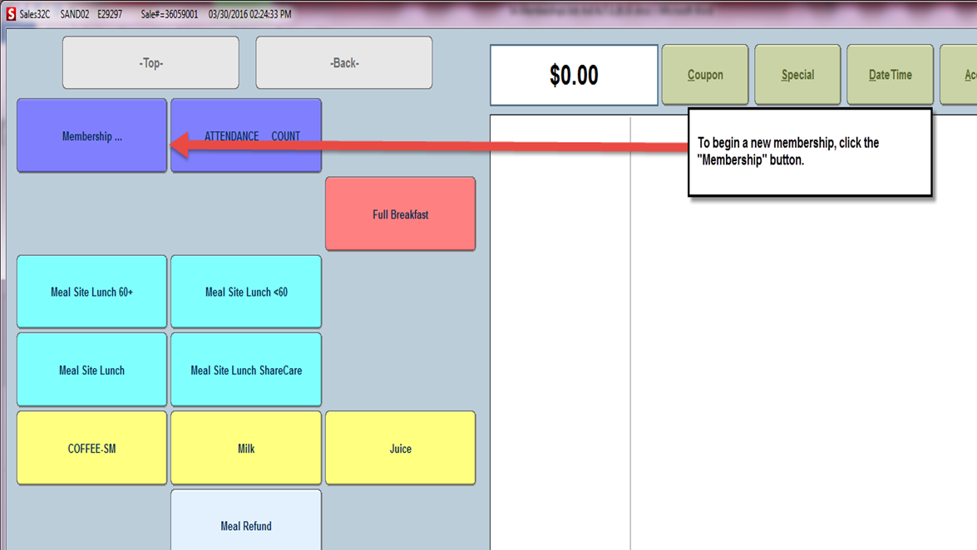
DSA Memberships Course-Section 6 Alternate Membership Eligibility/Linking in Point of Sale System- Special Codes
To begin a new membership, click the “Membership” button

Slide 5
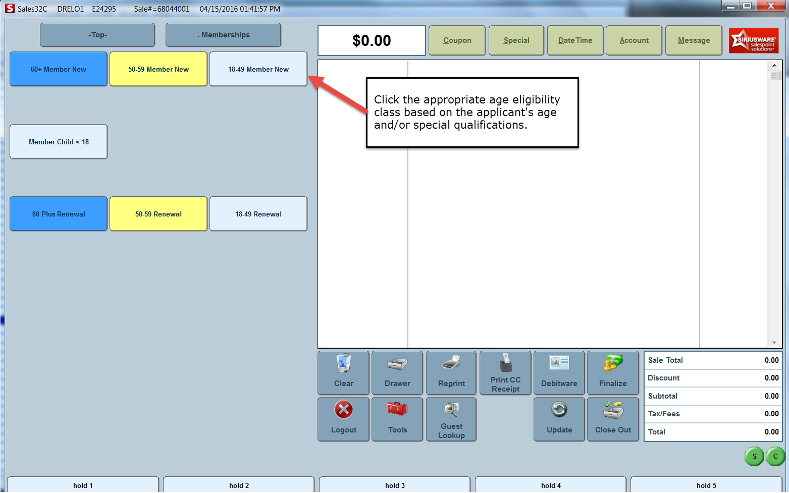

Slide 7
DSA Memberships Course-Section 6 Alternate Membership Eligibility/Linking in Point of Sale System- Special Codes
From the main screen you will now enter the Qualified Child or Spouse info (Follow steps in Issuing a New Membership Section 4):
60+ (Same as Qualified member to ensure the correct card color is printed) > Special> Select the correct Special Code> Click “Okay”>Set Guest > Enter the following information of the qualifying person
Birth Date- Age Calculated Automatically
Zip Code
Phone Number
Address
Email
Enter SAMS Access Information Number(Addit No) – 1+Birthdate (dd/mm/yy) e.g. Birthday 01/07/1937, Last four of SSN: 1234: AdditNo = 10107371234
Save – Return to main screen.
“Pass Ready” Must be visible

Slide 8
DSA Memberships Course-Section 6 Alternate Membership Eligibility/Linking in Point of Sale System- Special Codes

Slide 9
DSA Memberships Course-Section 6 Alternate Membership Eligibility/Linking in Point of Sale System- Special Codes
Enter required member information in the indicated fields: First Name Last Name Date of Birth Phone Number Address
A
Click the “New Photo” button to take the member’s photo with the camera attached to the ELO screen at the front desk
B

Slide 10
DSA Memberships Course-Section 6 Alternate Membership Eligibility/Linking in Point of Sale System- Special Codes

Slide 11
DSA Memberships Course-Section 6 Alternate Membership Eligibility/Linking in Point of Sale System- Special Codes
Disabled child living with a qualified Senior that is 60+
Spouse under sixty years of age with qualified senior
Click the “OK” button after selecting the appropriate eligibility special code.

Slide 12
DSA Memberships Course-Section 6 Alternate Membership Eligibility/Linking in Point of Sale System- Special Codes
Process Payment: Click the Finalize button to process the transaction and collect payment in the Siriusware System.
Test Cards: Ensure that both of the cards are printed with the same appropriate age eligibility color (White 18-49, Yellow 50-59, Blue 60+) work by swiping them each through both the Siriusware and SAMS systems.

Slide 13
DSA Memberships Course-Section 6 Alternate Membership Eligibility/Linking in Point of Sale System- Special Codes
Congratulations! You have completed Section 6- Alternate Membership Eligibility/Linking in Point of Sale System – Special Codes for the DSA Memberships Course

