Slide 1

Department of Senior Affairs point of sale system Memberships Training Course
Section 1
An Overview of Siriusware & SAMS Software Applications Systems-Self-Paced Course
Revised December 6, 2016

Slide 2
DSA Memberships Course
Section 1-Siriusware & SAMS Software Applications systems
Goals and Objectives of Section 1:
  Through this DSA Membership Course Section 1, you will understand the difference between the Siriusware and SAMS systems and how to process transactions in the point of sales system and understand the congregate lunch meal tracking process for DSA in SAMS.

Slide 3

DSA Memberships Course
Section 1-Siriusware & SAMS Software Applications systems
What is Siriusware and what is SAMS? Siriusware and SAMS are separate software application systems utilized by DSA to issue memberships, process various point of sales transactions and capture information for the Area Agency on Aging (AAA) Federal reporting requirements. Each system is housed on its own computer at the front of each DSA facility.
Siriusware Computer
SAMS Computer

Slide 4
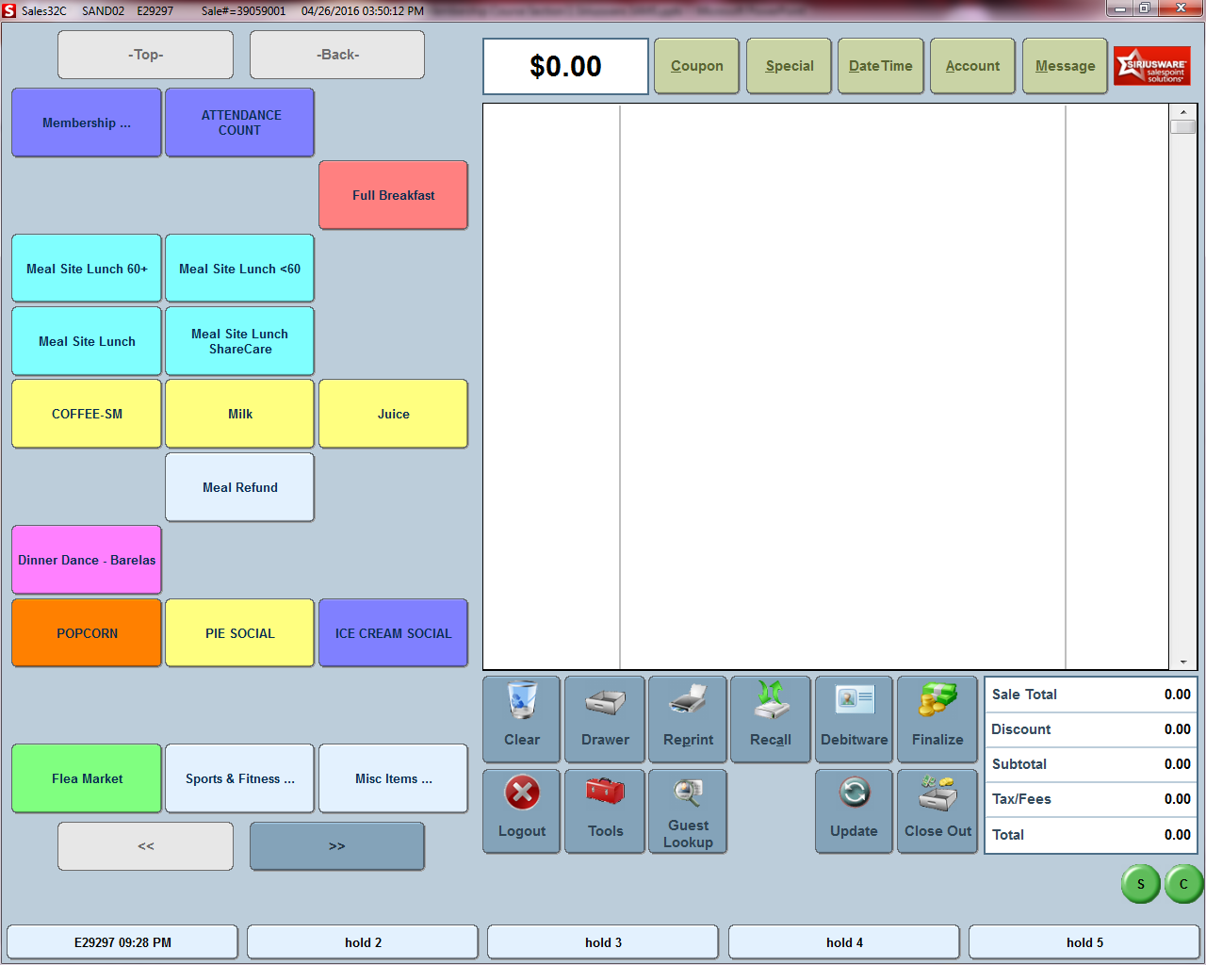

DSA Memberships Course
Section 1-Siriusware & SAMS Software Applications systems
What is Siriusware?
  Siriusware is the Point of Sales system application of record for the City of Albuquerque Department of Senior Affairs and is used to issue and renew memberships, print and reprint membership cards and process point of sales transactions.

Slide 5
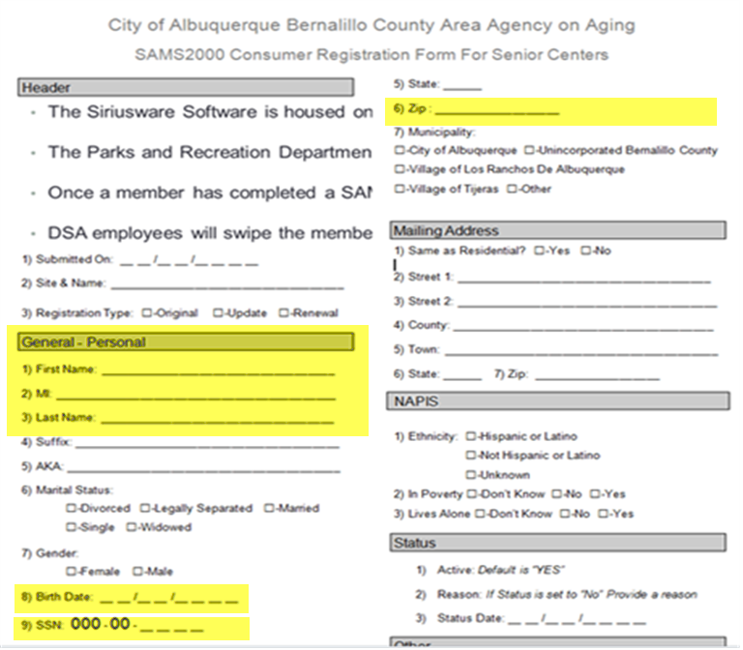
DSA Memberships Course
Section 1-Siriusware & SAMS Software Applications systems
What is the Social Assistant Management System (SAMS)?
  SAMS is the Reporting System for Qualifying Services for the Area Agency on Aging Activities. Member information, meals, activities and other items are tracked in SAMS for federal reporting and funding requirements for 60+ members who have filled out a SAMS form and have been entered into the SAMS system.
  SAMS/DSA Membership Form: The highlighted areas on the SAMS/DSA Membership form are required to be entered into the SAMS system.
SAMS/DSA Membership Form

Slide 6
DSA Memberships Course
Section 1-Siriusware & SAMS Software Applications systems
  Once a member has completed a SAMS/DSA membership form, their information is entered into the Siriusware system to create their Membership and Membership Card.
  *If the member is 60+ years old, the same member information that is entered in the Point of Sales system must be entered in the SAMS system PLUS additional information based on AAA requirements to create a member profile for case review and to determine AAA federal reporting qualifications

Slide 7
DSA Memberships Course
Section 1-Siriusware & SAMS Software Applications systems
  The Siriusware Software is housed on its own computer with its own:
    Card Swipe Hardware (to swipe membership cards)
    Camera Hardware (to take member pictures) and
    Printer Hardware (to print membership cards)
  The Siriusware point of sales software system is on a computer at the front desk of DSA facilities next to, but separate from the SAMS application computer.
  *The Parks and Recreation Department also uses the Siriusware system to issue their own membership cards for golf activities.

Slide 8
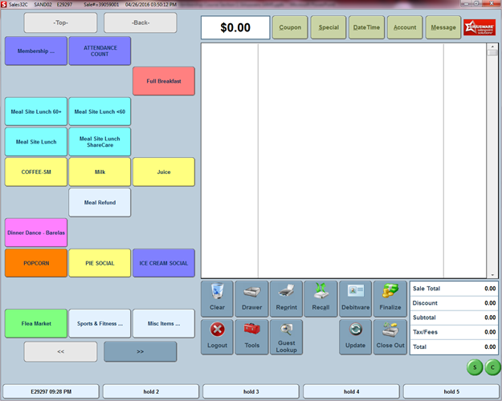

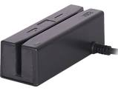

DSA Memberships Course
Section 1-Siriusware & SAMS Software Applications systems
  DSA Membership Card Use: Once a member has a membership card, DSA employees will swipe the membership card through the Card Swipe Hardware on the Siriusware computer system to process transactions for meals, trips, activities, etc. when a member visits a DSA facility.

Slide 9

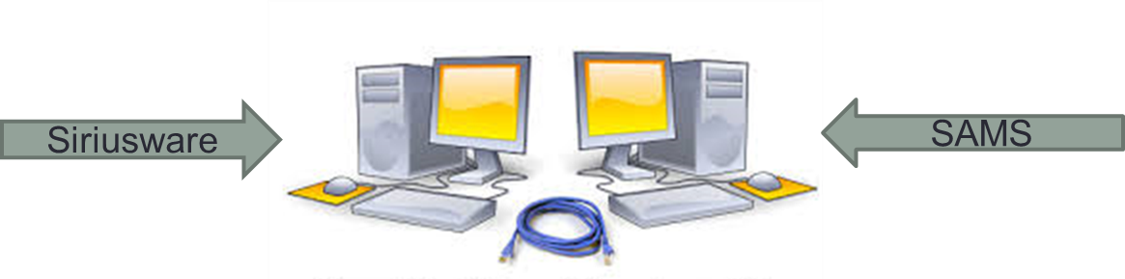
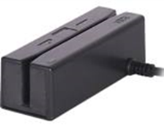


DSA Memberships Course
Section 1-Siriusware & SAMS Software Applications systems
  Process Transactions in Siriusware and Track eligible activities in SAMS: Some transactions for qualifying congregate meals (lunch) and activities will need to be run through both Siriusware and SAMS systems depending on the member’s age and eligibility qualifications.

Slide 10

DSA Memberships Course
Section 1-Siriusware & SAMS Software Applications systems
Congratulations! You have completed Section 1- Overview of the Siriusware and SAMS applications systems for the DSA Memberships Course.

