Slide 1
Human Resources, Insurance and Benefits Division
Open Enrollment FY27
Virtual Meeting

Slide 2
agenda
Welcome
Important Updates
Open Enrollment Dates and Information
What’s New
Questions
  open discussion

Slide 3
Important Updates
Lovelace Letter -Lovelace and BCBSNM are working on a new contract
The current contract ends June 1, 2026
Nothing changes right now
Updates will be shared as soon as possible

Slide 4
What Could happen
If no new agreement is reached:
  Lovelace may become out-of-network
  This would happen May 31, 2026, at midnight.
The City will offer a Special Enrollment Period (SEP)
Any plan changes will be backdate to June 1, 2026.

Slide 5
What can employees do?
Keep going to your doctor as usual
Search for in-network providers within your current plan
Wait and decide later during Special Enrollment if needed
If you are in active treatment:
  You may qualify for continuity of care.
  A form is required
  Approval is not automatic.

Slide 6
Open Enrollment
Takes place every April/May
Changes take effect on July 1st
You Can:
  Change Plans
  Enroll or cancel benefits
  Add or Remove Dependents
  Re-enroll in FSA benefits
Notes:
"Open Enrollment is a crucial time each year. It occurs every May. You can change your health plans, enroll or dis-enroll in benefits, add or remove dependents, and re-enroll in FSA benefits. Changes made during this period take effect on July 1st."

Slide 7
Open Enrollment Dates
  April 27th-May 15th to make changes
  12 meetings at 8 locations
    Introducing virtual meetings
    Two dedicated time slots have been reserved for enrollments in the computer lab.
    Enrollment/Health Fair at Convention Center
    Health screenings and dental cleanings!
  Employees get 2 hours PLO to attend any meeting - approved by CAO
  Meeting Schedule, Parking Voucher, and PLO Memorandum posted on eWeb

Slide 8
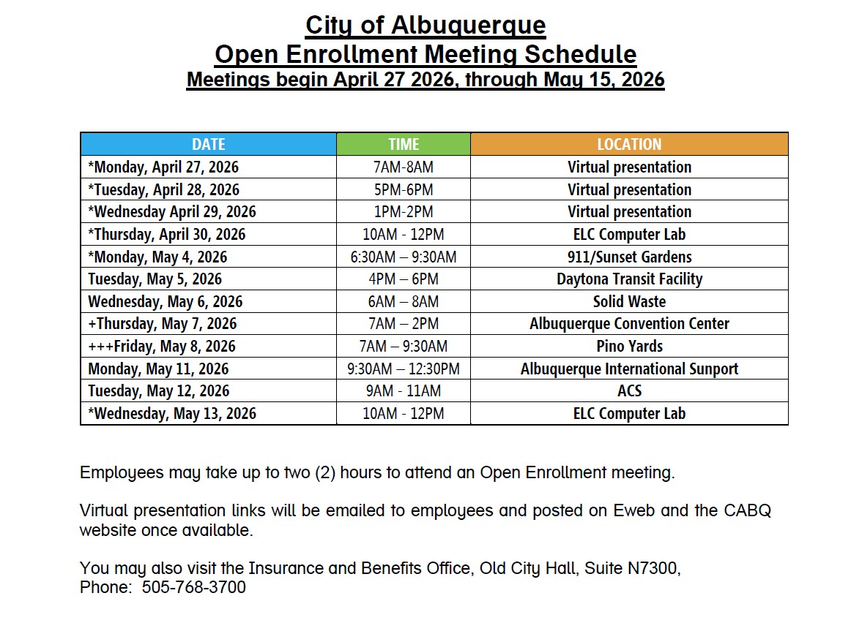

Slide 9
What’s New - Dental
Moving to self-funded dental
Positive Enrollment
    Blue Care Dental:
    No change to premiums
    Delta Dental:
    New Option
    About 10% higher premiums

Slide 10
What’s New - GYM
Gym Benefit
Positive Enrollment
    $25 imputed tax is eliminated
    $5 employee deduction

Slide 11
What’s New - FSA
Medical
    New annual maximum from $3,300 to $3,400
    Rollover Increased from $660 to $680
Daycare
    New annual maximum from $5,000 to $7,500
    REMINDER – New Mexico has Universal Childcare
Parking
    New monthly maximum from $325 to $340

Slide 12
What’s New- Medical Changes
    Copays and prescription costs are increasing
 | Previous | New
Inpatient copay | $500 | $750
Outpatient copay | $500 | $750
ER copay | $200 | $300
Urgent Care copay | $50 | $65
PCP/SCP copay | EPO -$35/$50 PPO -$40/$55 | EPO- $35/$60 PPO - $40/$60
Behavioral Health copay | $0 | $35
RX copay | $10/$30/$50 | $15/$40/$65
    Remove GLP-1s for weight loss

Slide 13
Medical premiums
    Medical premiums are increasing slightly per pay check
Tier | Employee FY2026 | Employee FY2027 | City FY2026 | City FY2027 | Total FY2026 | Total FY2027
Single | $59.15 | $63.56 | $236.61 | $254.35 | $295.76 | $317.94
Couple | $120.35 | $129.38 | $481.42 | $517.52 | $601.77 | $646.90
S/Parent | $95.02 | $102.14 | $380.07 | $408.58 | $475.09 | $510.72
Family | $173.70 | $186.72 | $694.78 | $746.90 | $868.48 | $933.62
Bi-Weekly Medical Premium Deduction
Bi-Weekly Medical Premium Deduction

Slide 14
Dental premiums
    Blue Care Dental premiums stay the same
    Delta Dental will cost a little more per pay check
Tier | Employee FY2026 | Employee BCBS FY2027 | Employee Delta FY2027 | City FY2026 | City BCBS FY2027 | City Delta FY2027 | Total FY2026 | Total BCBS FY2027 | Total Delta FY2027
Single | $2.89 | $2.89 | $3.18 | $11.56 | $11.56 | $12.71 | $14.45 | $14.45 | $15.89
Couple | $5.84 | $5.84 | $6.43 | $23.38 | $23.38 | $25.71 | $29.22 | $29.22 | $32.14
S/Parent | $6.42 | $6.42 | $7.06 | $25.68 | $25.68 | $28.25 | $32.10 | $32.10 | $35.31
Family | $8.69 | $8.69 | $9.56 | $34.76 | $34.76 | $38.24 | $43.45 | $43.45 | $47.80
Bi-Weekly Medical Premium Deduction

Slide 15
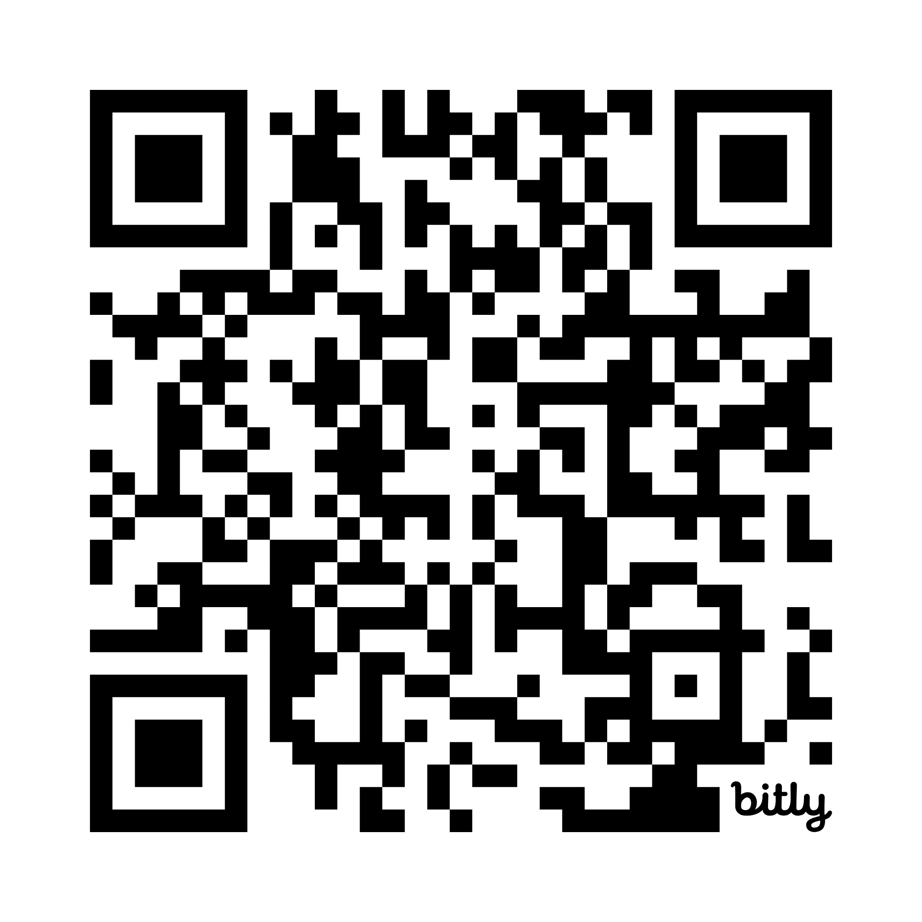
Contact information
7th Floor – North City Hall
505-768-3700 or 311
Email: employeebenefits@cabq.gov
Refer to cabq.gov/humanresources/employee-benefits
for schedule and details.
Notes:
"If you have any questions, you can reach the Human Resources, Insurance and Benefits Division on the 7th Floor of North City Hall. Our phone number is 768-3700 or you can dial 311. You can also email us at employeebenefits@cabq.gov or visit our website at cabq.gov/benefits. The back pages of your benefit guide include websites and phone numbers for all vendors."

Slide 16
Open Discussion
Questions?
We are here to help.

Slide 17
Thank You

