Slide 1
Gibson Health Hub
Community Input Session, June 10, 2021

Slide 2
Welcome and thank you for being here!
Notes:
Welcome! About 75 people here with us today.

Slide 3
Carol pierce
Director, Family and Community Services
City of Albuquerque
Notes:
Here today to talk about Gibson Health Hub
This is our 6th community meeting since acquiring Gibson Health Hub.
We have appreciated and received a lot of valuable community feedback to date.
The purpose of today’s meeting is to obtain community feedback as required by R-21-141.
This meeting is NOT related to conditional use – will talk about an upcoming conditional use related meeting later in the presentation.
Hand outs sent earlier today, please review as these address some of the myths floating in the community.

Slide 4
Dr. peter M. belletto
Vice President, SE Heights Neighborhood Association
President, District 6 Coalition
Notes:
The shelter will not replace or replicate existing services in our community.
The shelter will not be a “one stop” shop
Instead, it will be integrated with and link people to the system of services that are already available in the community

Slide 5
Agenda
4:30 p.m. Welcome
4:35 p.m. Plenary
5:00 p.m. Transition to Breakout Rooms
5:10 p.m. Instructions
5:20 p.m. Session: Safety
5:40 p.m. Session: Entry and Exit
6:10 p.m. Break
6:20 p.m. Session: Overnight Capacity
6:50 p.m. Evaluation and Follow up
7:00 p.m. Adjourns
Notes:
To start with, we will share some information with you about our vision for the Gibson Health Hub
Then we will break into 5 breakout sessions
Each breakout session will cover the same three topics: safety, entry/exit and overnight capacity

Slide 6
Today’s Objectives
Collect input on the 3 core operational components identified R-21-141
Health Hub neighbors provide input into key operational elements of the Gibson Health Hub that will inform the Good Neighbor Program

Slide 7
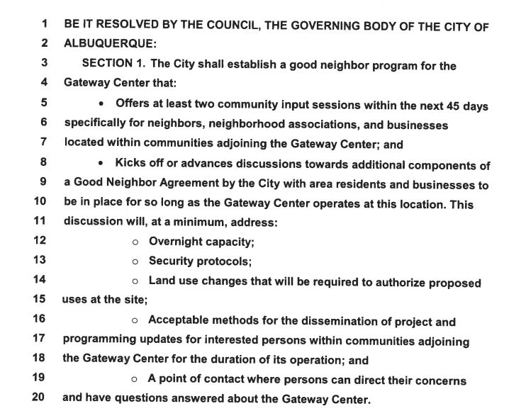
R-21-141

Slide 8
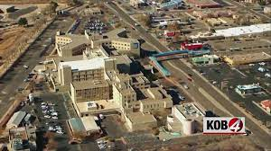
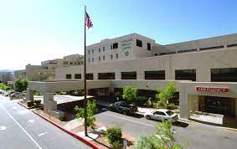
Gibson Health hub
Notes:
Acquired Gibson Medical Center on April 1, 2021
Now calling this facility our Gibson Health Hub
570,000 square feet - Old and New City Hall can fit into Gibson Health Hub

Slide 9
Gibson health hub Vision
To provide health services to the surrounding community that promote healing and recovery, including but not limited to primary care services, inpatient treatment, behavioral health services, and shelter and services for people without homes.

Slide 10
Current Tenants at Gibson health hub
Behavioral Health Services
Haven Behavioral Health
Optum
Turquoise Lodge
Zia Community Health
Employment
NM Dept. of Vocational Rehabilitation (employment training/services for individuals with disabilities)
Medical Care
AMG (long term acute care)
Fresnius Medical Care (dialysis and kidney services)
Optum (endoscopy and gastroenterology)
Other
Blue Stone
Sandia Labs
Notes:
10 existing tenants, 8 of whom are providing health-related services
Gibson is ALREADY a health hub for the community – we are expanding/strengthening that role

Slide 11
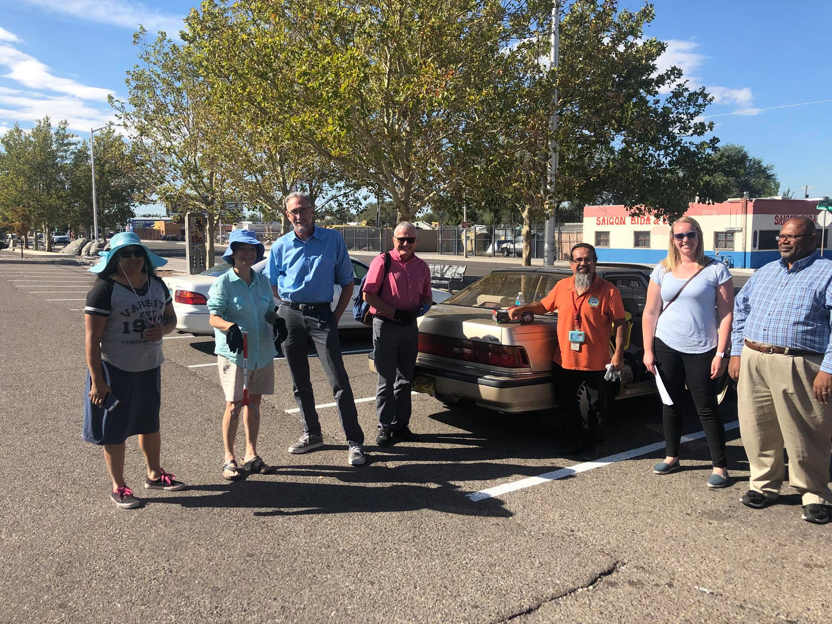
The history
Enrique’s Story
Notes:
Core points:
Enrique felt loss for himself and family when Lovelace Hospital relocated in 2000.
Family had gone there for health services, including optometry, behavioral health services over the years
This densely populated neighborhood is underserved in terms of health services. People who live in the neighborhood need health services.
As response to the loss of services in the community, residents came together to create the SE Health Coalition. Today is the ID Health Communities Coalition which many of you are a part of.

Slide 12
Homelessness & health
At least 1,525 people are in shelters or on the streets each night in Albuquerque
At least 5,000 households experienced homelessness in 2020
Notes:
We know that there are many people without homes in the International District. In order for Gibson to be a true Health Hub to the full community, we must use this facility to help meet the needs of those experiencing homelessness.

Slide 13
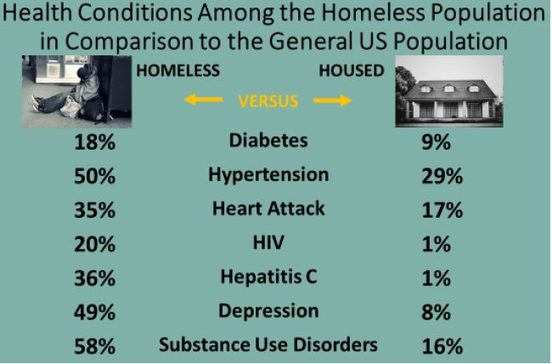
Homelessness & health
Source: National Health Care for the Homeless Council, https://nhchc.org/wp-content/uploads/2019/08/homelessness-and-health.pdf
Notes:
According to National Health Care for the Homeless Council, people who are homeless die 12 years sooner on average than those who are housed.

Slide 14
Medical respite at Gibson Health Hub
Medical Respite at Gibson Health Hub will provide short-term medical care for patients without homes who are too ill to recover from a physical illness or injury while living in shelter or on the streets, but who are not sick enough to be in a hospital.
Notes:
KEEP IT SHORT – Don’t need to spend a lot of time on this one
Medical respite care is “acute and post-acute medical care for patients experiencing homelessness who are too ill or frail to recover from a physical illness or injury while living in shelter or on the streets, but who are not sick enough to be in a hospital.”
A common example is a skin infection, which is easy to treat under the right conditions but can be deadly if not cared for properly.
While are some social medical respite beds in Albuquerque there is an identifiable need for additional options.
Medical respite not only keeps people healthy, it also takes the strain off of ERs for return for preventable issues.
Medical respite will provide a path to services and housing.
NOT Emergency shelter or long term care

Slide 15
The gateway at Gibson health hub
The Gateway at Gibson Health Hub will promote healing and recovery for people without homes by providing safe, dignified emergency shelter with robust, wrap-around services that help Gateway guests exit to stable, permanent housing and other community resources.
Notes:
Gateway Center will be ONE component of the Gibson Health Hub, and is aligned with the larger vision of a facility that promotes health, healing and recovery for our community.

Slide 16
The gateway center
Behavioral Health Services
Medical Care
Links to Permanent Housing
Case Management Services
Employment Services
Part of a comprehensive, community system that provides individuals with supports that link them with health care, employment and permanent housing
Gateway Center
Notes:
The Gateway Center at GMC is another piece in the comprehensive system of care we have been building for the past few years. We know this won’t end homelessness by itself but, in combination with other locations in the community and the right supports, it is a step in the right direction.
The City is also investing in other parts of that system. For example, funding for supportive housing has increased by almost 45% since FY18.
The City is investing $14 million in new dollars in affordable in FY22 of which some will be used to help house people staying at Gateway at Gibson Health Hub

Slide 17
The gateway at Gibson health hub
Trauma-informed
On site supportive services, including case management and peer support
Individualized transition plan into stable housing, services and community resources
Notes:
$4 million available for operations and $3.5 million available toward maintenance and trauma-informed renovations.

Slide 18
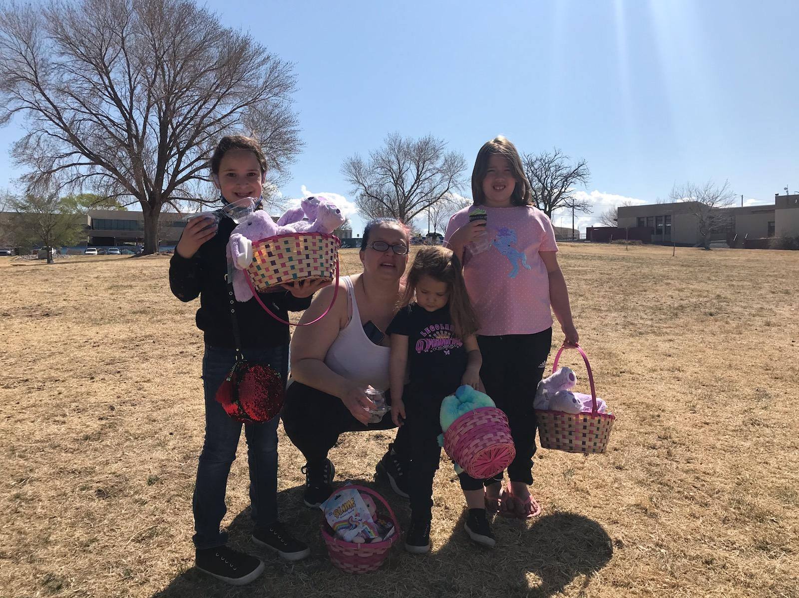
Cammie’s story
Notes:
Connection: Shows that safe emergency shelter with services they need can help put people on path to stable housing
Single mother of six children
Began experiencing homelessness off and on during her a 15-year abusive relationship
For 3 years, shuffled between houses of friends, relatives and her car
Health issues with the youngest child and hospitals stays made it hard to keep a steady job or a home.
After contracting COVID in October 2020, lost both her job and her car.
Through a school counselor, Cammie was connected to the WEHC and HCH
She got a job, a car, and the family received behavioral health services to process traumas
HOUSED: DATE
Shows that safe emergency shelter with services they need can help put people on path to stable housing

Slide 19
Gateway Center at Gibson Health Hub - Operational components
Services
Supportive staffing needs (case managers, peer support specialists, etc)
Staff to client ratio
Meals for overnight Gateway clients
Crisis response
Policies
Intake process to shelter (referred, just walk in, time, appt.)
Entry and exits into and from Gateway
Wait list or first come, first serve
Behavioral rules (guest agreement)
Hospital discharges to Gateway
Access to Gateway services by community members not staying at Gateway
Neighborhood
Safety (within Gateway and surrounding neighborhood)
Infrastructure Improvements
Building exterior aesthetic and functionality
Other Operational Components
Overnight capacity
Operating hours
Emergency drop-off
Look at partners on transitions (hospitals, hotels, etc.)
Transportation to and from the Gateway (public transportation, shuttle, walk in, etc)
Phasing
Notes:
A robust operational plan is an important part of creating a Gateway Center that helps people get off the streets and into safe, stable housing with minimal impact on the neighborhood. As we move forward, we will be developing the full operational plan with input from the surrounding community and experienced service providers.
DON’T go into detail – just highlight the three elements we will be focusing on today: Safety, Entry & Exits and Overnight Capacity Why? Because required by R-21-141
Informed by community discussions including HCC, Homeless Services Committee, Homeless Advisory Council, neighborhood meetings. Informed by today’s meeting.

Slide 20
Community outreach
April-June 2021
    Neighborhood Associations
      Parkland Hills (April 27)
      Trumbull (April 28)
      D6 (May 17)
      South San Pedro (May 19)
      Elder Homestead (June 3)
      Siesta Hills (next week)
    Elected Officials
    Schools
    Service Providers
    Tenants
    Homeless Coordinating Council and committees
    Businesses
    Other Stakeholders
Notes:
A lot of the work for this project is really just beginning. We leaned heavily on community input during site selection and we will continue to seek it and use it—along with input from our service provider partners—as we flesh out the vision. These first meetings with neighborhoods and businesses surrounding the Gateway Center will just be the first of several opportunities to help shape this project. Going forward, you can expect more meetings and chances to share your thoughts– we plan to host meetings with neighborhood associations, coalitions and businesses to talk through each stage of the development process. We also anticipate needing to get a conditional use permit for this facility and that process also includes opportunities for community input. Any feedback gathered during that process will come back to us to use to inform the project but we will also make sure there are meetings and opportunities outside that process.

Slide 21
What’s Next
Conditional Use Process Facilitated Meeting
Tuesday, June 22, 2021, 5:30pm – 7:30pm, Zoom
RSVP at www.cabq.gov/unhoused
Incorporating Your Feedback
Good neighbor program
Operational Plan
Notes:
City must request and receive approval to provide overnight emergency shelter, which is considered a conditional use, at Gateway. The facilitated meeting is an opportunity for the community to discuss and ask questions about this. The community can request a facilitated meeting, and the City has already scheduled on.

Slide 22
Break outs
You will now be sent to your Zoom breakout room (you don’t need to do anything)
Each breakout room will cover the same 3 topics (Safety, Entry & Exit and Overnight Capacity)
Each breakout room will have an experienced facilitator, subject matter expert and a note taker
We will not reconvene as a large group at the end of the breakout sessions
You will receive a follow-up email with a link. Please click the link to evaluate this community meeting and to tell us the best way to communicate with you in the future.
Notes:
You will be sent to your pre-assigned Zoom room. You don’t need to do anything. If you aren’t automatically sent to a breakout room, just stay put and we will get you there.

Slide 23
Stay Connected:
cabq.gov/unhoused
GatewayInput@cabq.gov

