Slide 1
Albuquerque
Lobbyist System
Quick Start Guide

Slide 2
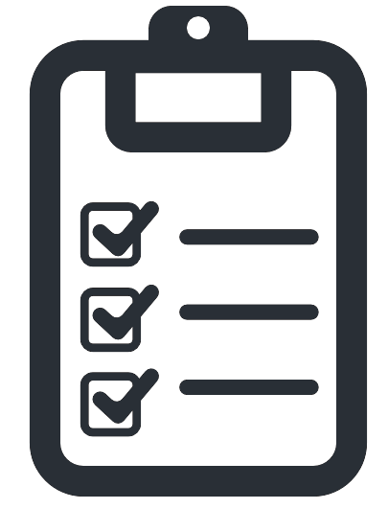
Agenda Overview
Part 1 – Existing User Sign in
Part 2 – New Lobbyist Registration
Part 3 – Using your account

Slide 3
Part 1 – Existing User Sign in

Slide 4
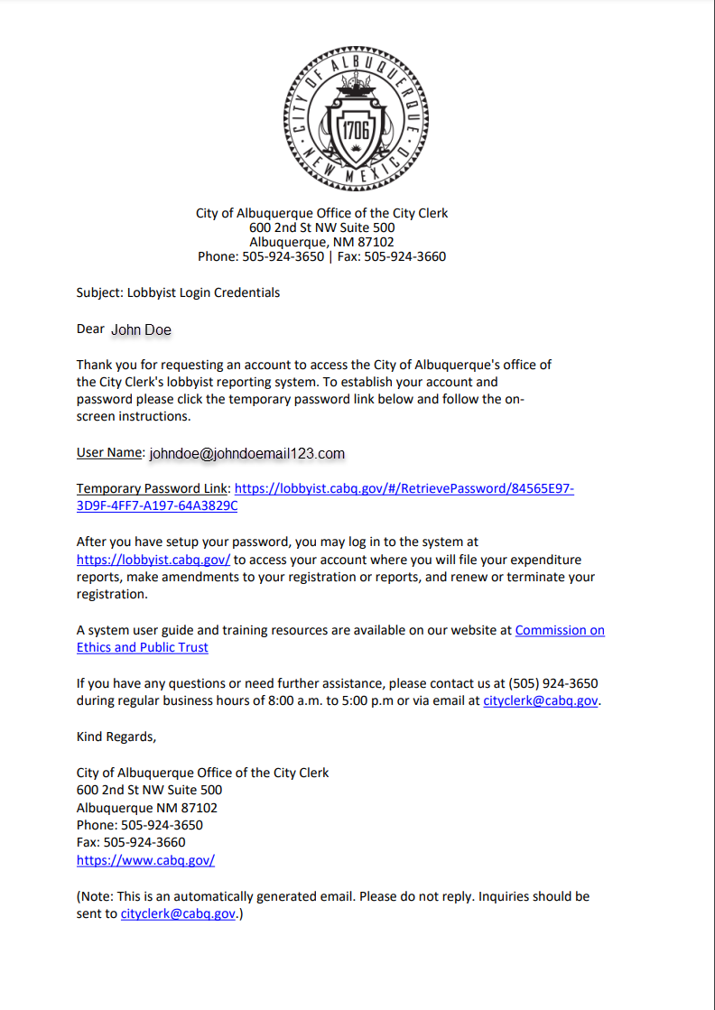
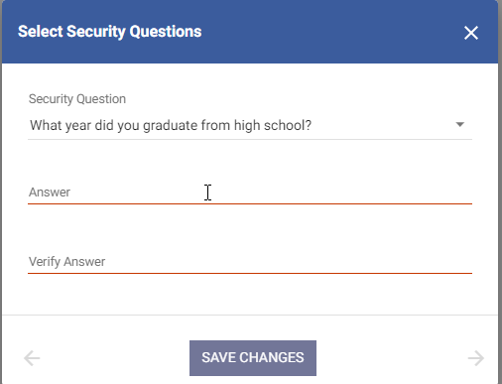
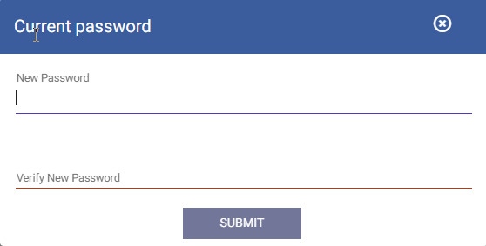
Part 1 Existing User Sign in – Account creation
Users already registered in the system with a valid email address will have received an email with a link to create credentials in the new system.
Your email address will serve as your username in the new system
Follow the Link to create a password in the email
System will prompt you to create answers to security questions and a new password.

Slide 5
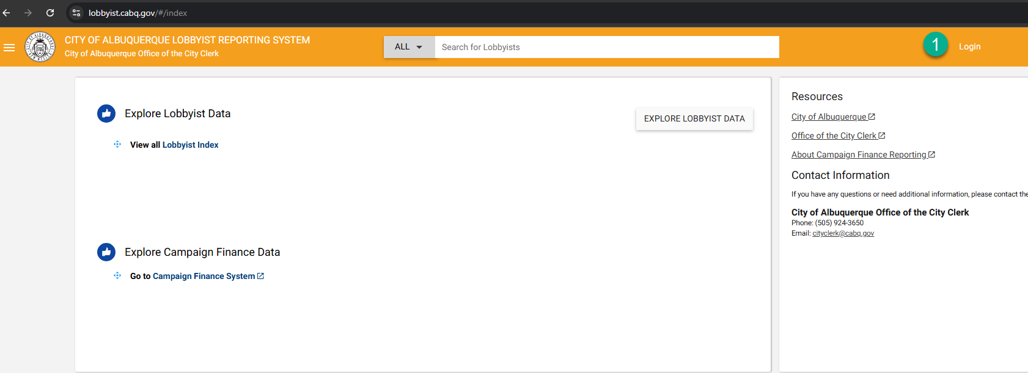
Part 1 Existing User Sign in – Login
Once you have created your security questions and password, you are ready to sign in from the public site. Follow the link to “Log In” from the top of the page.

Slide 6
Part 2 – New Lobbyist Registration

Slide 7
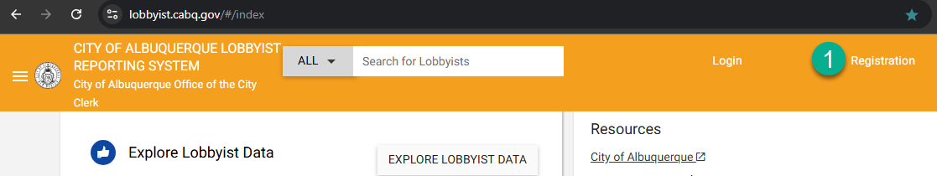
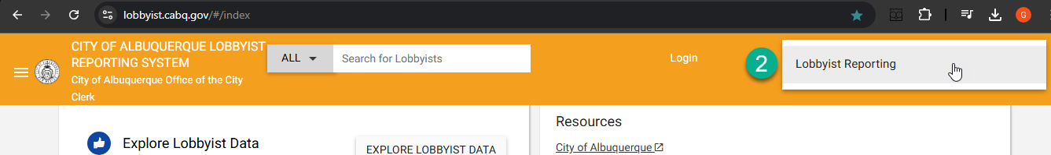
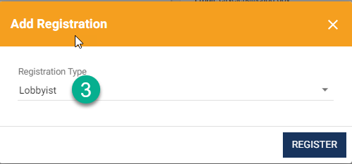
Part 2 New Lobbyist Registration – Public Site
From the Public site, you will select “Registration”
Choose “Lobbyist Reporting”
Choose Registration type “Lobbyist” and select button to “Register”

Slide 8
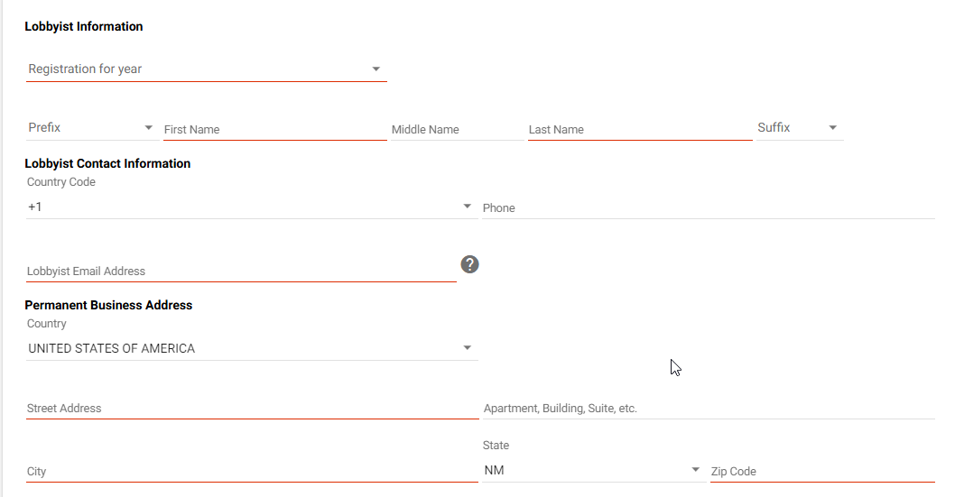
Part 2 New Lobbyist Registration – Information
Complete Lobbyist Information, Contact Information, and Address Info sections (Note email will be your username for login) and submit

Slide 9
Part 2 New Lobbyist Registration – Credentials Email
After you complete registration and are approved by an admin, the system will deliver a credentials email where you will set security questions and create a password. Once this step is complete, you are ready to log in to the application.

Slide 10
Part 2 New Lobbyist Registration – Signing in
Once Credentials and Password are set, you can log into the application by navigating to the Albuquerque Lobbyist Reporting System Home page and selecting “Login”.

Slide 11
Part 3 – Using your account
Lobbyists

Slide 12
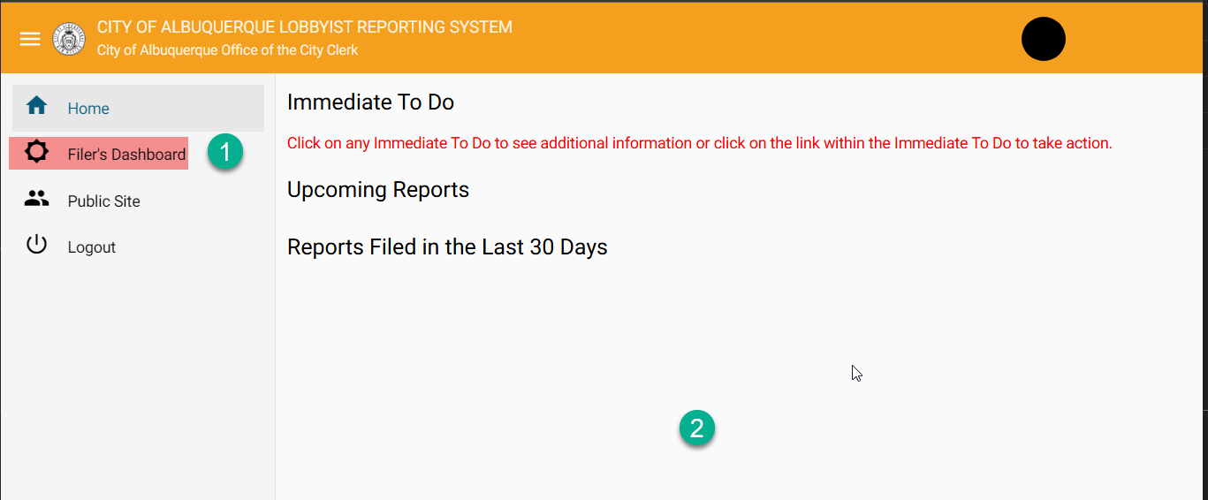
Part 3 Using your account (Lobbyists) – Home screen
Once Credentials are set, you can log into the application by navigating to the Albuquerque Lobbyist Reporting System Public page and selecting “Login”. The first screen you see is the Home Screen. You will want to navigate to the Filer’s Dashboard.
For lobbyist no information will be updated in this home screen section.

Slide 13
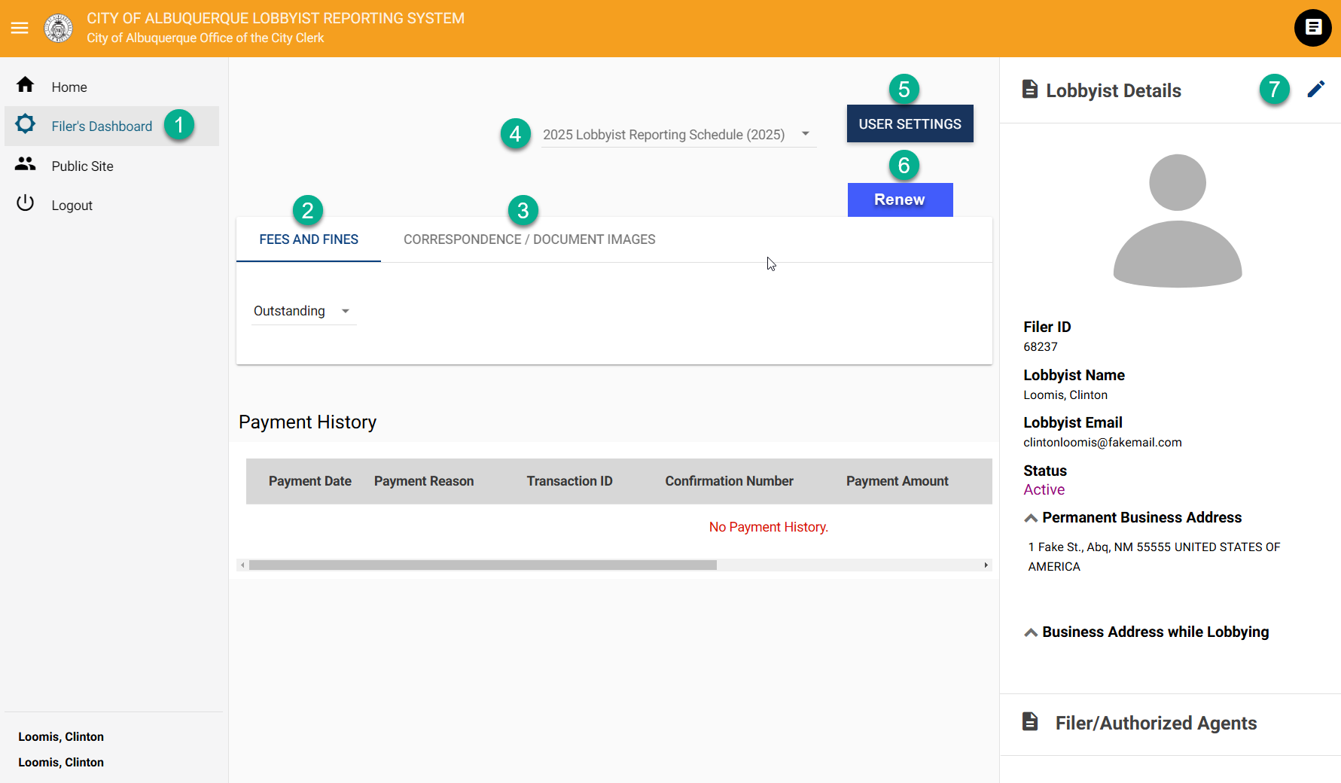
Part 3 Using your account (Lobbyists) – Filer’s Dashboard
The next option in the menu is Filer’s Dashboard, which contains important information and account controls
You can view and make payments on the Fees and Fines tab
Correspondence/Document Images – copies of email and where you will upload reports and forms
Filing year dropdown allows you to view info by year
User settings allows you to change password or security questions
Renew (when available) allows you to renew your registration
Amend (pencil icon) allows you to amend your registration. information

Slide 14
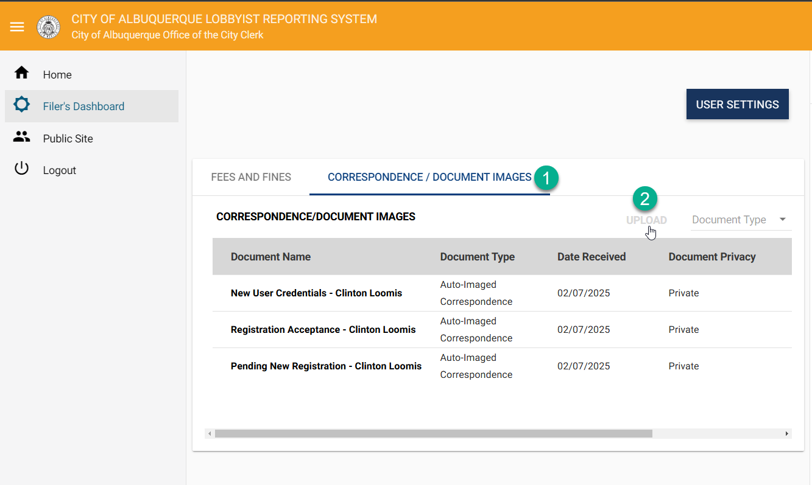
Part 3 Using your account (Lobbyists) – Uploading Reports and Forms
On Filer’s Dashboard, select Correspondence/Document Images tab. This is where you will be uploading your required reports/forms
Select “Upload”

Slide 15
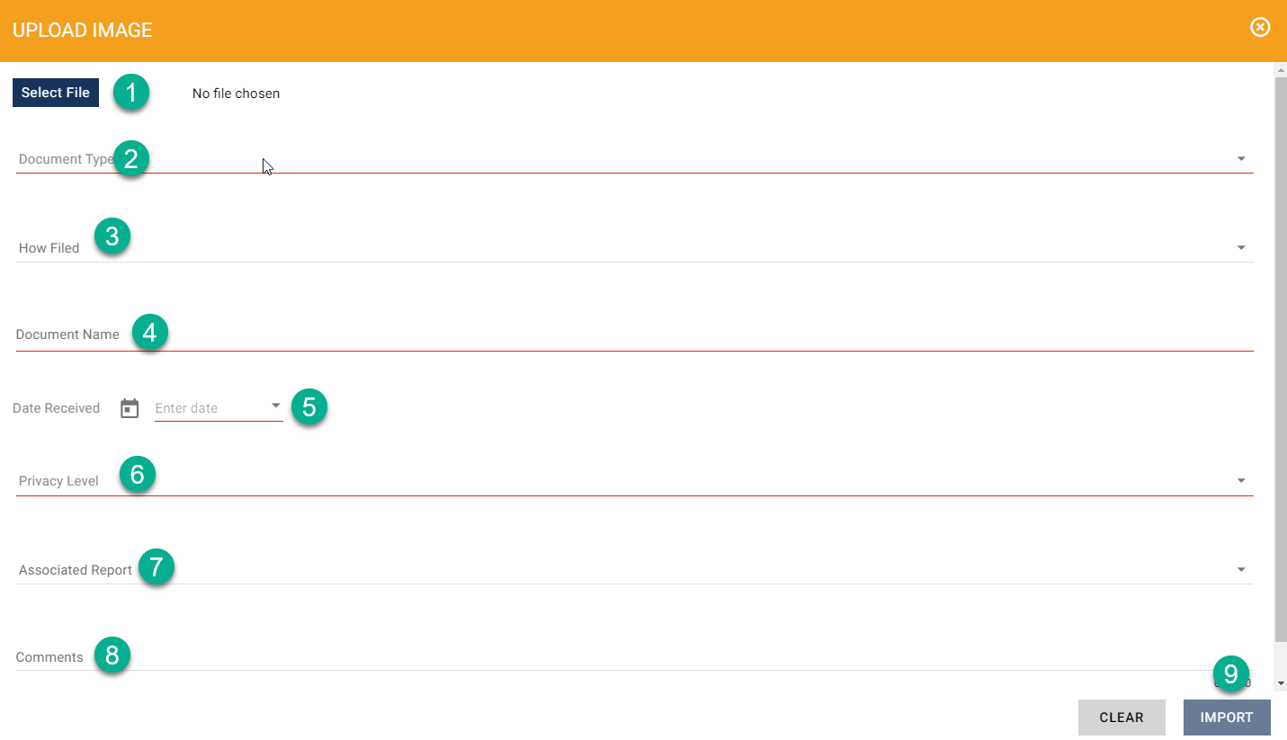
Part 3 Using your account (Lobbyists) – Upload Modal
Select file – choose a file to upload
Document Type – Select which type of Doc you are uploading
How Filed – Optional field to enter how it was
Document Name – Give your document a name
Date Rec - Enter Date you are entering the document
Privacy level – Select how visible you would like the document to be
Associated Report – Optional field (recommend not using)
Comment – Optional field to include supplemental info
Import – Select this when you have complete the required fields

Slide 16
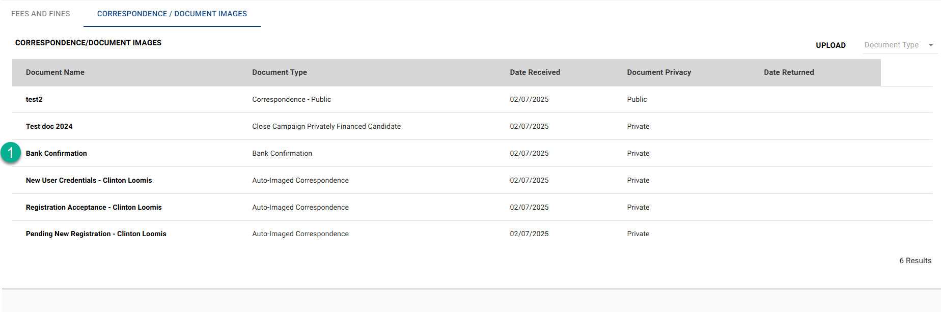
Part 3 Using your account (Lobbyists) – View uploaded documents
Once you have completed an upload, it will appear here in the Correspondence/Doc Images tab. You can view the uploaded document (or any others visible) by selecting it.

Slide 17
Thank You

