Slide 1
Air Dispersion Modeling
Jeff Stonesifer, Meteorologist
March 10, 2020

Slide 2
purpose
Using Air Dispersion Modeling
Models estimate impacts of pollution emitted by industry
Compare the estimated impacts to air quality standards
Air quality standards limit emissions from industry

Slide 3
Permitting
Connection to Permitting
Modeling used to set permit conditions
Require control strategies
Hours of operation
Emission rates
Distance of equipment from fence

Slide 4
Analogy
Sprinkler system surrounded by buckets
Wind is important in distributing water
Depth of water in buckets ~ concentrations at receptors
Notes:
Sprinkler image: https://commons.wikimedia.org/wiki/File:Sprinkler_Irrigation_-_Sprinkler_head.JPG
Bucket image: https://www.google.com/imgres?imgurl=https%3A%2F%2Fblog.gunassociation.org%2Fwp-content%2Fuploads%2F2018%2F06%2Frain-falling-bucket-full-waterrainwater-harvestingrainy-rainwater-ss-Featured.jpg&imgrefurl=https%3A%2F%2Fblog.gunassociation.org%2Ffilter-rainwater%2F&tbnid=f-Jc0BiO1pbsKM&vet=12ahUKEwiXhtD1otPuAhUGlJ4KHUm9BS8QMygfegUIARD1Aw..i&docid=TxHjt4sM5yPBiM&w=1500&h=840&q=buckets%20collecting%20water&hl=en&ved=2ahUKEwiXhtD1otPuAhUGlJ4KHUm9BS8QMygfegUIARD1Aw

Slide 5
inputs
Dispersion Model Inputs
Meteorology
Wind speed
Wind direction
Temperature
Terrain & Land Use
Rural or urban
Elevations
Emissions
Rates
Hrs of operation
Sources
Source type
Parameters
Downwash
Buildings
WIND PROFILE
Gravitational Settling
Particle Size
Density
CENTERLINE
Building
VORTEX

Slide 6
Source type
Point Source

Slide 7
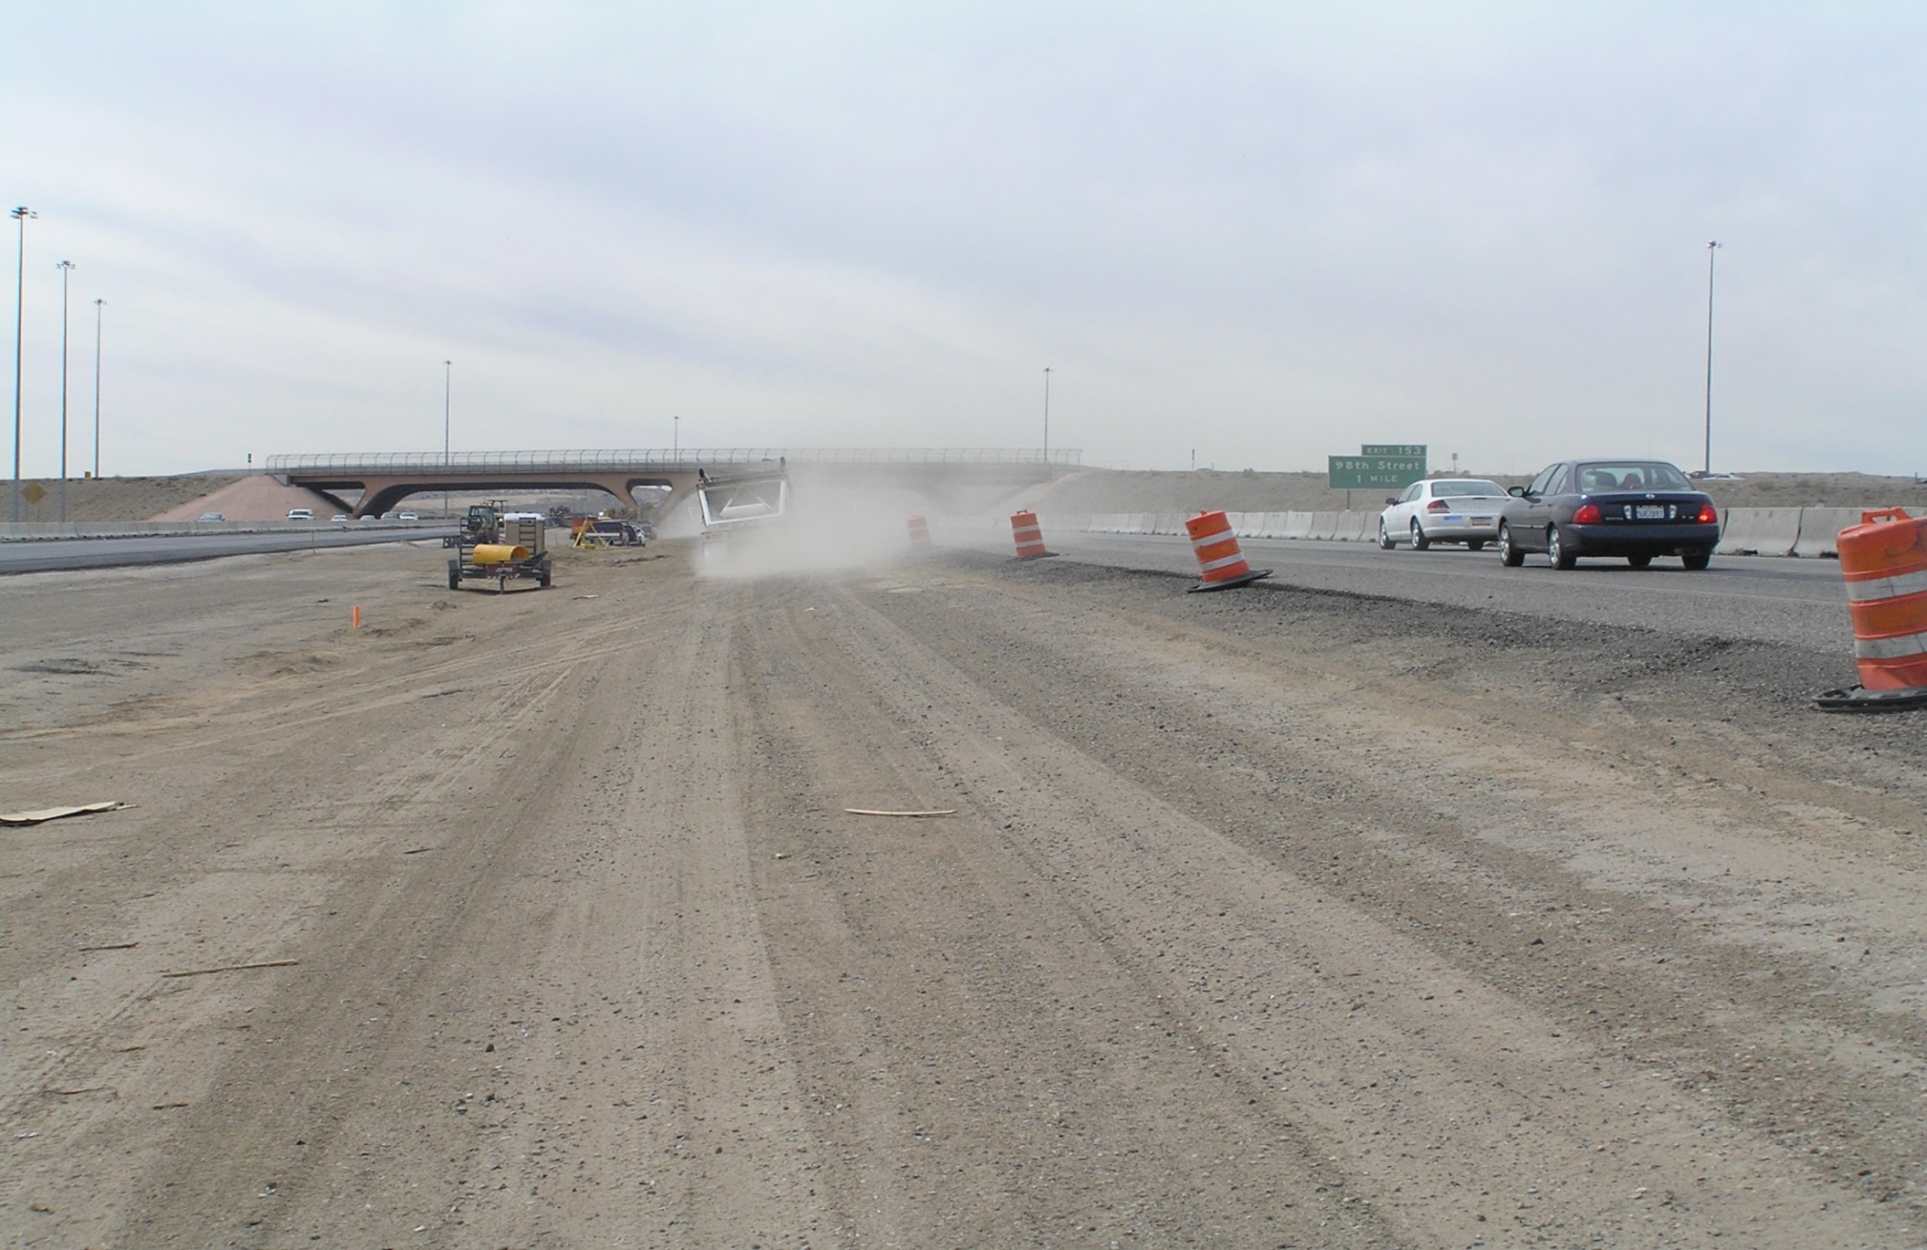
Source type
Volume Source

Slide 8
Guidelines
Federal, State, & Local Guidelines
Federal: 40 CFR 51, a.k.a. Appendix W
NMED’s Air Dispersion Modeling Guidelines
Air Quality Program’s Air Dispersion Modeling Guideline

Slide 9
Cumulative impacts
Cumulative Impacts Modeling
Background levels are from monitored data
Background data added to modeled impact
Inclusion of nearby facilities depends on
Distance from applicant’s facility
Amount of emissions from nearby facilities
What the background monitor is sampling

Slide 10
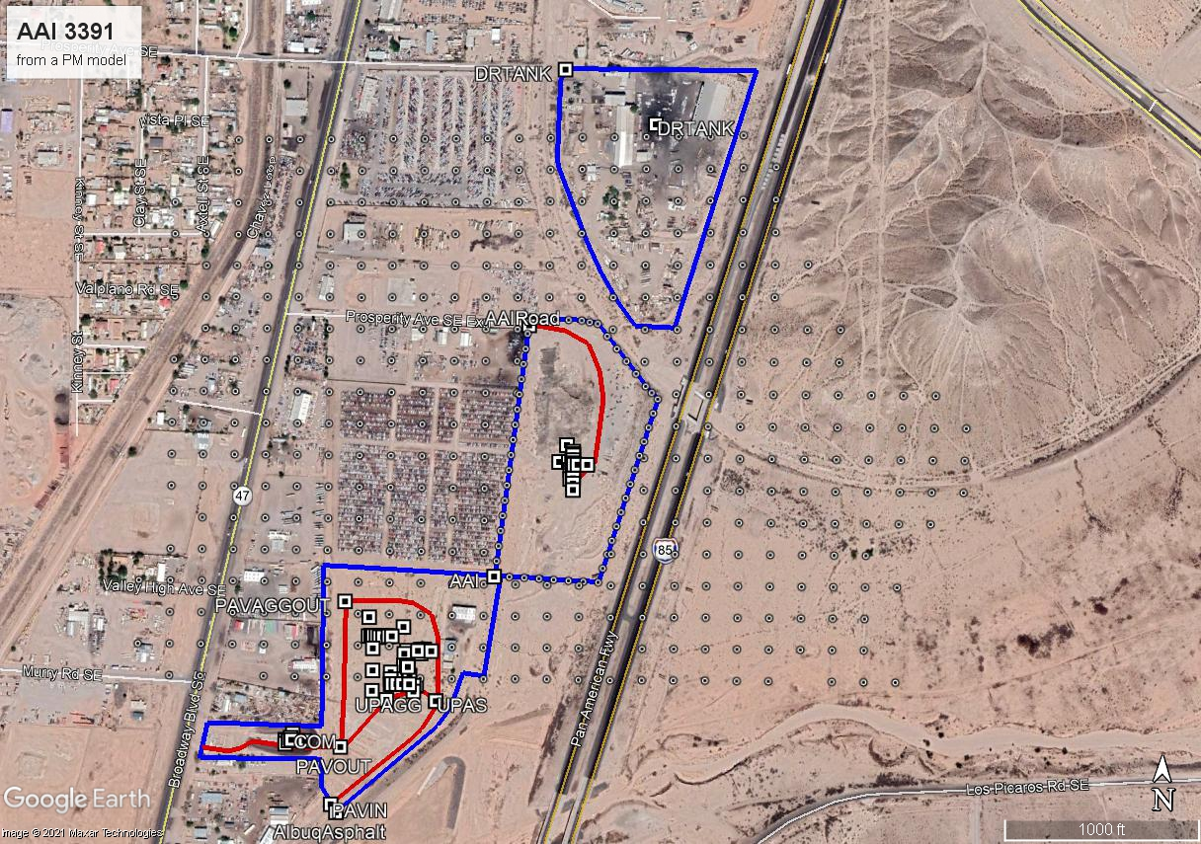
Example
Recent modeling review
D&R Tank
Albuquerque Asphalt aggregate plant
Albuquerque Asphalt HMA

Slide 11
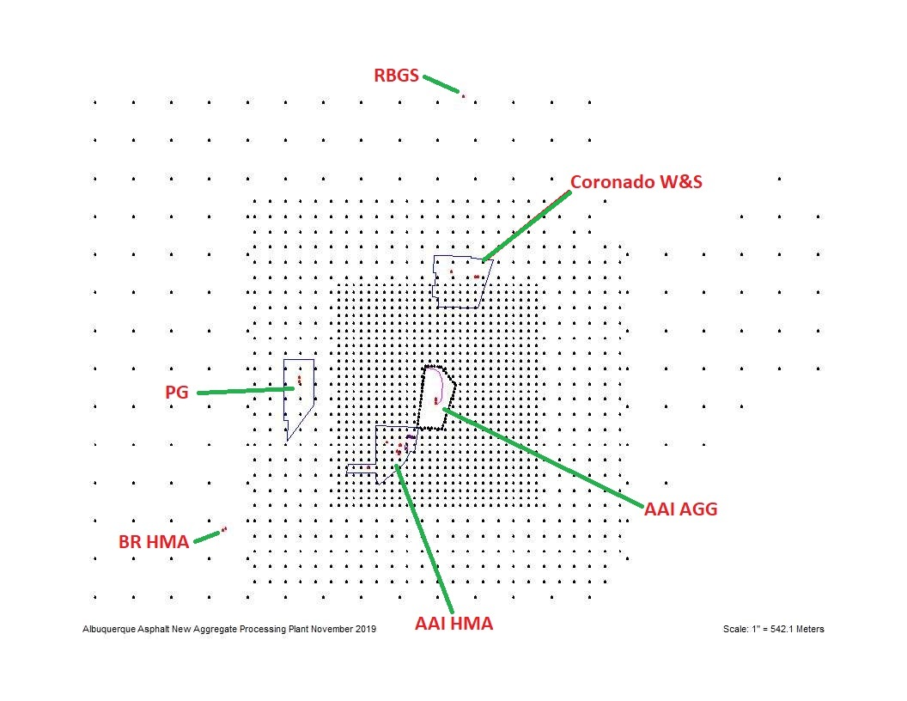
example
NO₂ model for the same facility

Slide 12
Cumulative impacts
More on cumulative modeling
“…the question of which nearby sources to include in the cumulative modeling is inextricably linked to the question of what the ambient monitoring data represents within the project area.” –Section 8.3.3(a), p. 5221
Cumulative impact is compared to air quality standards

Slide 13
compliance
Compare to Standards
NAAQS | Modeled Impact (µg/m³) | Background (µg/m³) | Model + Background (µg/m³) | Level of the standard (µg/m³)
NO₂ 1-hour | 117.1 | 62.8 | 179.9 | 188
PM₁₀ 24-hour | 65.7 | 35 | 100.7 | 150

Slide 14
EPA Model
AERMOD
U.S. EPA’s preferred air dispersion model since Nov. 2005
Standard among all regulatory clean air agencies
Confidence that AERMOD doesn’t underestimate
EPA is concerned about underestimation
LOWWIND options have not been accepted for regulatory modeling

Slide 15
Reliability
AERMOD Reliability
EPA SCRAM website
Databases used to evaluate AERMOD performance
Documents on AERMOD performance and formulation
Support Center for Regulatory Atmospheric Modeling (www.epa.gov/scram)
Notes:
For more info: https://www.epa.gov/scram/air-quality-dispersion-modeling-preferred-and-recommended-models#aermod

Slide 16
Verification
Example of EPA Testing AERMOD
Excerpts from description of EPA experiment:
“…near-surface, non-buoyant tracer release” experiments with “surface sampling arrays positioned 50 meters to 800 meters downwind…”
Empire Abo, NM field study mentioned in
March 1, 2011 EPA clarification memo

Slide 17
Safety
Furthering the Margin of Safety
Rural dispersion coefficients
Continuous full bore operations for all sources on property
Lack of NO2/NOX data → often results in worst-case assumptions

Slide 18
Rejections
Reasons EHD Rejects Modeling
Discrepancy between model & application
E.g. Application requests operations 7 days/wk; only modeled 6 days a week
Inappropriate modeling techniques
Outdated downwash algorithm
Inappropriate use of urban dispersion
Incorrect modeling
Sources, roads, fence don’t match up with aerial imagery

Slide 19
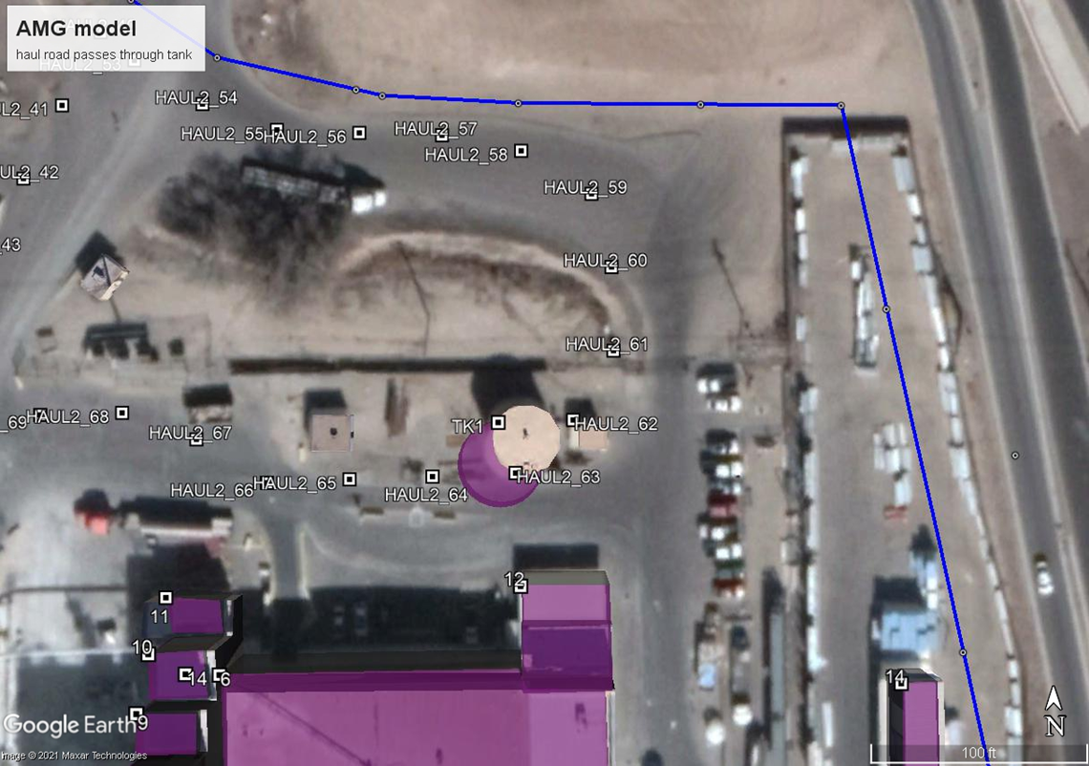
example
Example of Incorrect Mapping

Slide 20
conclusion
In Conclusion
AQP uses checklists for protocol reviews, preliminary reviews, final reviews, and peer reviews as a matter of quality assurance and quality control.
AERMOD- a reliable tool for keeping Bernalillo County within the standards for particulates, H₂S, lead, NO₂, SO₂, and CO

Slide 21
Questions?

Slide 22
references
AERMOD User’s Guide, https://gaftp.epa.gov/Air/aqmg/SCRAM/models/preferred/aermod/aermod_userguide.pdf
AERMOD: Latest Features and Evaluation Results, EPA-454/R-03-003, June 2003, https://gaftp.epa.gov/Air/aqmg/SCRAM/models/preferred/aermod/aermod_mep.pdf
Guideline on Air Quality Models (aka Appendix W), https://www.epa.gov/sites/production/files/2020-09/documents/appw_17.pdf

Slide 23
REFERENCES
Additional Clarification Regarding Applicability of Appendix W Modeling Guidance for the 1-hour NO2 NAAQS (EPA Clarification Memo, 01Mar2011), https://www.epa.gov/sites/production/files/2020-10/documents/additional_clarifications_appendixw_hourly-no2-naaqs_final_03-01-2011.pdf

Slide 24
REFERENCES
City of Albuquerque Environmental Health Department Air Dispersion Modeling Guidelines, https://documents.cabq.gov/environmental-health/airquality/ADM/final%20COA%20Oct2019%20guidelines.pdf
New Mexico Environment Department Air Dispersion Modeling Guidelines, https://www.env.nm.gov/air-quality/modeling-publications/

