Slide 1
Comparison of EPA’s AQI and WHO’s IQAir

Slide 2
Introduction
Air Board Request to answer the following
Revise the AQI to match the WHO IQAir?
Compare the EPA AQS to the WHO IQAir
Where are we with the EPA AQS? data analysis
What would our data look like using the IQAir?

Slide 3
Revise the AQI to match WHO
EPA AQI
  Reporting is required by EPA
    Federal Register 40 CFR Part 58 Air Quality Index Reporting; Final Rule, Vol. 64, No. 149 Wednesday, August 4, 1999
  Reporting agencies receive EPA funding
  This requirement can’t be replaced or modified by state or local agencies.
  If we stop reporting the AQI or revise the AQI from the Federal requirements the agency could be financially liable for failure to comply.

Slide 4
Comparison of IQAir and AQI
EPA AQI
  Uses Governmental reference sensor data for CO, ozone, SO₂, NO₂, PM₁₀
  Data processed through the EPA’s AIRNow website
  WHO IQAir
  Uses Governmental reference sensor data (EPA’s AirNow data)
  Uses low cost, public sensors (PurpleAir sensors), PM_{2.5} only
    Public Sensor data are processed using a data calibration algorithm based on environmental conditions.
  All data are processed through the IQAir AirVisual platform
Obvious differences
IQAir’s categories are based on lower concentrations than EPA’s AQI
IQAir presents visualization for all pollutants but they focus on PM_{2.5}

Slide 5
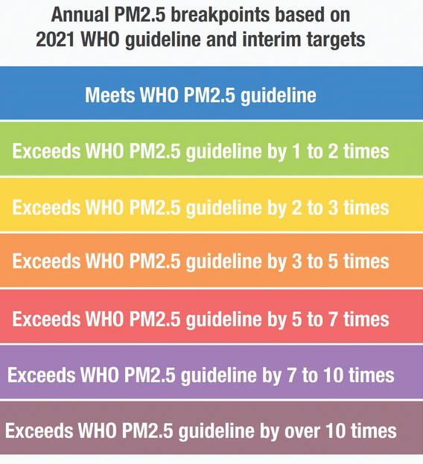
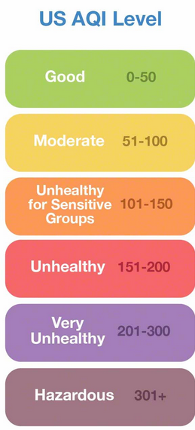
Categories
US EPA AQI
  6 Categories
  WHO IQAir
  7 Categories

Slide 6
Where we are in AQI
EPA AQI Category | 2021 |  | 2020 |  | 2019
 | No. of Days | Percentage | No. of Days | Percentage | No. of Days | Percentage
Good | 86 | 23.56% | 135 | 36.89% | 193 | 52.88%
Moderate | 257 | 70.41% | 221 | 60.38% | 168 | 46.03%
Unhealthy for Sensitive Groups | 20 | 5.48% | 7 | 1.91% | 4 | 1.10%
Unhealthy | 2 | 0.55% | 2 | 0.55% | 0 | 0.00%
Hazardous |  |  | 1 | 0.27%
Total | 365 | 100.00% | 366 | 100.00% | 365 | 100.00%
Primary Pollutant
Ozone Total | 171 |  | 197 |  | 244
Good | 65 |  | 105 |  | 123
Moderate | 94 |  | 87 |  | 117
Unhealthy for Sensitive Groups | 12 |  | 5 |  | 4
PM10 Total | 125 |  | 82 |  | 50
Good | 13 |  | 6 |  | 20
Moderate | 106 |  | 72 |  | 30
Unhealthy for Sensitive Groups | 6 |  | 1
Unhealthy |  |  | 2
Hazardous |  |  | 1 (9/8/2020)
PM2.5 Total | 69 |  | 87 |  | 71
Good | 8 |  | 24 |  | 50
Moderate | 57 |  | 62 |  | 21
Unhealthy for Sensitive Groups | 2 |  | 1
Unhealthy | 2
EPA AQS data

Slide 7
IQAir Status
67.5% of the data would be in the Blue to Yellow categories, while for the EPA AQI approximately 95% of data falls in the Green to Yellow categories.
EPA AQS 2020 data, site 2ZV, raw data concentration values

