Slide 1
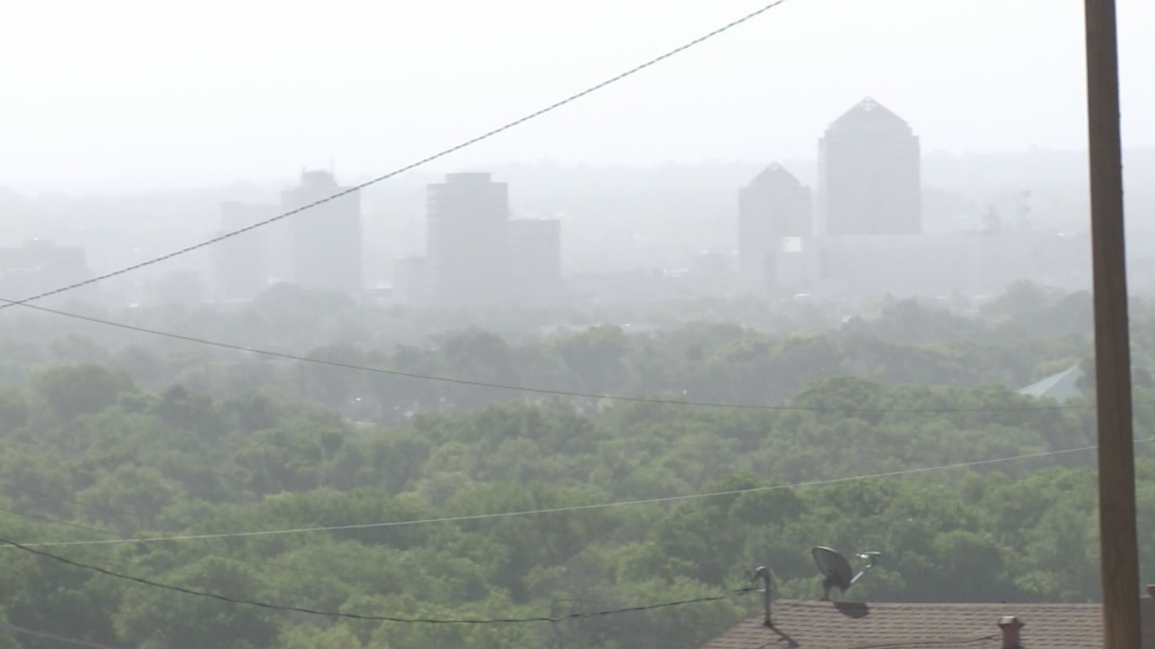
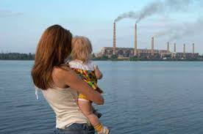

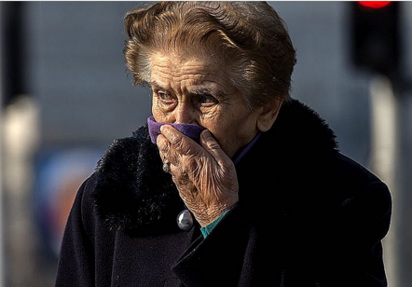
WHO Air Pollution Guidelines
What are they and why?
Charles Gasparovic, Ph.D. (Biophysics and Health Sciences)
Why: > 7M annual premature deaths and life-long
health effects
What: the US and WHO guidelines
How: air quality evaluation in Albuquerque

Slide 2
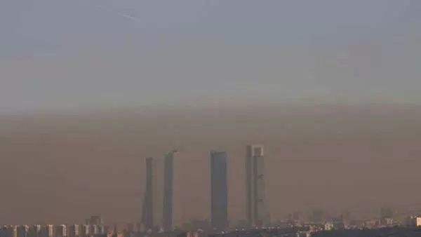
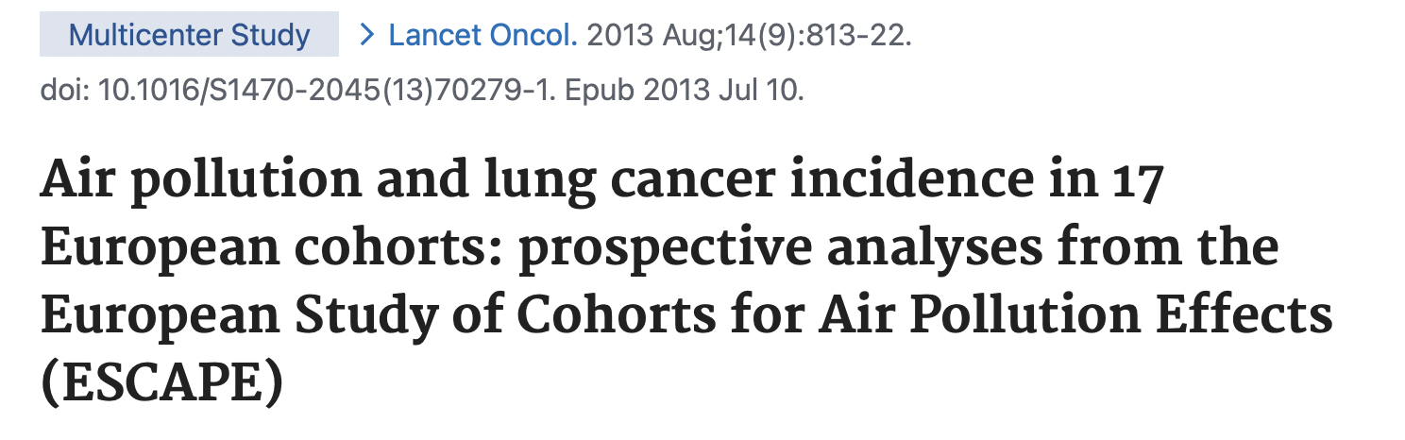
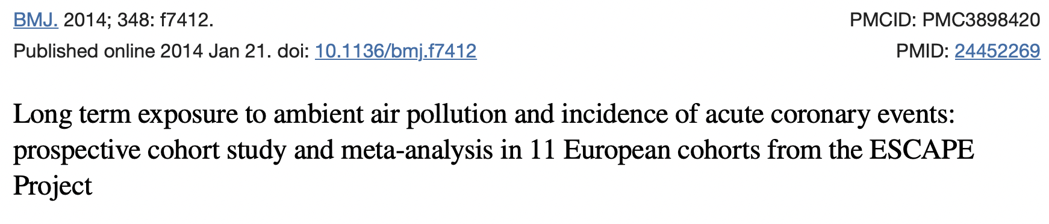
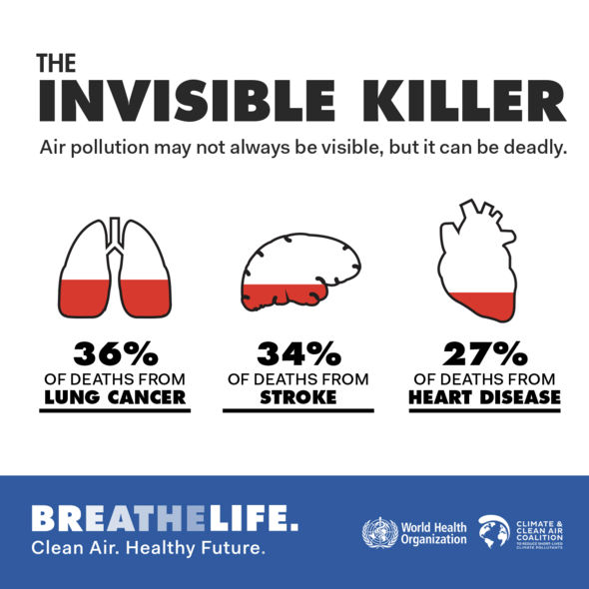
The World Health Organization has concluded that Air Pollution is a cause of more than
7 million early deaths each year.
Findings: The 312 944 cohort members contributed 4 013 131 person-years at risk. During follow-up (mean 12·8 years), 2095 incident lung cancer cases were diagnosed. The meta-analyses showed a statistically significant association between risk for lung cancer and PM10 (hazard ratio [HR] 1·22 [95% CI 1·03-1·45] per 10 μg/m(3)). For PM2·5 the HR was 1·18 (0·96-1·46) per 5 μg/m(3). The same increments of PM10 and PM2·5 were associated with HRs for adenocarcinomas of the lung of 1·51 (1·10-2·08) and 1·55 (1·05-2·29), respectively. An increase in road traffic of 4000 vehicle-km per day within 100 m of the residence was associated with an HR for lung cancer of 1·09 (0·99-1·21). The results showed no association between lung cancer and nitrogen oxides concentration (HR 1·01 [0·95-1·07] per 20 μg/m(3)) or traffic intensity on the nearest street (HR 1·00 [0·97-1·04] per 5000 vehicles per day).
Results 5157 participants experienced incident events. A 5 μg/m³ increase in estimated annual mean PM_{2.5}was associated with a 13% increased risk of coronary events (hazard ratio 1.13, 95% confidence interval 0.98 to 1.30), and a 10 μg/m³ increase in estimated annual mean PM₁₀ was associated with a 12% increased risk of coronary events (1.12, 1.01 to 1.25) with no evidence of heterogeneity between cohorts. Positive associations were detected below the current annual European limit value of 25 μg/m³ for PM_{2.5} (1.18, 1.01 to 1.39, for 5 μg/m³ increase in PM_{2.5}) and below 40 μg/m³ for PM₁₀ (1.12, 1.00 to 1.27, for 10 μg/m³increase in PM₁₀). Positive but non-significant associations were found with other pollutants.

Slide 3
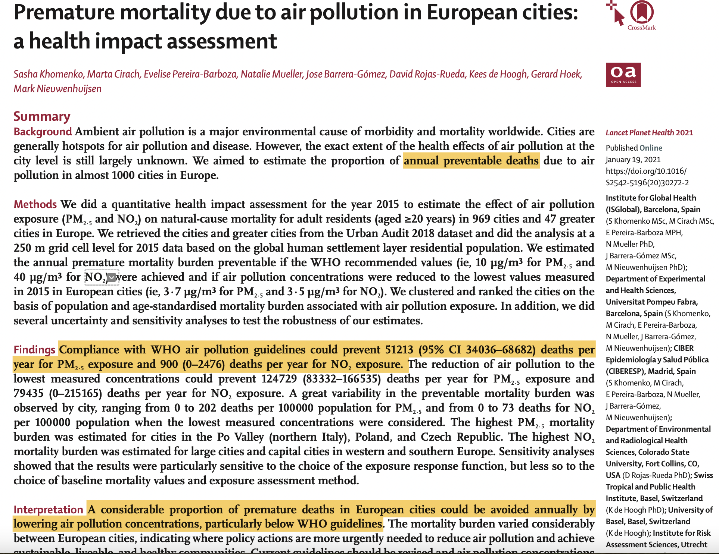

Slide 4
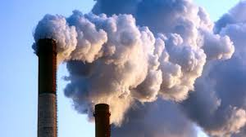
A killer stalking us
throughout life
Birth Defects
Premature Births
Pulmonary Development
Asthma
Brain Development
Learning and Memory
Childhood cancers
Stroke and Dementias
Pulmonary Diseases
Heart diseases
Cancer

Slide 5
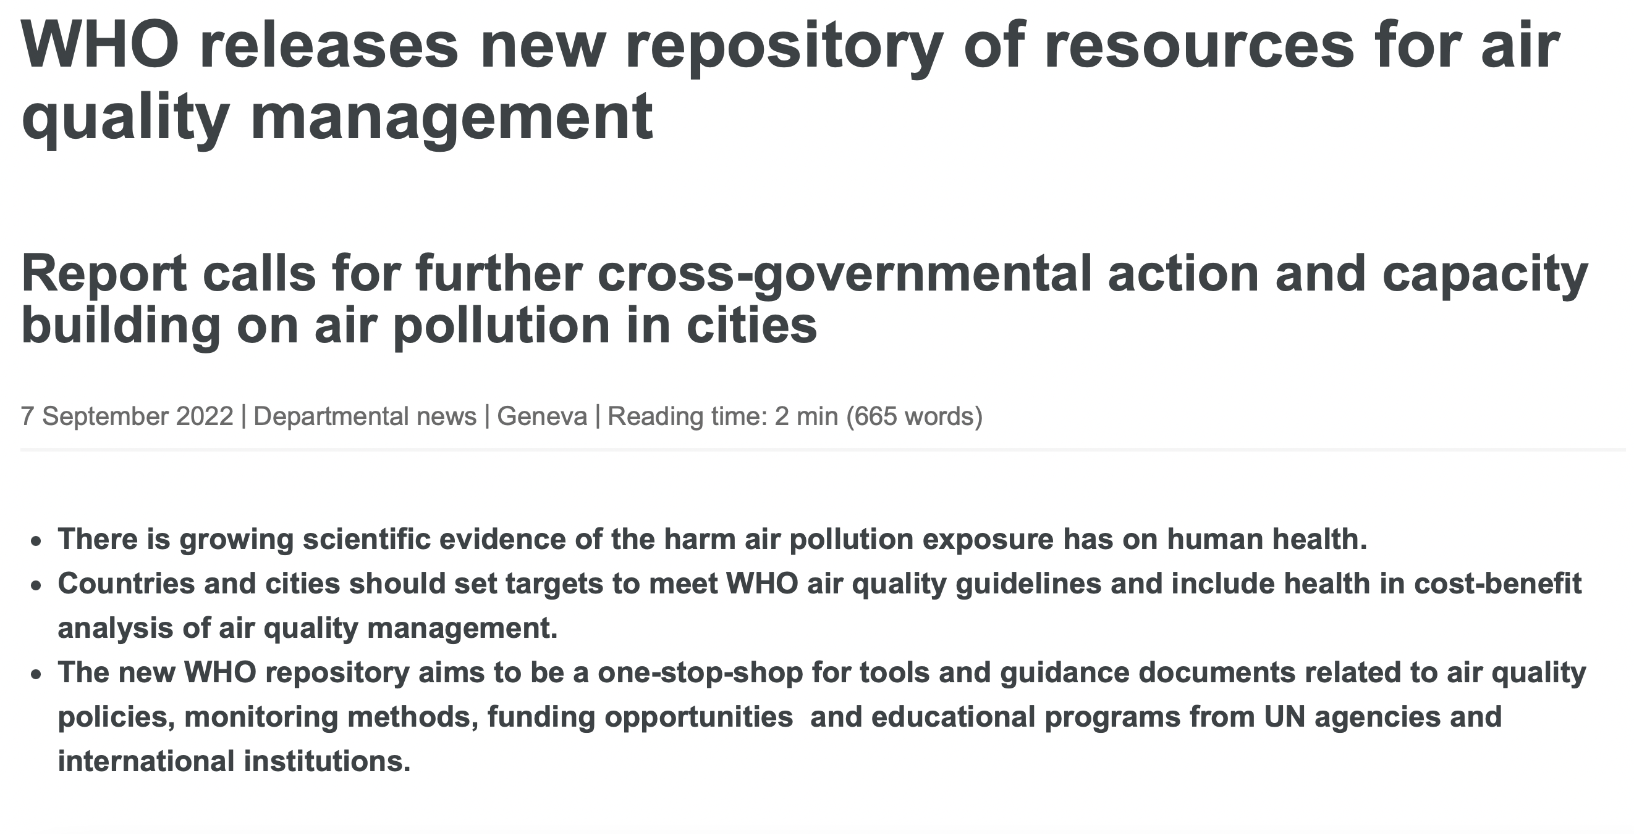
https://www.who.int/news/item/07-09-2022-who-releases-new-repository-of-resources-for-air-quality-management

Slide 6
National Ambient Air Quality Standards (NAAQS)
Clean Air Act (1963, 1970 and amendments 1971-2016)
WHO
Pollutant Type Standard Averaging Time Form
Sulfur dioxide Primary .075 ppm (195 μg/m³) 1-hour 99th Percentile of 1-hour daily maximum concentrations,
(SO₂) averaged over 3 years.
Particulate matter Primary
(PM₁₀) 150 μg/m³ 24-hour Not to be exceeded more than once per year on average
over 3 years
Particulate matter Primary 12 μg/m³ annual Annual mean, averaged over 3 years
(PM_{2.5})
Primary 35 μg/m³ 24-hour 98th percentile, averaged over 3 years
Carbon monoxide Primary 35 ppm (40 mg/m³) 1-hour Not to be exceeded more than once per year
(CO) Primary 9 ppm (10 mg/m³) 8-hour Not to be exceeded more than once per year
Ozone Primary
(O₃) 0.12 ppm (235 μg/m³) 1-hour expected number of days per calendar year, with maximum hourly average concentration greater than 0.12 ppm, is equal to or less than 1
Primary
0.070 ppm (140 μg/m³) 8-hour Annual fourth-highest daily maximum 8-hour concentration,
averaged over 3 years
Nitrogen dioxide Primary
(NO₂) 0.053 ppm (100 μg/m³) annual Annual mean
Lead Primary
(Pb) 0.15 μg/m³ Rolling 3 mo Not to be exceeded
SO₂ 500 μg/m³ - 10 min
40 μg/m³ - 24h
PM₁₀ 45 μg/m³ - 24h
15 μg/m³ - annual
PM_{2.5} 15 μg/m³ - 24h
5 μg/m³ - annual
CO 100 mg/m³ - 15 min
35 mg/m³ - 1 h
10 mg/m³ - 8 h
4 mg/m³ - 24 h
O₃ 100 μg/m³ - 8h
NO₂ 200 μg/m³ - 1h
25 μg/m³ - 24h
10 μg/m³ - annual
Notes:
In his half-hour presentation, Tony Cox, a risk analyst from Denver, claimed that researchers are overstating their findings that show the dangers of air pollution. He explained how his own statistical modeling of health data indicates that other factors could explain the links between dirty air and respiratory problems or heart attacks.
Scientists and others at the Health Effects Institute annual conference were appalled. Some added to their speeches what they had thought was obvious: Yes, air pollution really is dangerous.
Cox might have been just shrugged off as a provocateur, a denier of established science. But he leads the Trump administration’s panel of scientists that offers advice on how to protect the health of about 126 million Americans who live in smoggy and sooty places.
In that role, he’s in a prime position to spread his skepticism of the science of air pollution: The Environmental Protection Agency is poised this year to review its health standards for fine particles known as PM2.5 and ozone, the main component of smog.
These decisions, scientists say, literally could mean life and death for people in cities across the United States.
The EPA’s seven-member Clean Air Scientific Advisory Committee, which has been completely remade under President Donald Trump, is responsible for reviewing the science and advising the EPA on what level of pollution is unhealthy. Cox was appointed a year ago, and earlier this month, all remaining holdovers from the Obama administration were replaced with new appointees, including two who also downplay the threats of breathing polluted air.
Powerful industries – such as power companies, vehicle manufacturers and oil companies – oppose tighter health standards because they would force states to adopt costly rules that cut emissions.
According to documents obtained through the Freedom of Information Act, Cox was nominated for the science board’s top position by the U.S. Chamber of Commerce, which has sued the EPA multiple times in an effort to loosen air pollution standards. The nomination came from Dan Byers of the chamber’s Global Energy Institute, who leads “efforts to promote and maintain coal’s vital role in America’s energy system.”
Cox has made his living challenging established science on behalf of industry. He has worked as a consultant for more than a dozen companies or industry groups that lobby against clean air or worker safety rules and are major sources of pollution, according to his website. He consulted for the American Petroleum Institute, which represents oil and gas companies, and the Truck and Engine Manufacturers Association, which represents makers of diesel and gasoline engines. He also consulted for the mining industry and tobacco giant Philip Morris.

Slide 7
 |  | Del Norte HS |  | Jefferson |  | S. Valley |  | Foothills |  | N. Valley
 | year average | 5 |  | 11 |  | 8 |  | 6 |  | 11
 | yr ave <30 | 5 |  | 10 |  | 8 |  | 5 |  | 11
days | PM2.5>5 | 156 |  | 342 |  | 264 |  | 129 |  | 336
days | PM2.5>12 | 12 |  | 93 |  | 53 |  | 23 |  | 131
days | PM2.5>20 | 2 |  | 27 |  | 14 |  | 3 |  | 34
days | PM2.5>35 | 1 |  | 3 |  | 2 |  | 1 |  | 2

Slide 8
 |  | Del Norte HS |  | Jefferson |  | S. Valley |  | Foothills |  | N. Valley
 | year average | 23 |  | 47 |  | 52 |  | 19 |  | 45
 | yr ave <100 | 23 |  | 42 |  | 46 |  | 19 |  | 40
days | PM10>15 | 260 |  | 341 |  | 334 |  | 181 |  | 343
days | PM10>20 | 174 |  | 310 |  | 314 |  | 104 |  | 313
days | PM10>50 | 16 |  | 126 |  | 143 |  | 11 |  | 109
days | PM10>100 | 1 |  | 18 |  | 25 |  | 1 |  | 16
days | PM10>150 | 0 |  | 2 |  | 4 |  | 0 |  | 1

Slide 9
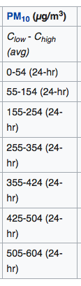
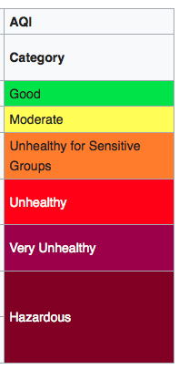
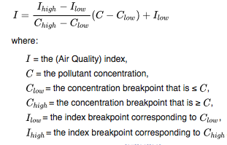
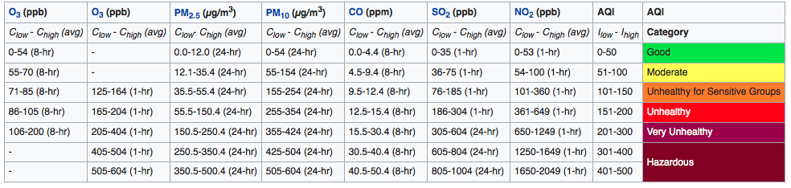
C = C_{low} + (C_{high}-C_{low})(I-I_{low})/(I_{igh}-I_{low})

Slide 10
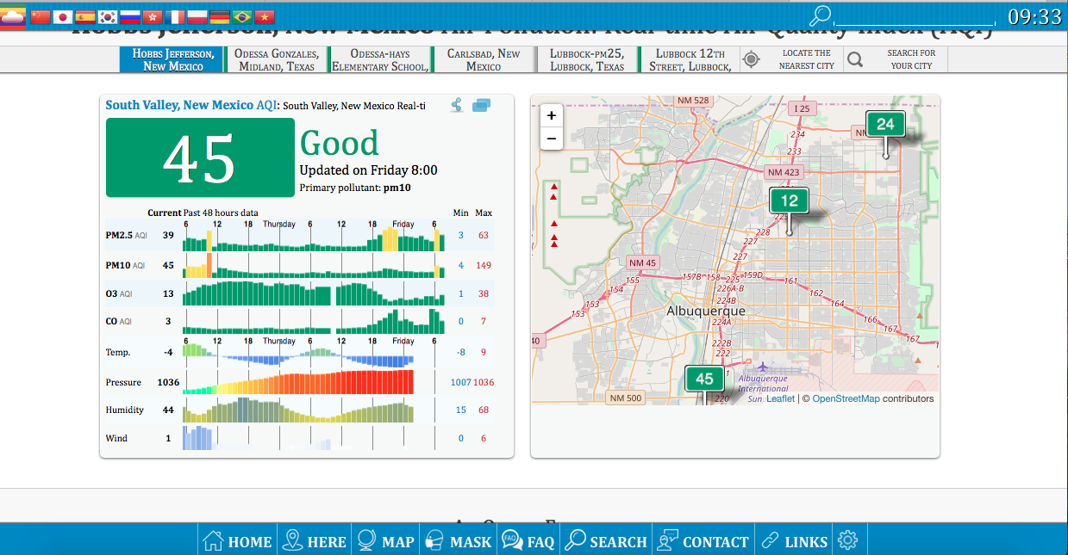
C _{PM10}= 49 μg/m³
5% increase risk heart attack (Bañeras el, 2018)
5% increase rate of death (Ortiz et al, 2017)
chronic 49 μg/m³ -> higher AD risk (Wu et al, 2017)
http://aqicn.org/city/usa/new-mexico/south-valley/

Slide 11
Supplement 1:
Major Measured Pollutants

Slide 12
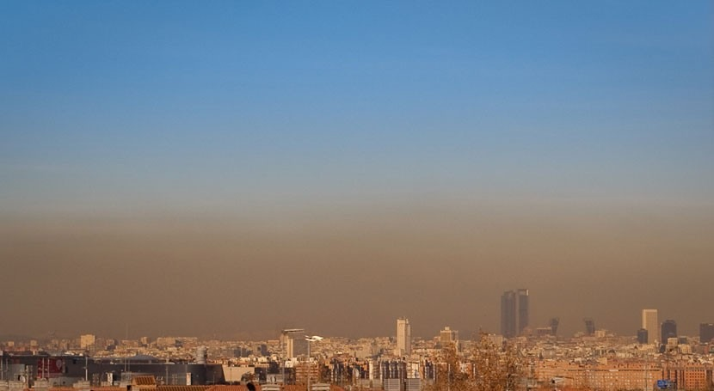
What is it and where does it come from?

Slide 13
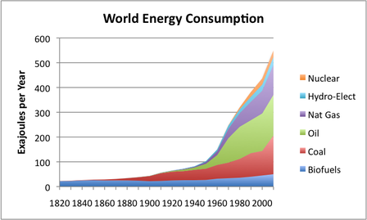


Planet of the Carbon Burners
1.3 Billion
7.5 Billion
× 10
× 2.3
3.2 Billion
127 M
1963 Clean Air ACT
1963 Clean Air Act
2016
2016
https://ourfiniteworld.com/2012/03/12/world-energy-consumption-since-1820-in-charts/

Slide 14
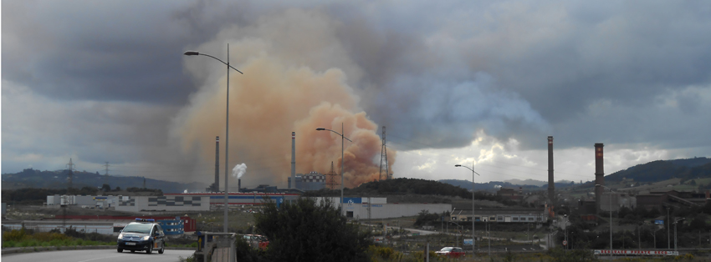
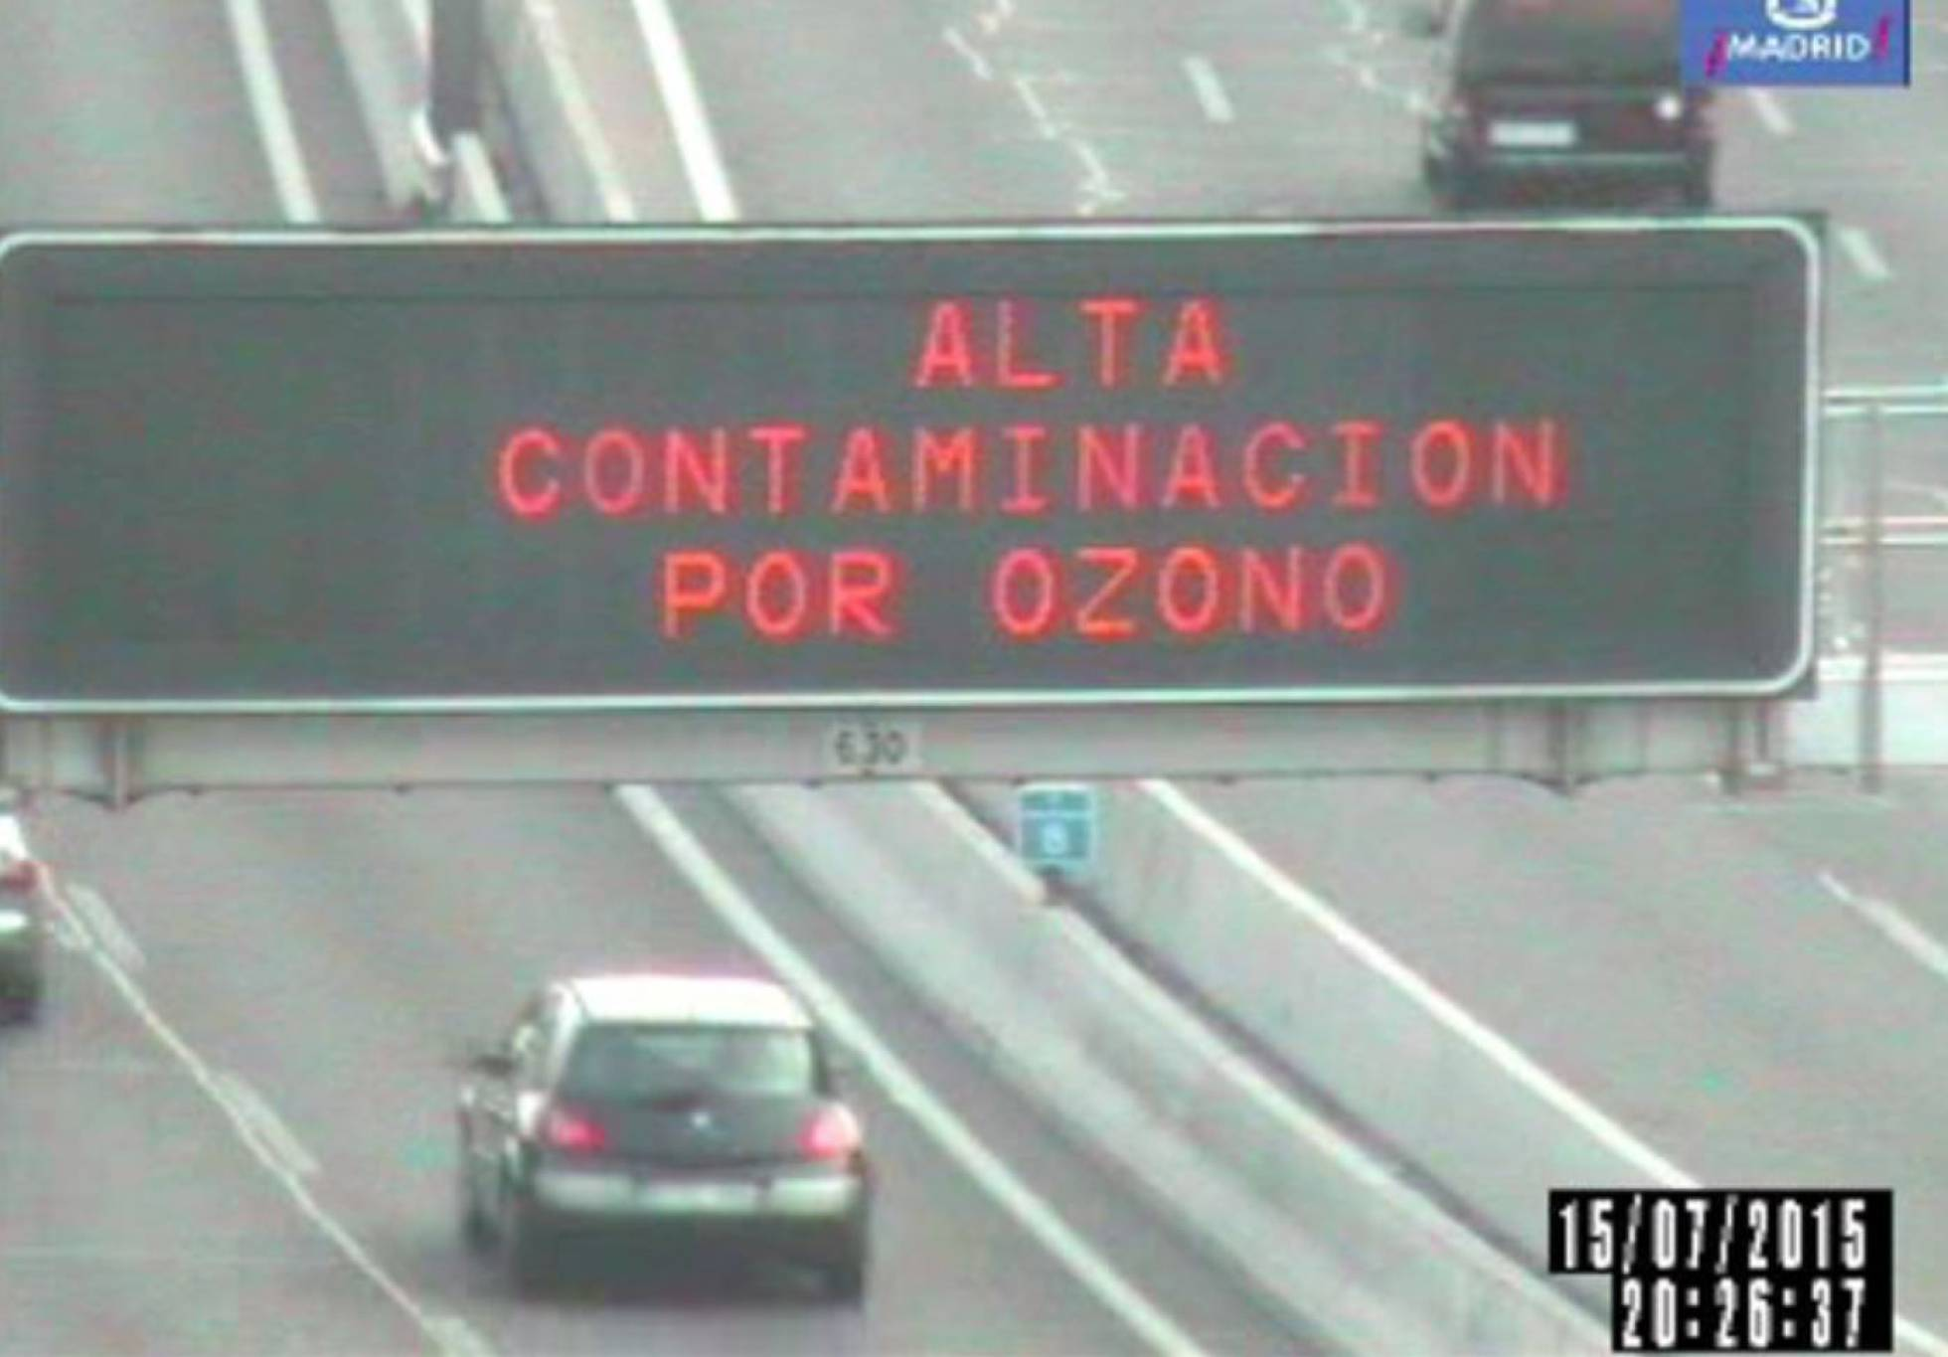
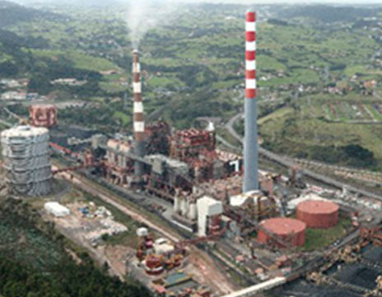
Major Human Sources
Industry
Traffic
Agriculture, Construction
Fossil Fuel Extraction
Commercial/Institutional
Homes/Buildings
Waste disposal
Power Plants

Slide 15

O₃ ground level
Carcinogens, neuronal & cardiovascular effects,
fetal development effects
CO
NO
NO₂
SO₂
Volatile Organic Compounds (VOC)
(e.g. benzene)
Polycyclic Aromatic
Hydrocarbons (PAH)
(e.g. benzo[a]pyrene)
Respiratory Irritants
Cardiovascular Disease
Particulate Matter
(PM10, PM2,5, PM1)
iron
mercury
lead
arsenic
cadmium
nickel
Neurologic and metabolic toxins,
carcinogens
All of the above!

Slide 16
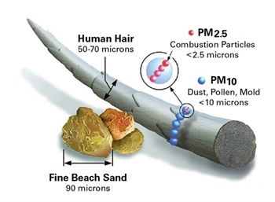
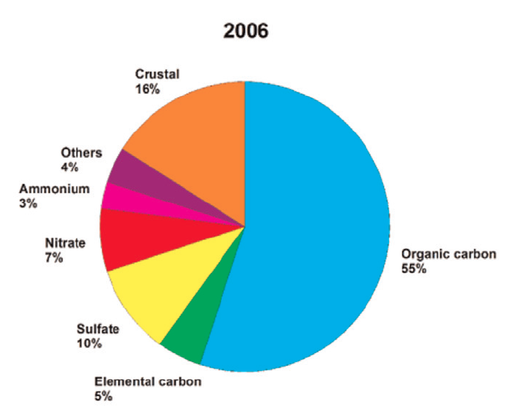
Anthropogenic Particulate Matter:
Toxic cocktails
Elemental carbon, gases and salts of sulfur, nitrogen, ammonia, metals, benzene, benzo[a]pyrene, toluene and other volatile organic compounds.
Sizes of <0.1 micrometers can enter the blood circulation via the alveoli, macrophages, or GI tract.
Evidence of PM entering the brain via the olfactory nerve.
Calderón-Garcidueñas et al., 2016

Slide 17
Supplement 2:
General Health Effects

Slide 18
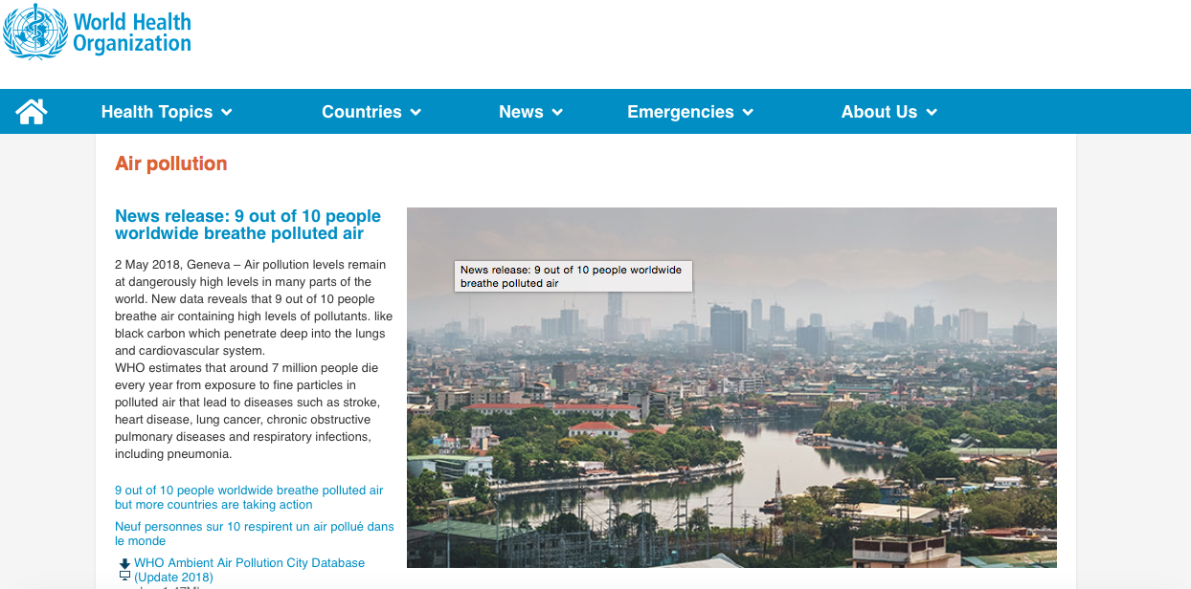
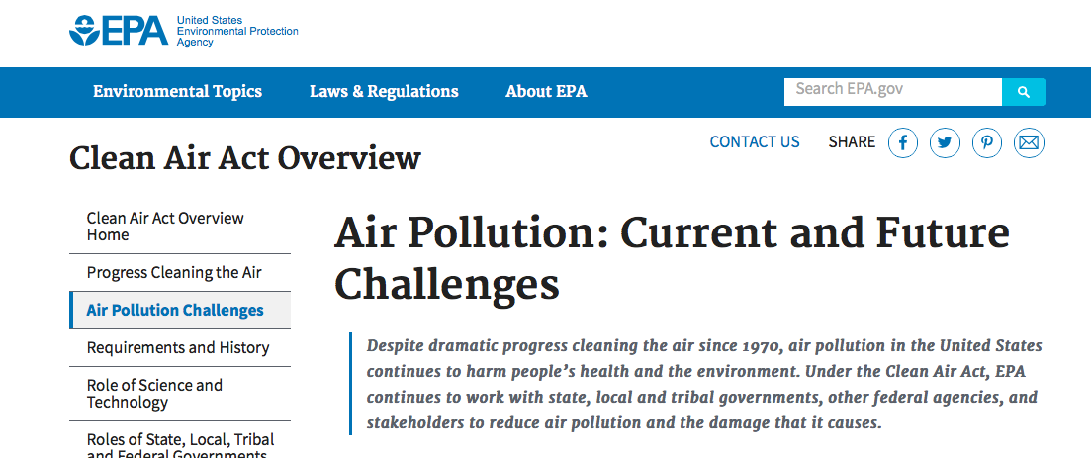
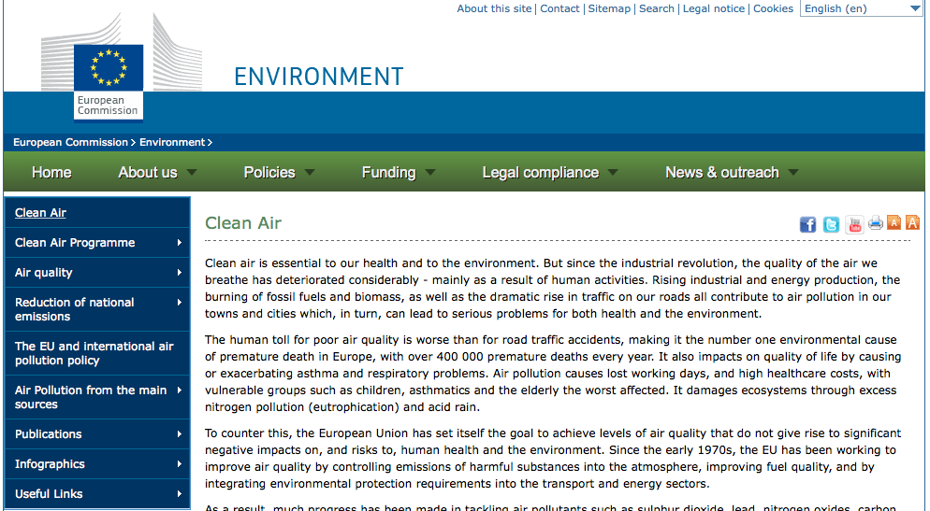
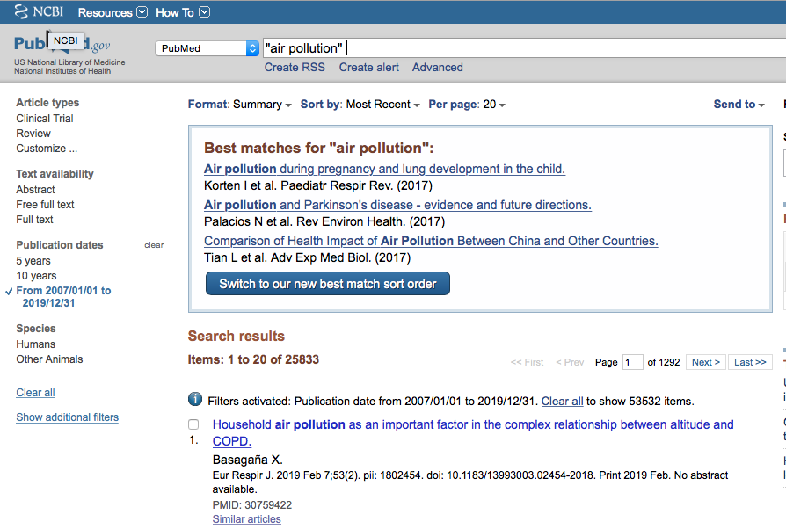
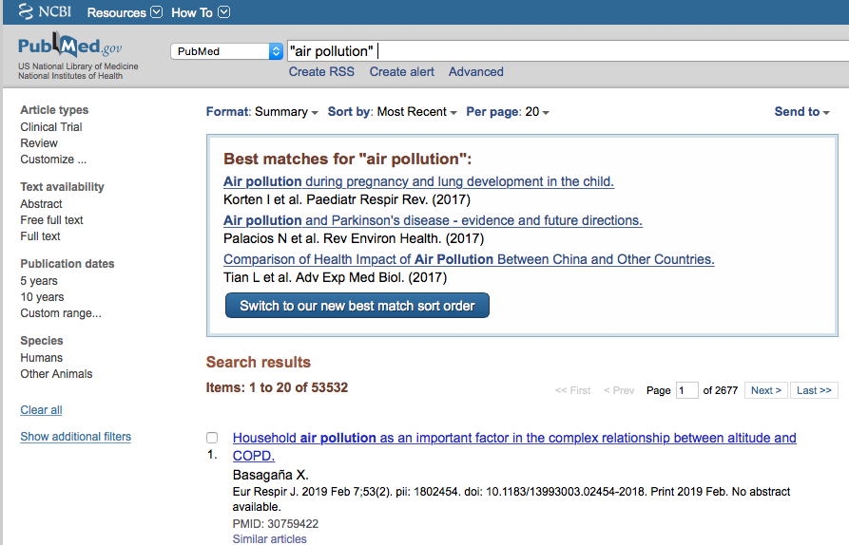
The DATA

Slide 19
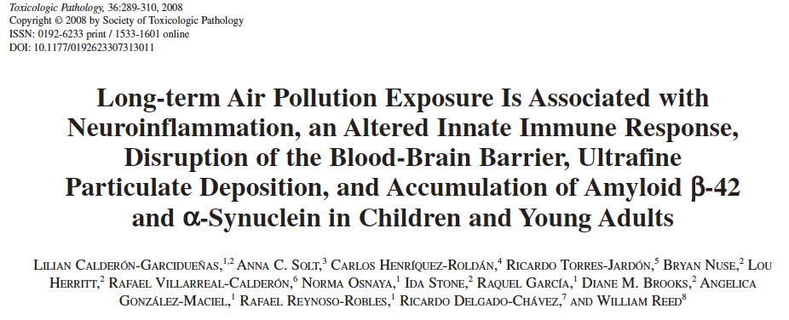
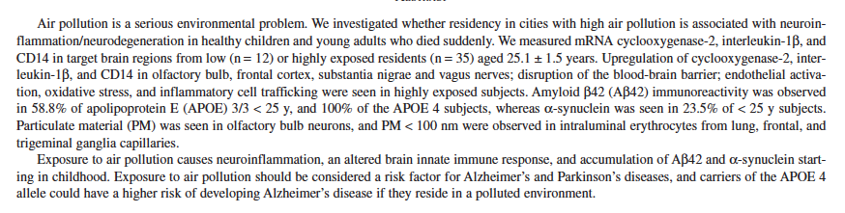
Notes:
barrera hematoencefálica

Slide 20
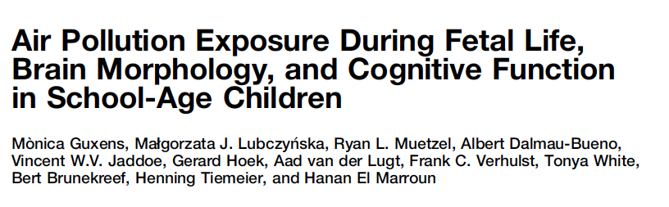
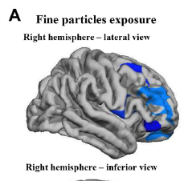

(6-10 y.o.)
Biological Psychiatry August 15, 2018; 84:295–303

Slide 21
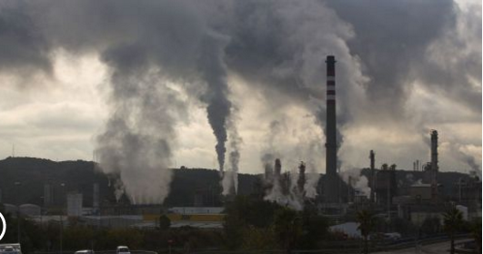
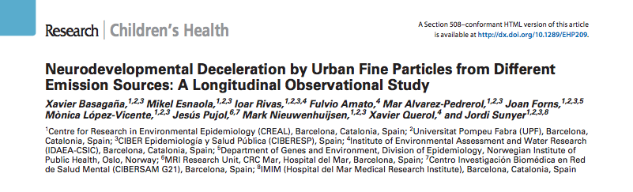
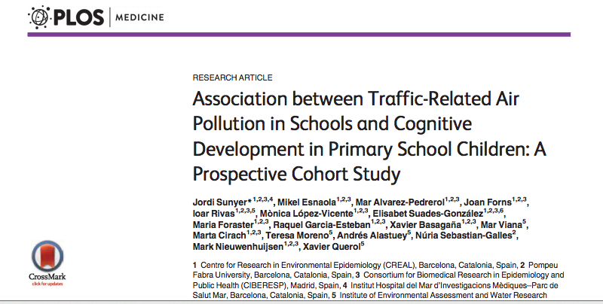
Neurodevelopment
2618 young students (~8.5 y) were tested for memory and attention 4 times over 1 year. PM2.5 was measured during twice over 1-week periods and analyzed for source. Traffic-related PM2.5 correlated inversely with preformance on the tests.
2715 young students (7-10 años) showed less improvements in cognitive tasks during 1 year if they were exposed to the highest levels of elemental carbon, NO₂, y PM2.5 in the study.
Notes:
We aimed to explore the role of PM sources in school air on cognitive development. Methods: A cohort of 2,618 schoolchildren (average age, 8.5 years) belonging to 39 schools in Barcelona (Spain) was followed up for a year. Children completed tests assessing working memory, superior working memory, and inattentiveness during four visits. Particulate matter ≤ 2.5 μm (PM2.5) was measured during two 1-week campaigns in each school, both outdoors and in the classroom. Source apportionment resulted in nine sources: mineral, organic/textile/chalk, traffic, secondary sulfate and organics, secondary nitrate, road dust, metallurgy, sea spray, and heavy oil combustion. Differences in cognitive growth trajectories were assessed with mixed models with age-by-source interaction terms. results: An interquartile range increase in traffic-related PM2.5 was associated with reduc tions in cognitive growth equivalent to 22% (95% CI: 2%, 42%) of the annual change in working memory, 30% (95% CI: 6%, 54%) of the annual change in superior working memory, and 11% (95% CI: 0%, 22%) of the annual change in the inattentiveness scale. None of the other PM2.5 sources was associated with adverse effects on cognitive development. conclusions: Traffic was the only source of fine particles associated with a reduction in cognitive development. Reducing air pollution from traffic at primary schools may result in beneficial effects on cognition.
We conducted a prospective study of children (n = 2,715, aged 7 to 10 y) from 39 schools in
Barcelona (Catalonia, Spain) exposed to high and low traffic-related air pollution, paired by
school socioeconomic index; children were tested four times (i.e., to assess the 12-mo developmental
trajectories) via computerized tests (n = 10,112). Chronic traffic air pollution
(elemental carbon [EC], nitrogen dioxide [NO2], and ultrafine particle number [UFP; 10–700
nm]) was measured twice during 1-wk campaigns both in the courtyard (outdoor) and inside
the classroom (indoor) simultaneously in each school pair. Cognitive development was assessed
with the n-back and the attentional network tests, in particular, working memory
(two-back detectability), superior working memory (three-back detectability), and inattentiveness
(hit reaction time standard error). Linear mixed effects models were adjusted for
age, sex, maternal education, socioeconomic status, and air pollution exposure at home.
Children from highly polluted schools had a smaller growth in cognitive development
than children from the paired lowly polluted schools, both in crude and adjusted models
(e.g., 7.4% [95% CI 5.6%–8.8%] versus 11.5%[95% CI 8.9%–12.5%] improvement in working
memory, p = 0.0024). Cogently, children attending schools with higher levels of EC,
NO2, and UFP both indoors and outdoors experienced substantially smaller growth in all
the cognitive measurements; for example, a change from the first to the fourth quartile in indoor
EC reduced the gain in working memory by 13.0% (95% CI 4.2%–23.1%). Residual
confounding for social class could not be discarded completely; however, the associations
remained in stratified analyses (e.g., for type of school or high-/low-polluted area) and after
additional adjustments (e.g., for commuting, educational quality, or smoking at home), contradicting
a potential residual confounding explanation.
Conclusions
Children attending schools with higher traffic-related air pollution had a smaller improvement
in cognitive development.

Slide 22
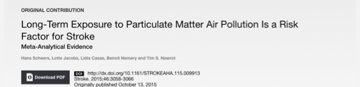
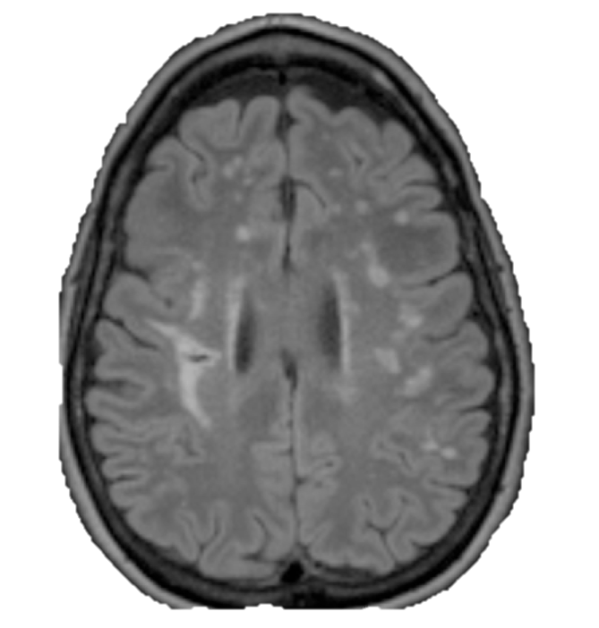
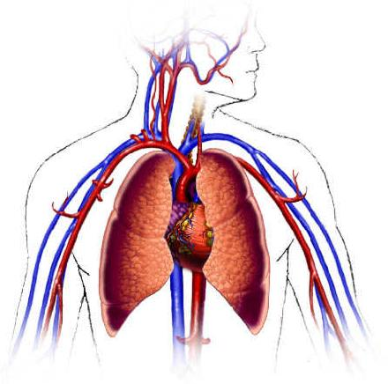
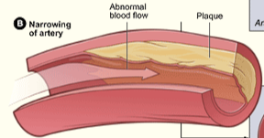
PM
Arterioesclerosis
Emboli
Embolism/
Thrombosis

Slide 23
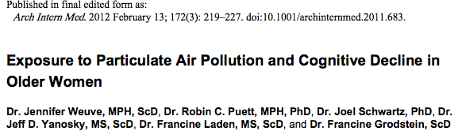
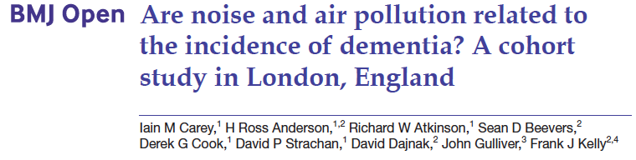
19,409 US women aged 70 to 81 years. Geographic information was used with to estimate recent (1 month) and long-term (7–14 years) exposures to PM2.5 and PM10, preceding base-line cognitive testing (1995–2001). Higher levels of long-term exposure to both PM10 and PM2.5 were associated with significantly faster cognitive decline. Two-year decline on a global score was 0.020 standard units worse per 10 μg/m³ increment in PM10 exposure and 0.018 units worse per 10 μg/m³ increment in PM2.5 exposure.
130,978 adults in London aged 50–79 years with no history of dementia. Average NO2, PM2.5 and O3 levels during 2004 were estimated. Traffic intensity, distance from major road and night-time noise levels were estimated at the subject postal codes and linked to clinical data. Diagnoses of dementia were noted during 2005–2013. There was a positive exposure response relationship between dementia and all measures of air pollution except O3.
Notes:
Summary
Background Emerging evidence suggests that living near major roads might adversely aff ect cognition. However, little
is known about its relationship with the incidence of dementia, Parkinson’s disease, and multiple sclerosis. We aimed
to investigate the association between residential proximity to major roadways and the incidence of these three
neurological diseases in Ontario, Canada.
Methods In this population-based cohort study, we assembled two population-based cohorts including all adults
aged 20–50 years (about 4.4 million; multiple sclerosis cohort) and all adults aged 55–85 years (about 2.2 million;
dementia or Parkinson’s disease cohort) who resided in Ontario, Canada on April 1, 2001. Eligible patients were free
of these neurological diseases, Ontario residents for 5 years or longer, and Canadian-born. We ascertained the
individual’s proximity to major roadways based on their residential postal-code address in 1996, 5 years before
cohort inception. Incident diagnoses of dementia, Parkinson’s disease, and multiple sclerosis were ascertained
from provincial health administrative databases with validated algorithms. We assessed the associations between
traffi c proximity and incident dementia, Parkinson’s disease, and multiple sclerosis using Cox proportional hazards
models, adjusting for individual and contextual factors such as diabetes, brain injury, and neighbourhood income.
We did various sensitivity analyses, such as adjusting for access to neurologists and exposure to selected air
pollutants, and restricting to never movers and urban dwellers.
Findings Between 2001, and 2012, we identifi ed 243 611 incident cases of dementia, 31 577 cases of Parkinson’s disease,
and 9247 cases of multiple sclerosis. The adjusted hazard ratio (HR) of incident dementia was 1.07 for people living
less than 50 m from a major traffi c road (95% CI 1.06–1.08), 1.04 (1.02–1.05) for 50–100 m, 1.02 (1.01–1.03) for
101–200 m, and 1.00 (0.99–1.01) for 201–300 m versus further than 300 m (p for trend=0.0349). The associations
were robust to sensitivity analyses and seemed stronger among urban residents, especially those who lived in major
cities (HR 1.12, 95% CI 1.10–1.14 for people living <50 m from a major traffi c road), and who never moved (1.12,
1.10–1.14 for people living <50 m from a major traffi c road). No association was found with Parkinson’s disease or
multiple sclerosis.
Interpretation In this large population-based cohort, living close to heavy traffi c was associated with a higher incidence
of dementia, but not with Parkinson’s disease or multiple sclerosis.
Background: The aging rate in Taiwan is the second highest in the world. As the population ages quickly, the prevalence of dementia increases rapidly. There are some studies that have explored the association between air pollution and cognitive decline, but the association between air pollution and dementia has not been directly evaluated.
Methods: This was a case-control study comprising 249 Alzheimer’s disease (AD) patients, 125 vascular dementia (VaD) patients, and 497 controls from three teaching hospitals in northern Taiwan from 2007 to 2010. Data of particulate matter ,10 mm in diameter (PM10) and ozone were obtained from the Taiwan Environmental Protection Administration for 12 and 14 years, respectively. Blood samples were collected to determine the apolipoprotein E (APOE) 34 haplotype. Bayesian maximum
entropy was used to estimate the individual exposure level of air pollutants, which was then tertiled for analysis. Conditional logistic regression models were used to estimate adjusted odds ratios (AORs) and 95% confidence intervals between the association of PM10 and ozone exposure with AD and VaD risk.
Results: The highest tertile of PM10 (_49.23 mg/m3) or ozone (_21.56 ppb) exposure was associated with increased AD risk (highest vs. lowest tertile of PM10: AOR 5 4.17; highest vs. lowest tertile of ozone: AOR 5 2.00). Similar finding was observed for VaD. The association with AD and VaD risk remained for the highest tertile PM10 exposure after stratification by APOE 34 status and gender.
Conclusions: Long-term exposure to the highest tertile of PM10 or ozone was significantly associated with an increased risk of AD and VaD.
Abstract
Objective To investigate whether the incidence of
dementia is related to residential levels of air and noise
pollution in London.
Design Retrospective cohort study using primary care
data.
Setting 75 Greater London practices.
Participants 130 978 adults aged 50–79 years registered
with their general practices on 1 January 2005, with no
recorded history of dementia or care home residence.
Primary and secondary outcome measures A first
recorded diagnosis of dementia and, where specified,
subgroups of Alzheimer’s disease and vascular dementia
during 2005–2013. The average annual concentrations
during 2004 of nitrogen dioxide (NO2), particulate matter
with a median aerodynamic diameter ≤2.5 μm (PM2.5) and
ozone (O3) were estimated at 20Å~20 m resolution from
dispersion models. Traffic intensity, distance from major
road and night-time noise levels (Lnight) were estimated
at the postcode level. All exposure measures were linked
anonymously to clinical data via residential postcode. HRs
from Cox models were adjusted for age, sex, ethnicity,
smoking and body mass index, with further adjustments
explored for area deprivation and comorbidity.
Results 2181 subjects (1.7%) received an incident
diagnosis of dementia (39% mentioning Alzheimer’s
disease, 29% vascular dementia). There was a positive
exposure response relationship between dementia and all
measures of air pollution except O3, which was not readily
explained by further adjustment. Adults living in areas
with the highest fifth of NO2 concentration (>41.5 μg/m3)
versus the lowest fifth (<31.9 μg/m3) were at a higher risk
of dementia (HR=1.40, 95% CI 1.12 to 1.74). Increases
in dementia risk were also observed with PM2.5, PM2.5
specifically from primary traffic sources only and Lnight,
but only NO2 and PM2.5 remained statistically significant in
multipollutant models. Associations were more consistent
for Alzheimer’s disease than vascular dementia.
Conclusions We have found evidence of a positive
association between residential levels of air pollution
across London and being diagnosed with dementia, which
is unexplained by known confounding factors.
Abstract
Background—Chronic exposure to particulate air pollution may accelerate cognitive decline in older adults, although data on this association are limited. Our objective was to examine long-term exposure to particulate matter (PM) air pollution, both coarse ([PM 2.5–10 μm in diameter [PM2.5-10]) and fine (PM <2.5 μm in diameter [PM2.5]), in relation to cognitive decline.
Methods—The study population comprised the Nurses’ Health Study Cognitive Cohort, which included 19 409 US women aged 70 to 81 years. We used geographic information system–based spatiotemporal smoothing models to estimate recent (1 month) and long-term (7–14 years) exposures to PM2.5-10, and PM2.5 preceding base-line cognitive testing (1995–2001) of participants residing in the contiguous United States. We used generalized estimating equation regression to estimate differences in the rate of cognitive decline across levels of PM2.5-10 and PM2.5 exposures. The main outcome measure was cognition, via validated telephone assessments, administered 3 times at approximately 2-year intervals, including tests of general cognition, verbal memory, category fluency, working memory, and attention.
Results—Higher levels of long-term exposure to both PM2.5-10 and PM2.5 were associated with significantly faster cognitive decline. Two-year decline on a global score was 0.020 (95% CI, −0.032 to −0.008) standard units worse per 10 μg/m3 increment in PM2.5-10 exposure and 0.018 (95% CI, −0.035 to −0.002) units worse per 10 μg/m3 increment in PM2.5 exposure.

Slide 24
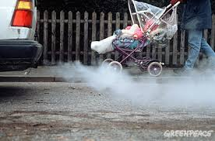
How much is healthy?

Slide 25
There is no threshold below which a pollutant has no effect on health.
– WHO
“Numerical guideline values, therefore, are not to be regarded as separating the acceptable from the unacceptable…”
- WHO

Slide 26
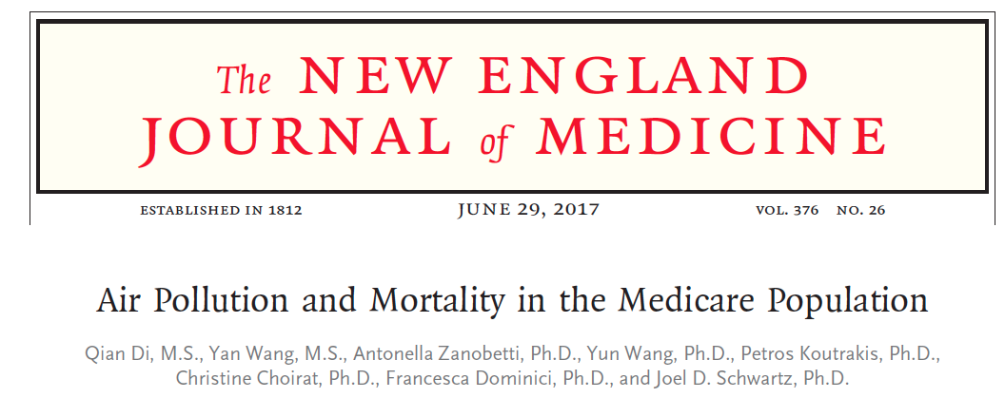
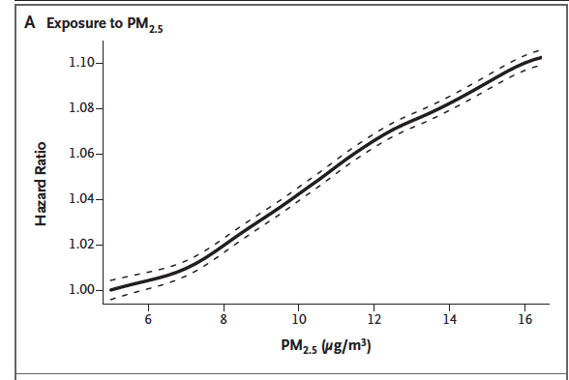
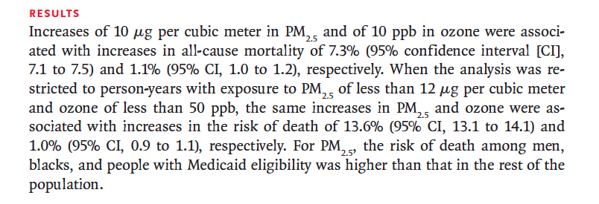
All Medicare beneficiaries (60,925,443 persons)min the continental United States from the years 2000 through 2012,

Slide 27
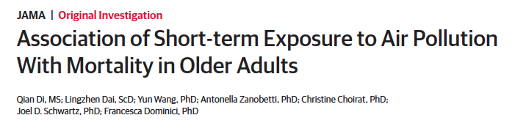
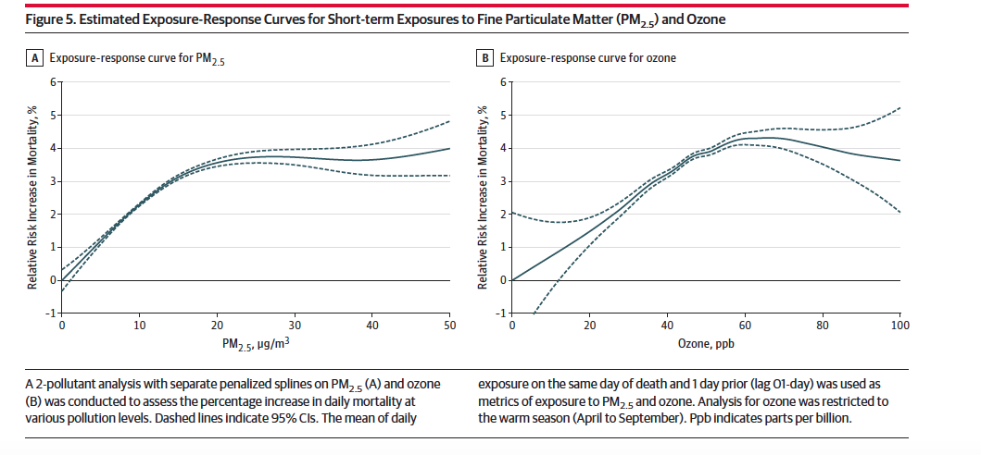
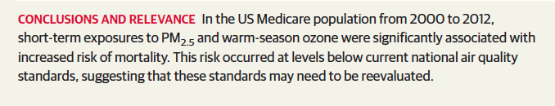
Each short-term increase of 10 μg/m3 in PM2.5 (adjusted by ozone) and 10 parts per billion (10−9) in warm-season ozone (adjusted by PM2.5) were statistically significantly associated with a relative increase of 1.05%(95%CI, 0.95%-1.15%) and 0.51%(95%CI, 0.41%-0.61%) in daily mortality rate.

Slide 28
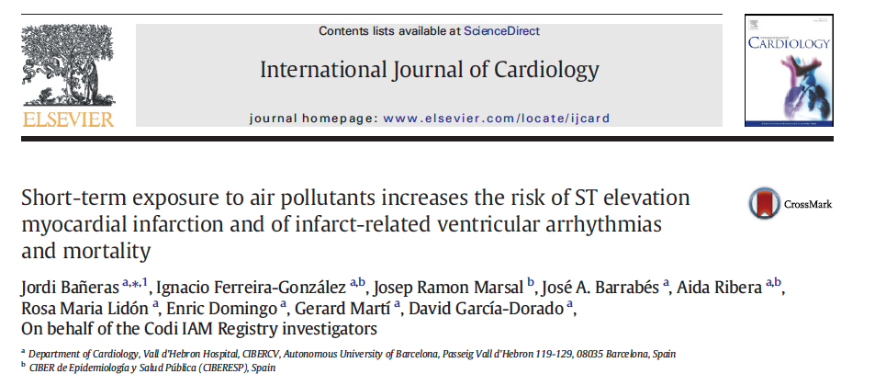
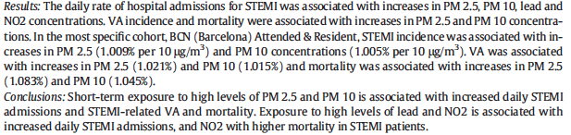

Slide 29
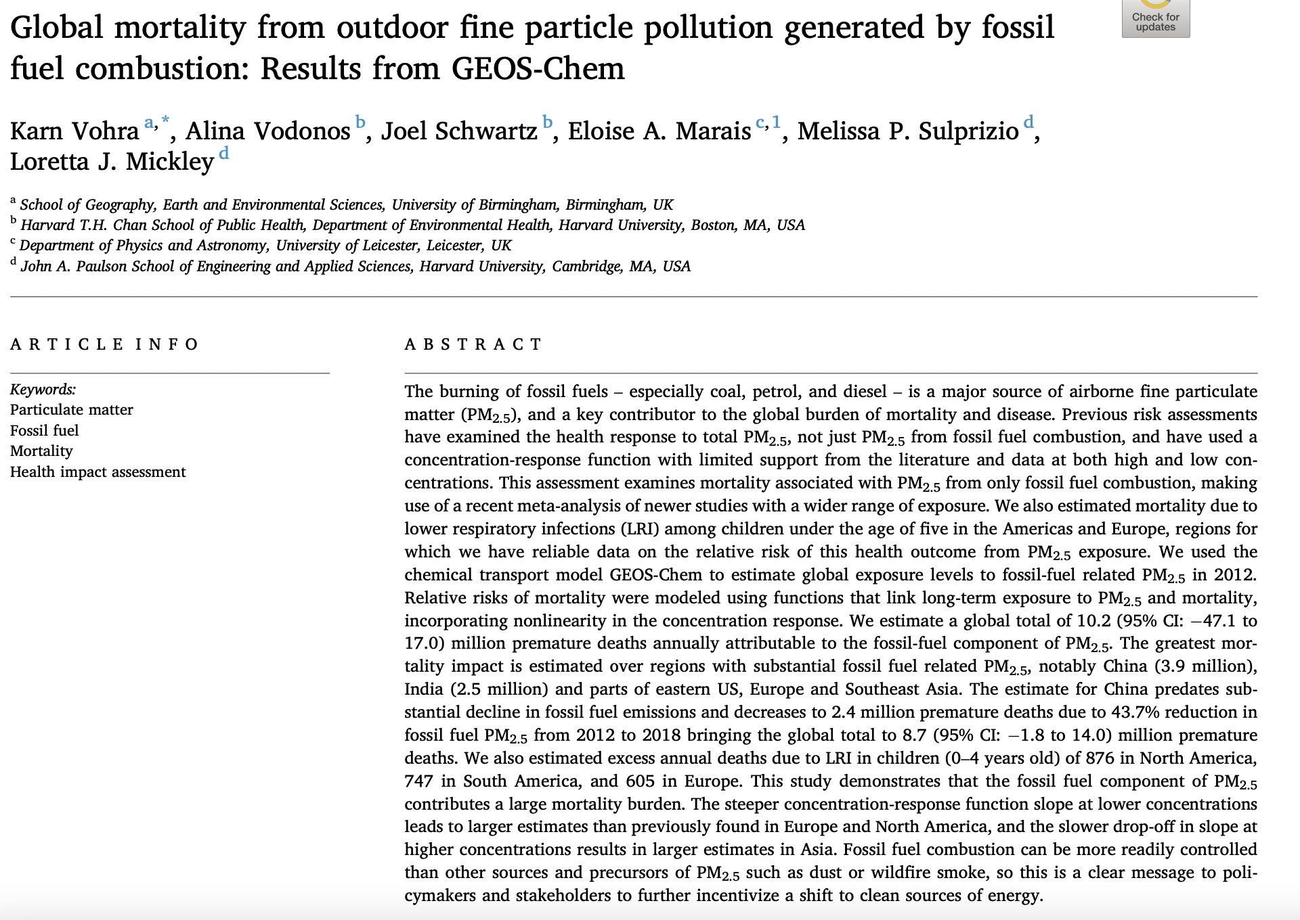

Slide 30



Slide 31
Supplement 3:
Air Quality Guidelines

Slide 32

The World Health Organization has concluded that Air Pollution is a cause of more than
7 million early deaths each year.

Slide 33
What are the US air quality standards?

Slide 34
National Ambient Air Quality Standards (NAAQS)
Clean Air Act (1963, 1970 and amendments 1971-2016)
EU
WHO
Pollutant Type Standard Averaging Time Form
Sulfur dioxide Primary .075 ppm (195 μg/m³) 1-hour 99th Percentile of 1-hour daily maximum concentrations,
(SO₂) averaged over 3 years.
Secondary 0.5 ppm (1,300 μg/m³) 3-hour Not to be exceeded more than once per year
Particulate matter Primary
(PM₁₀) and Secondary 150 μg/m³ 24-hour Not to be exceeded more than once per year on average
over 3 years
Particulate matter Primary 12 μg/m³ annual Annual mean, averaged over 3 years
(PM_{2.5}) Secondary 15 μg/m³ annual Annual mean, averaged over 3 years
Primary and
Secondary 35 μg/m³ 24-hour 98th percentile, averaged over 3 years
Carbon monoxide Primary 35 ppm (40 mg/m³) 1-hour Not to be exceeded more than once per year
(CO) Primary 9 ppm (10 mg/m³) 8-hour Not to be exceeded more than once per year
Ozone Primary and
(O₃) Secondary 0.12 ppm (235 μg/m³) 1-hour expected number of days per calendar year, with maximum hourly average concentration greater than 0.12 ppm, is equal to or less than 1
Primary and
Secondary 0.070 ppm (140 μg/m³) 8-hour Annual fourth-highest daily maximum 8-hour concentration,
averaged over 3 years
Nitrogen dioxide Primary and
(NO₂) Secondary 0.053 ppm (100 μg/m³) annual Annual mean
Lead Primary and
(Pb) Secondary 0.15 μg/m³ Rolling 3 mo Not to be exceeded
SO₂ 500 μg/m³ - 10 min
20 μg/m³ - 24h
PM₁₀ 50 μg/m³ - 24h
20 μg/m³ - annual
PM_{2.5} 25 μg/m³ - 24h
10 μg/m³ - annual
CO 100 mg/m³ - 15 min
35 mg/m³ - 1 h
10 mg/m³ - 8 h
7 mg/m³ - 24
O₃ 100 μg/m³ - 8h
NO₂ 200 μg/m³ - 1h
40 μg/m³ - annual
SO₂ 350 μg/m³ -1 h
125 μg/m³ - 24 h
PM₁₀ 50 μg/m³ - 24 h
40 μg/m³ - annual
PM_{2.5} 25 μg/m³ - annual
CO 10 mg/m³ - 8 h
O₃ 120 μg/m³ - 8 h
NO₂ 200 μg/m³ - 1h
40 μg/m³ - annual
Lead 0.5 μg/m³ - annual
Notes:
In his half-hour presentation, Tony Cox, a risk analyst from Denver, claimed that researchers are overstating their findings that show the dangers of air pollution. He explained how his own statistical modeling of health data indicates that other factors could explain the links between dirty air and respiratory problems or heart attacks.
Scientists and others at the Health Effects Institute annual conference were appalled. Some added to their speeches what they had thought was obvious: Yes, air pollution really is dangerous.
Cox might have been just shrugged off as a provocateur, a denier of established science. But he leads the Trump administration’s panel of scientists that offers advice on how to protect the health of about 126 million Americans who live in smoggy and sooty places.
In that role, he’s in a prime position to spread his skepticism of the science of air pollution: The Environmental Protection Agency is poised this year to review its health standards for fine particles known as PM2.5 and ozone, the main component of smog.
These decisions, scientists say, literally could mean life and death for people in cities across the United States.
The EPA’s seven-member Clean Air Scientific Advisory Committee, which has been completely remade under President Donald Trump, is responsible for reviewing the science and advising the EPA on what level of pollution is unhealthy. Cox was appointed a year ago, and earlier this month, all remaining holdovers from the Obama administration were replaced with new appointees, including two who also downplay the threats of breathing polluted air.
Powerful industries – such as power companies, vehicle manufacturers and oil companies – oppose tighter health standards because they would force states to adopt costly rules that cut emissions.
According to documents obtained through the Freedom of Information Act, Cox was nominated for the science board’s top position by the U.S. Chamber of Commerce, which has sued the EPA multiple times in an effort to loosen air pollution standards. The nomination came from Dan Byers of the chamber’s Global Energy Institute, who leads “efforts to promote and maintain coal’s vital role in America’s energy system.”
Cox has made his living challenging established science on behalf of industry. He has worked as a consultant for more than a dozen companies or industry groups that lobby against clean air or worker safety rules and are major sources of pollution, according to his website. He consulted for the American Petroleum Institute, which represents oil and gas companies, and the Truck and Engine Manufacturers Association, which represents makers of diesel and gasoline engines. He also consulted for the mining industry and tobacco giant Philip Morris.

Slide 35
But what is considered “good” air
in Albuquerque NM USA?

Slide 36

The Air Quality Index?

